Slide 1
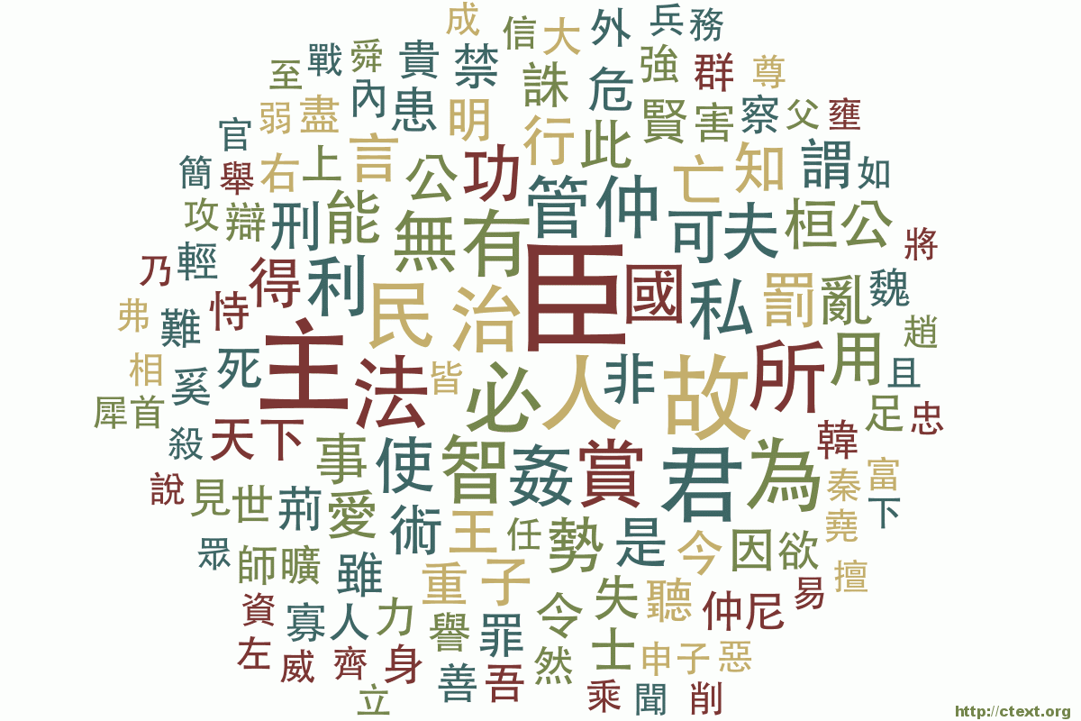
Towards a Scalable Digital Library of Pre-Modern Chinese
http://ctext.org
Donald Sturgeon
Postdoctoral Fellow
Fairbank Center for Chinese Studies

Slide 2
Overview
Background and introduction
Scalability, automation, distribution of labor
Examples
Automatic compilation of data
Optical Character Recognition (OCR)
Application Programming Interfaces (APIs)

Slide 3
Chinese Text Project (CTP)
Digital library with digital research tools
Aimed at Chinese and non-Chinese scholars
Motivated by interpretative issues
Primary sources
Commentary
Translations
Parallel passages
Created with limited resources

Slide 4
Origins (2005)
Research tool for searching pre-Qin texts
Small corpus with difficult textual issues
First text: Mohist Canons 《墨經》
“Encyclopedia-like” writing style
Not an essay or treatise; order of sections unimportant
Clear “database-like” structure in the text itself
One passage = one record
Methods working for one text work for others
Clear similarities to e.g. the Analects

Slide 5
Texts and data (2015)
Majority of pre-Qin and Han transmitted texts
~6 million characters
Library of scanned transmitted texts
~13 million pages
User-editable Wiki
~3 billion characters
Registered volunteer contributors
~6000 users

Slide 6
Chinese Text Project Users
How many?
~250,000/month
~2.5 million pages
Who are they?
Students
Researchers
Translators
General public

Slide 7
Site Structure – User Perspective
Textual database
Advanced functionality
Centrally edited
Majority of pre-Qin and Han texts
Small selection of post-Han texts
Pre-Qin and Han
Post-Han
Wiki section
Library (scanned texts)
Collaboratively edited
Versioned
Mostly post-Han texts
Huge number of texts
Dictionary
Discussion

Slide 8
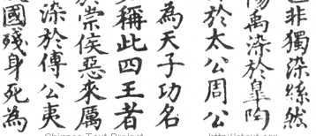
Paragraph-centric design

Slide 9
Scalability
Technical / engineering
Methods practical for <100 users, texts, etc.
Will they still work for >100,000 users, texts, etc.?
Organizational / real-world
Time and funding sufficient for small scale work
Will it be sufficient for exponentially more work?

Slide 10
Scalability: A pragmatic approach
To the greatest extent possible:
Automate what can be done automatically
Automation can often give approximate results
E.g. OCR-enabled search, machine translation
Sometimes only automation can provide results
E.g. Statistical data on large corpora
Crowd-source what cannot be automated
Sometimes only human beings will do
E.g. Interpretation, scholarship, semantics

Slide 11
Working with limited resources
Automation
Computer time is cheaper than human time
Computer time is more scalable
High setup costs, low ongoing costs
Difficult to create a definitive reference
No resources to proofread all texts
Give users tools to verify accuracy themselves
Check primary sources directly
Ask users to help edit texts

Slide 12
Automatic compilation
Writing dictionaries is hard (and not scalable)
Tens of thousands of Chinese characters
Majority of characters are extremely rare
Assembling primary evidence is easy
In a large corpus, most characters appear somewhere
The more obscure the character, the more important each occurrence is
The more common the character, the more data

Slide 13
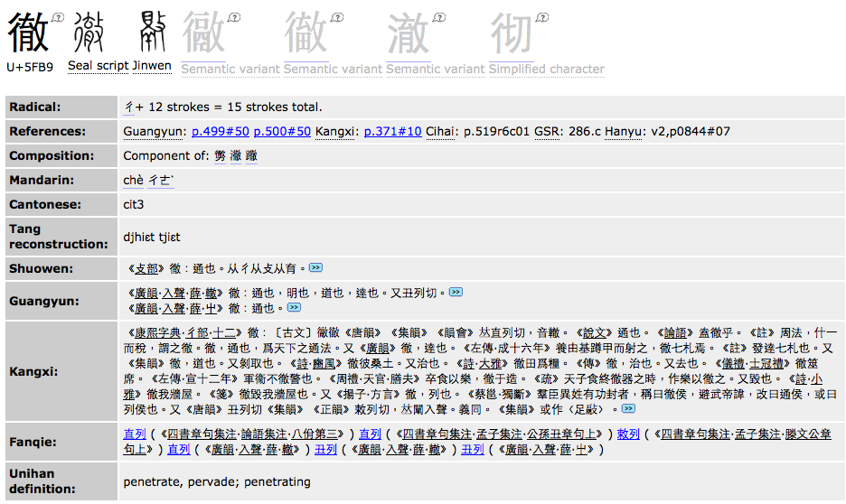
Automatic compilation
Kangxi Dictionary
Guangyun, commentaries

Slide 14
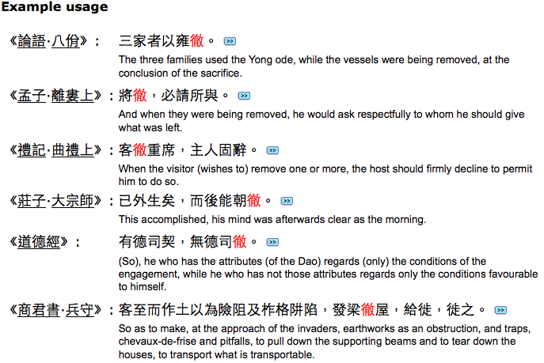
Automatic compilation

Slide 15
Statistics and Automation
Parallel corpora (e.g. Chinese-English)
Statistical co-occurrences
E.g. “徹” in Chinese co-occurs with “remove” in English
Compute automatically translations of terms
Record and interpolate translations of phrases
Foundation of statistical machine translation
Applications in computer assisted translation

Slide 16
Optical Character Recognition
Optical Character Recognition (OCR)
Can be applied directly to transmitted texts
Not perfect – introduces errors
Can still produce useful data
E.g. Google Book Search: allows searching of transmitted Chinese texts even if OCR is poor
Allows fast searching of primary sources
We can match an existing textual edition to a scan
Allows fast verification of digital editions
Allows us to improve OCR recognition

Slide 17
OCR – Procedure
Use OCR engine trained on modern Chinese
Apply to texts with existing transcriptions
Match OCR output to text character by character
Identify concrete instances of characters
Retrain the OCR engine on real data
Use the retrained OCR engine
Create more accurate alignments
Transcribe texts that have no transcription

Slide 18
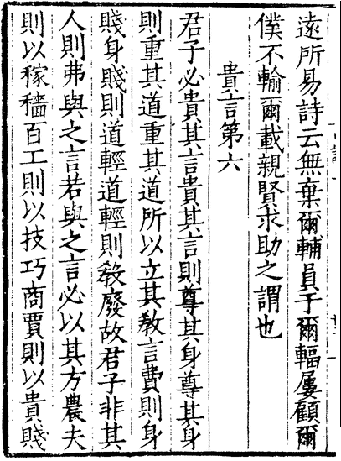
OCR – Matching
Existing accurate, punctuated text
遠所易詩云無棄爾輔員子爾輻屢顧爾
僕不輸爾載親賢求助之謂也
貴言第六
君予必遺其言遺其言則尊其身尊其身
則重甚道重甚道所以立其教言費則身
賤身賤則道輕道輕則教廢故君于非其
入則弗與之言若與之言心以其方農天
一則以家穡百工則以支巧商賈則以貴賤
… 必近所畏而遠所易。《詩》云：「無棄爾輔，員于爾輻。屢顧爾僕，不輸爾載。」親賢求助之謂也。
《貴言》
君子必貴其言。貴其言則尊其身，尊其身則重其道，重其道所以立其教。言費則身賤，身賤則道輕，道輕則教廢。故君子非其人則弗與之言，若與之言，必以其方。農夫則以稼穡，百工則以技巧，商賈則以貴賤，府史則…
Raw OCR: errors, no punctuation
Merged: accurate, linked, punctuated
Scanned image

Slide 19
OCR – Training data extraction
… 必近所畏而遠所易。《詩》云：「無棄爾輔，員于爾輻。屢顧爾僕，不輸爾載。」親賢求助之謂也。
《貴言》
君子必貴其言。貴其言則尊其身，尊其身則重其道，重其道所以立其教。言費則身賤，身賤則道輕，道輕則教廢。故君子非其人則弗與之言，若與之言，必以其方。農夫則以稼穡，百工則以技巧，商賈則以貴賤，府史則…
遠
所
易
詩
…
Merged: accurate, linked, punctuated
Scanned image

Slide 20
OCR – Training with real data
Identify concrete instances of each character
Train OCR engine to recognize these forms natively

Slide 21
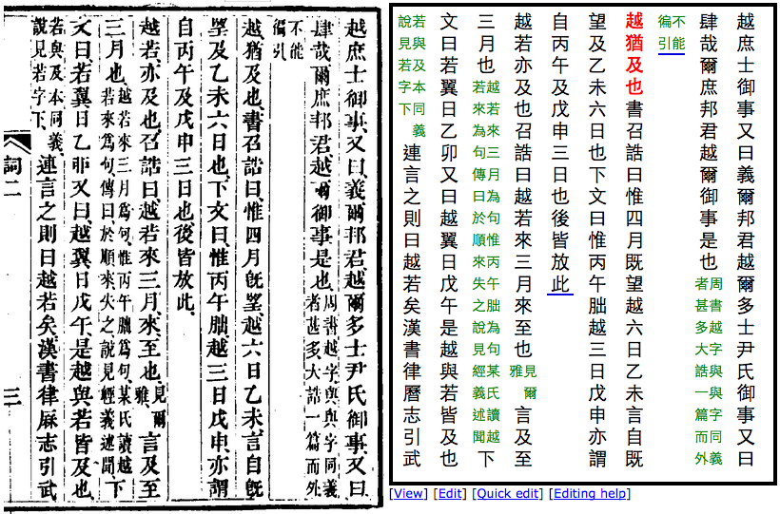
OCR – End result

Slide 22
Crowd-sourcing
OCR results are imperfect
Still useful – enable full-text search
Users can be active contributors
Frequent users want to correct mistakes
Corrections are easily validated
Records are kept of who edited what
Previous versions can be easily restored

Slide 23
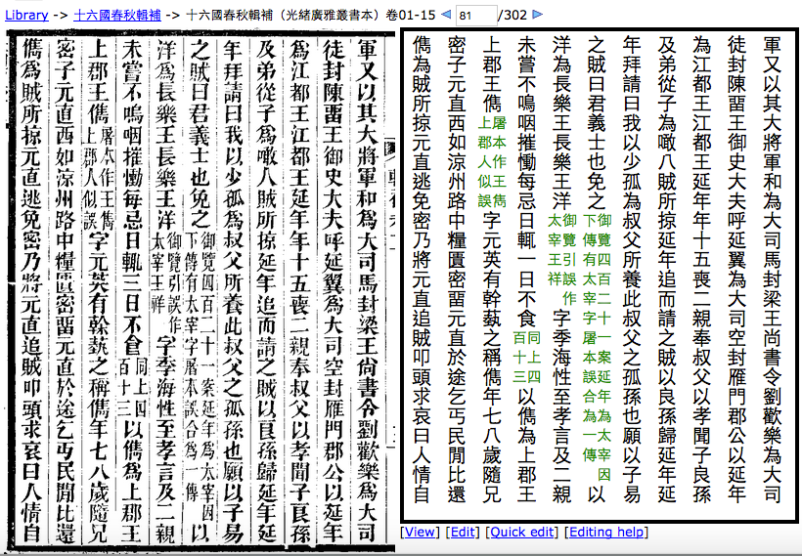
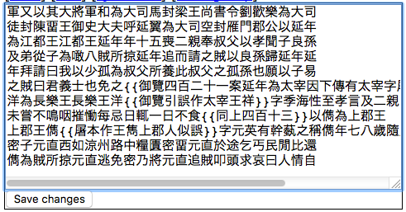
Making corrections

Slide 24
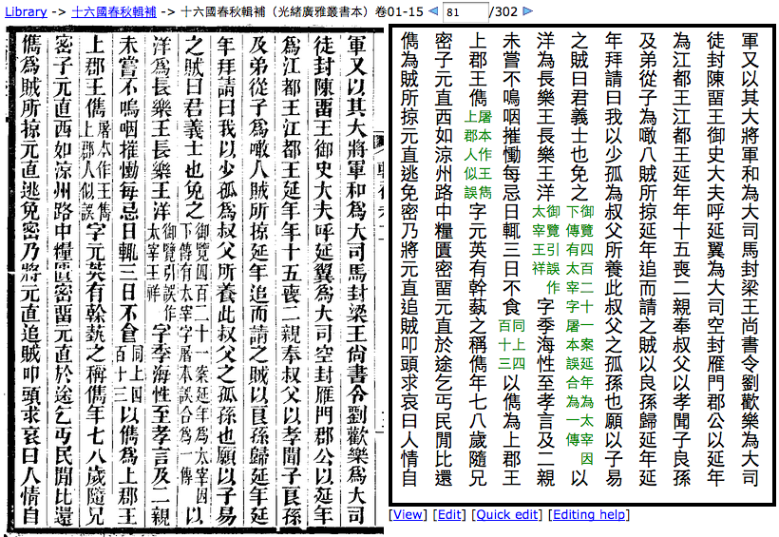
Making corrections

Slide 25
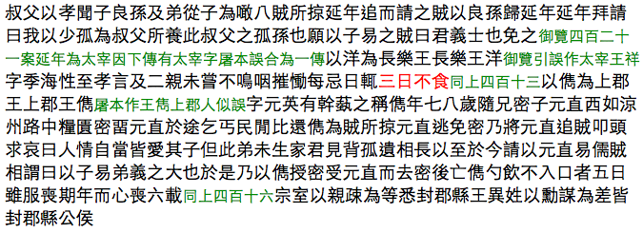
Making corrections
Changes propagate to all visualizations
Search index automatically updated

Slide 26
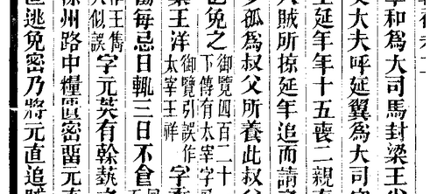
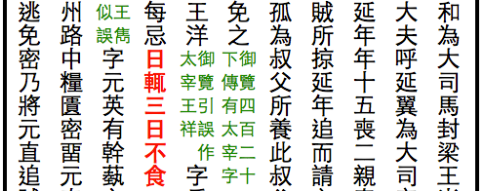
Edit log

Slide 27
Application Programming Interfaces
Formalize automated exchange of data
Standardize procedures for communication
Perform complex functions on externally supplied data
Allow distribution of labor
E.g. Google Maps API
Allow tools to work intuitively together

Slide 28
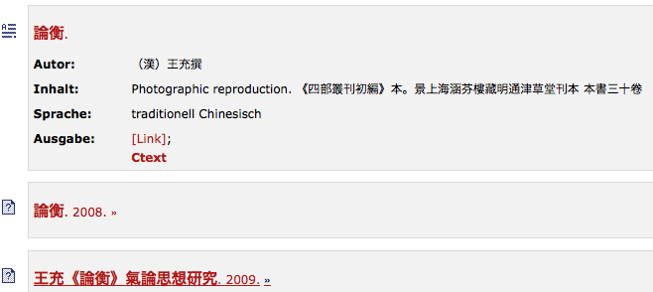
Third-party APIs on the CTP
OpenSearch API
Defines machine-readable search interface
Adds ctext.org search function to web browsers
Allows federated search (e.g. CrossAsia)
論衡 on CTP
論衡 in another library

Slide 29
Third-party APIs on the CTP
Pingback (trackback) API
Notifies a website when another site links to it
Standardized, distributed, automated
Links to the CTP often uniquely identify passages of text
Blogs and discussion can be linked back from cited passages

Slide 30
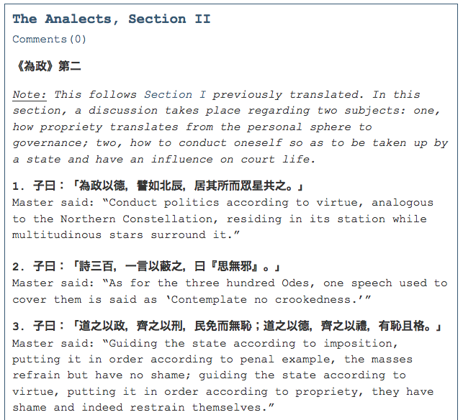
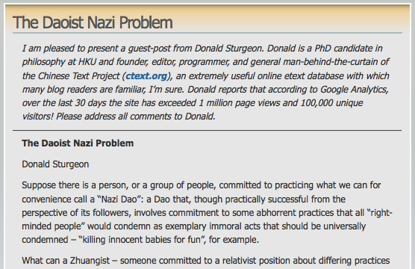
Pingbacks as Textual References

Slide 31
Chinese Text Project API – Goals
Allow other projects access to CTP data
Avoid having to maintain duplicates of all data
Obtain the current version in real time
Provide flexible, standard referencing methods
Allow two-way linking with the CTP
Allow corrections and improvements to be pooled
Allow easy access to scanned editions, parallel passages, linked commentaries etc.

Slide 32
CTP API – Two-way communication
Access other resources from within the CTP
Plugin model
User-definable specification of how to pass data
Send a chapter of text to an external tool
Exchange a reference to a specific line/passage of text
Look up a character or word in another dictionary
Access CTP data/tools from within other tools
Machine-readable data exchange
Request CTP textual data, metadata, statistics, …

Slide 33
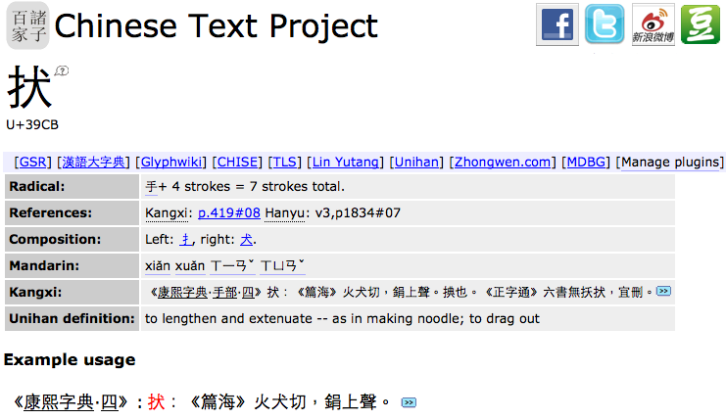
CTP API – Dictionary plugins
Open the same entry in
another dictionary/tool

Slide 34
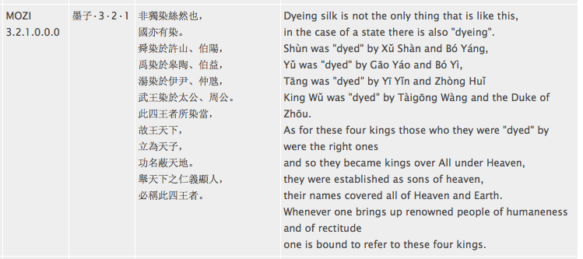
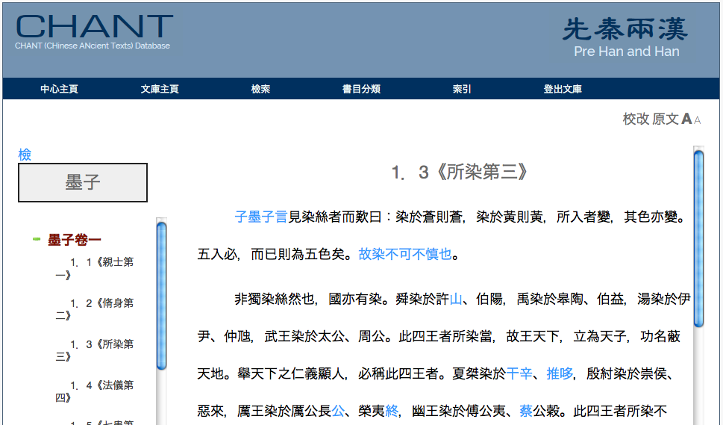
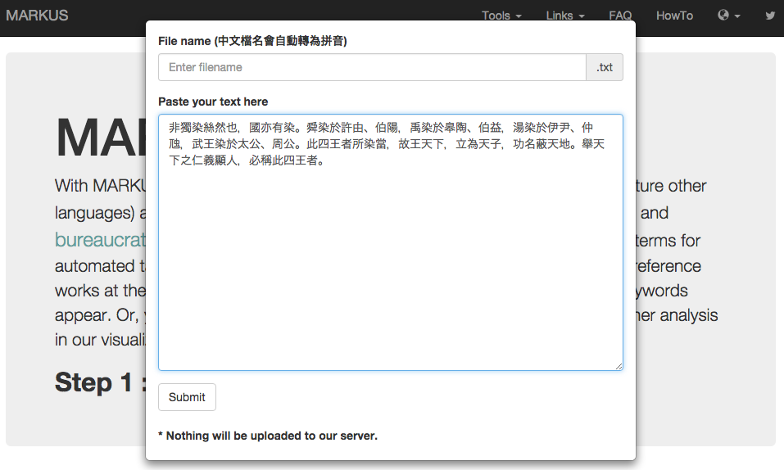
CTP API – Textual plugins

Slide 35
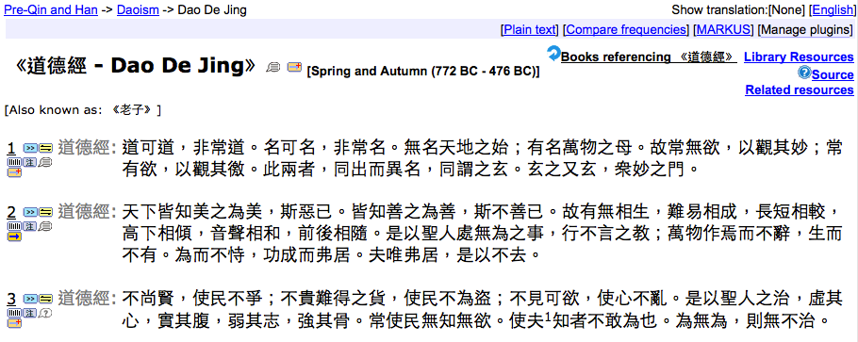
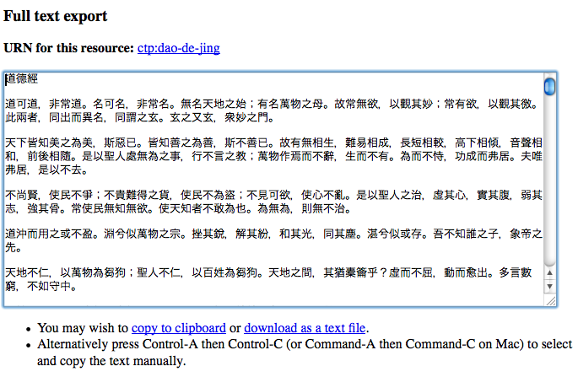
CTP API – Textual plugins

Slide 36
CTP API – Other functionality
Textual markup and metadata
Metadata relating to texts and editions
Disambiguation of proper names, tokenization
Provide statistical data for texts or periods
Difficult to compute, but easy to distribute

Slide 37
More Information
http://ctext.org/introduction
http://ctext.org/instructions/ocr
http://ctext.org/faq

