Slide 1
Digital Archiving in Real Time: Growing the JDA
Ryo Morimoto
Project Manager
Japan Digital Archive of the 2011 Disasters
Harvard University

Slide 2
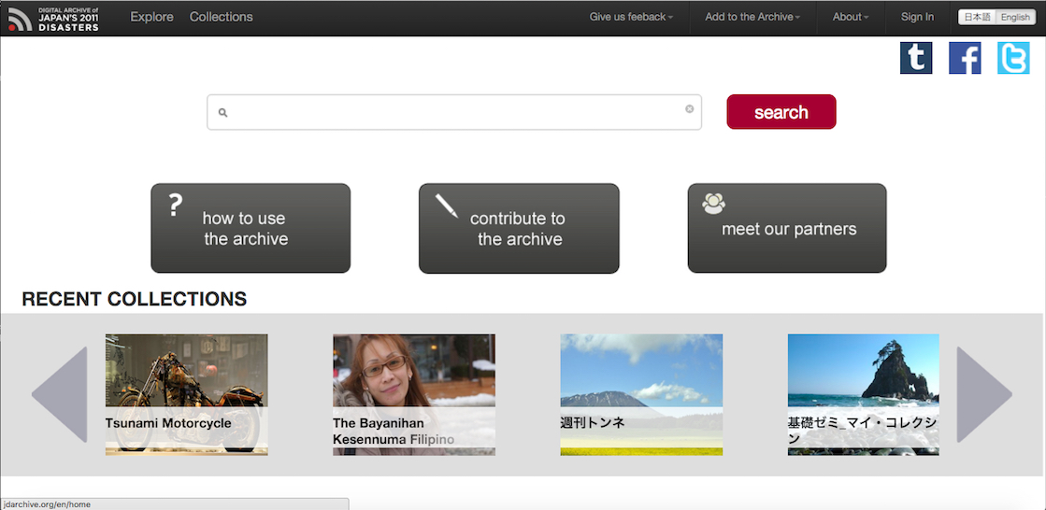
jdarchive.org
Notes:
The landing page of the JDA.

Slide 3
About JDA
Brief History
Introducing Project Idea
Archive itself
Organizational (infra)Structure
Archiving Real-time

Slide 4
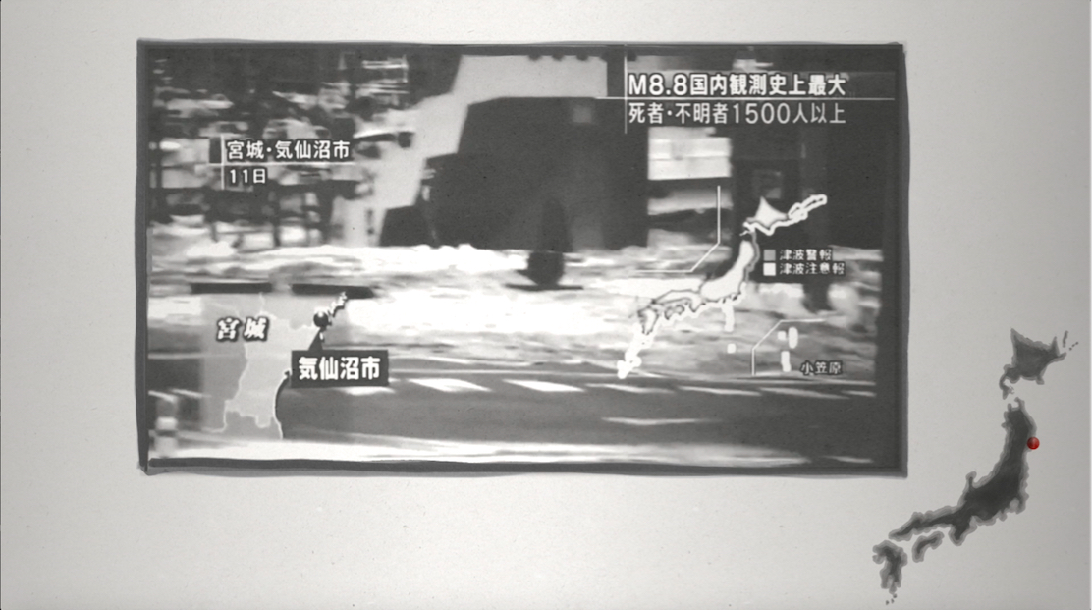
March 11th, 2011, The Great East Earthquake, Tsunami and…

Slide 5
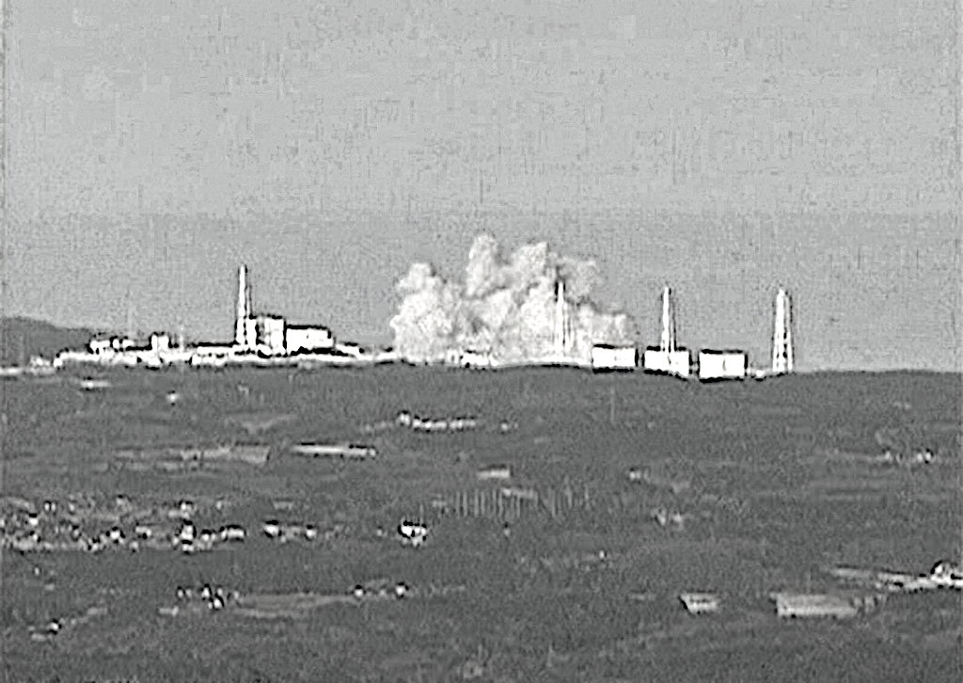
Nuclear Accident at Fukushima Daiichi Nuclear Power Station
Notes:
One of the most significant events happened in Japan in our life time. Born digital and the Constitutional Revision Research Project

Slide 6
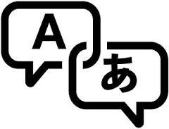
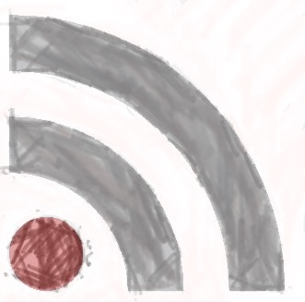
Conceptualizing JDA
Zeega
Center for Geographic Analysis
Reischauer Institute
metaLAB{at}harvard
Notes:
Open Source. Zeega and Ruby on rails. Leaving zeega made the core of the JDA to be black boxed.

Slide 7
Project Ideas, Missions & Keywords
1. As a digital archive,
JDA’s goal is to index, preserve and make widely accessible the digital records of the events of March 2011 and their aftermath.
Preserve and Discover
2. As an infrastructure of education and knowledge,
JDA’s goal is to provide a public space of information sharing, collaboration and conversation for citizens, researchers, students and policy makers.
Link
3. As a tool and mechanism for constructing a public place for remembrance and commemoration of 3.11 in society,
JDA’s goal is to serve as a site of shared memory for those most affected by these events and most concerned about their consequences.
Participate and Create

Slide 8
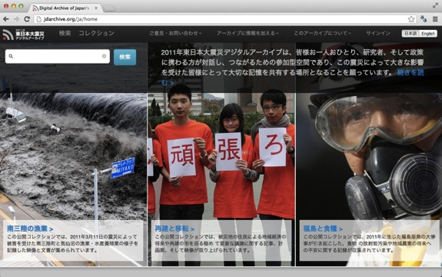
Notes:
The first JDA landing page. Launched just around the first year anniversary of 3.11.
The JDA is one of the first digital archives of 3.11.

Slide 9
The Current Trend of Disaster Archives (taken from Dr. Shibayama [2015])
-Yahoo!Japan
-Google
Ministry of Internal Affairs and Communication (MIC) “The Great East Japan Earthquake and Tsunami Archive” Basic Construction Project
-National Research Institute of Earth Science & Disaster Prevention
-Tohoku University
-Sendai Mediatheque
-3.11All Archives
-National Diet Library (NDL)
-Aomori Digital Archive System
-Iwate (Rikuzentakata Disaster Archive NAVI
-Miyagi（Kahoku Shimpo）
-Fukushima（Fukushima Disaster Archives）
NHK Disaster Archive
Red Cross Nuclear Disaster Resource Center
Tagajyo city
JDA
Immediately After 3.11
1st year
2nd year
3rd year
4th year

Slide 10
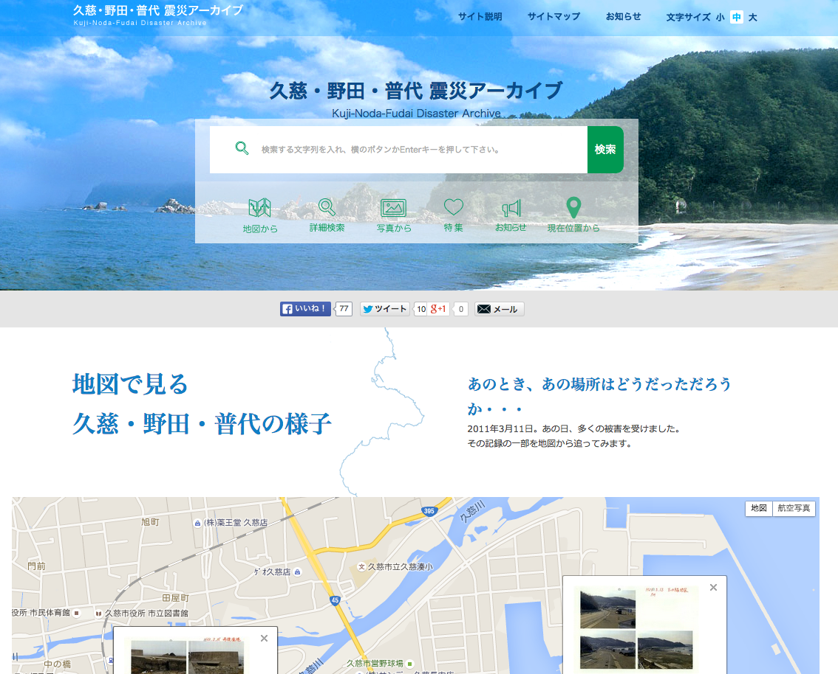
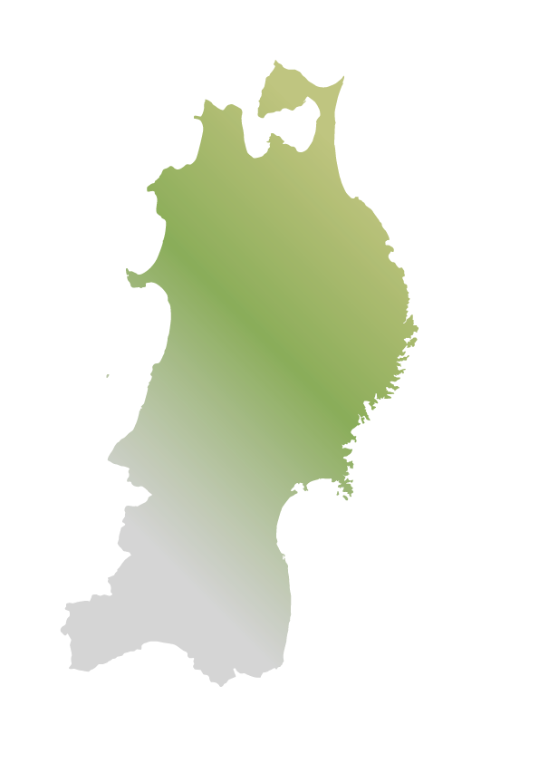
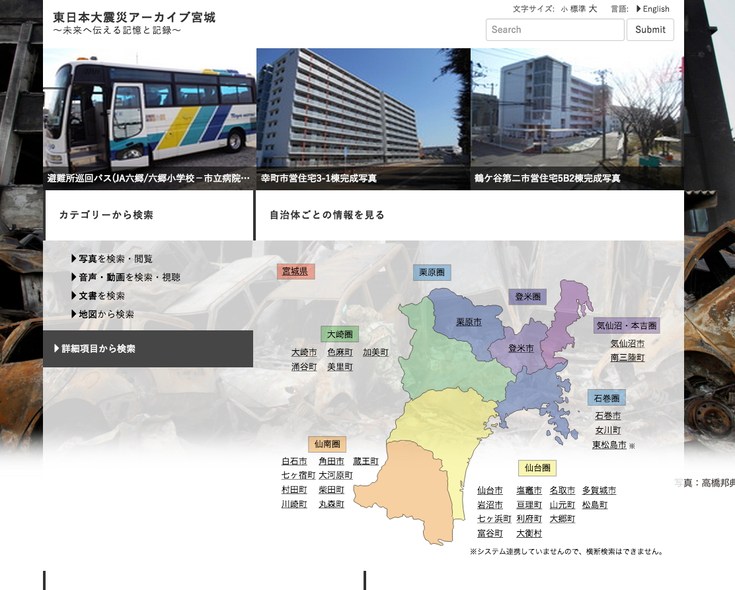
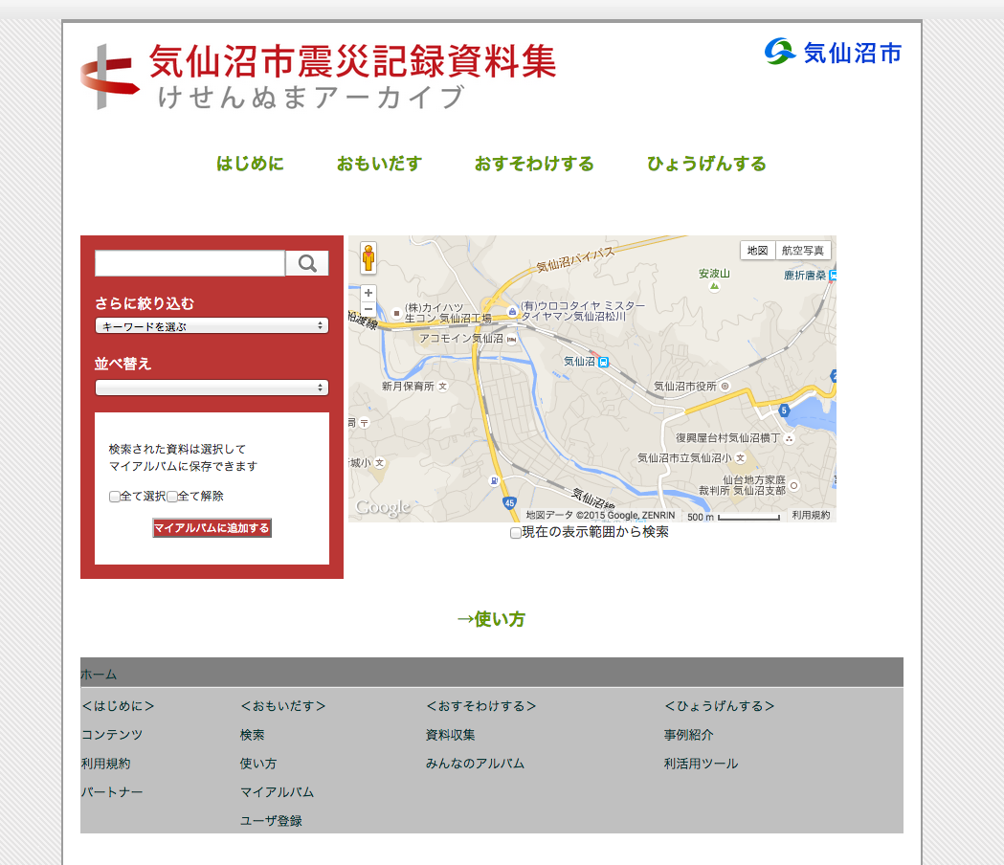
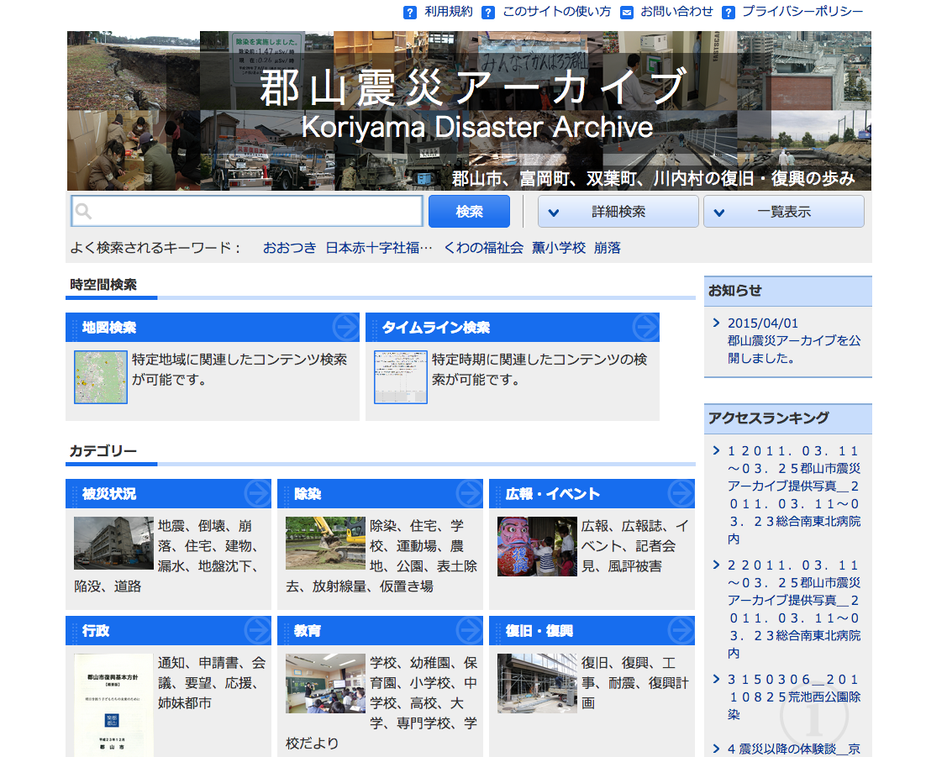
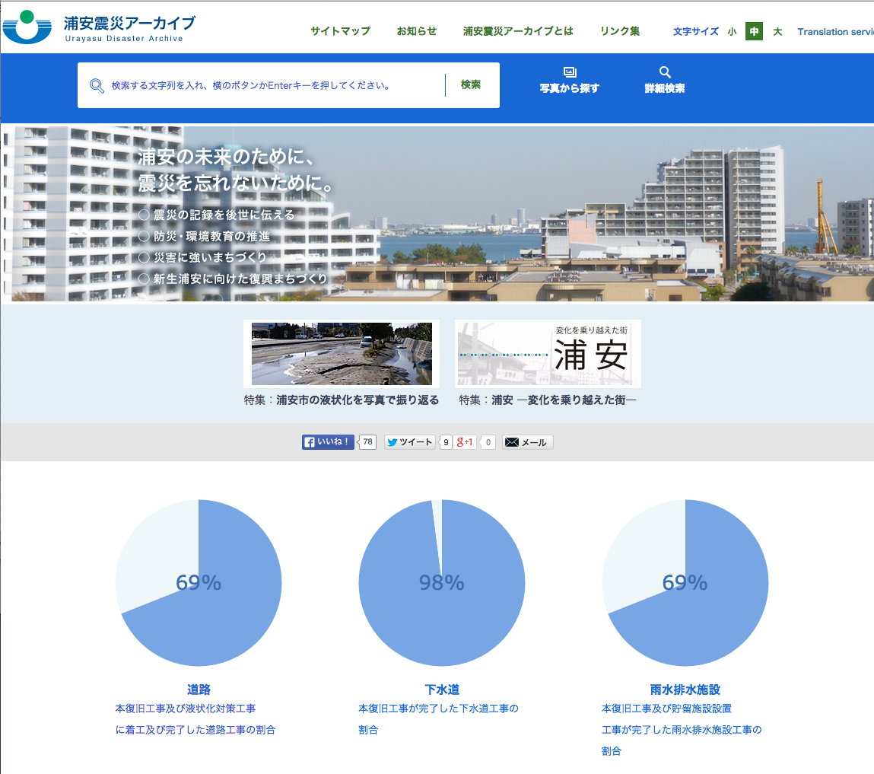
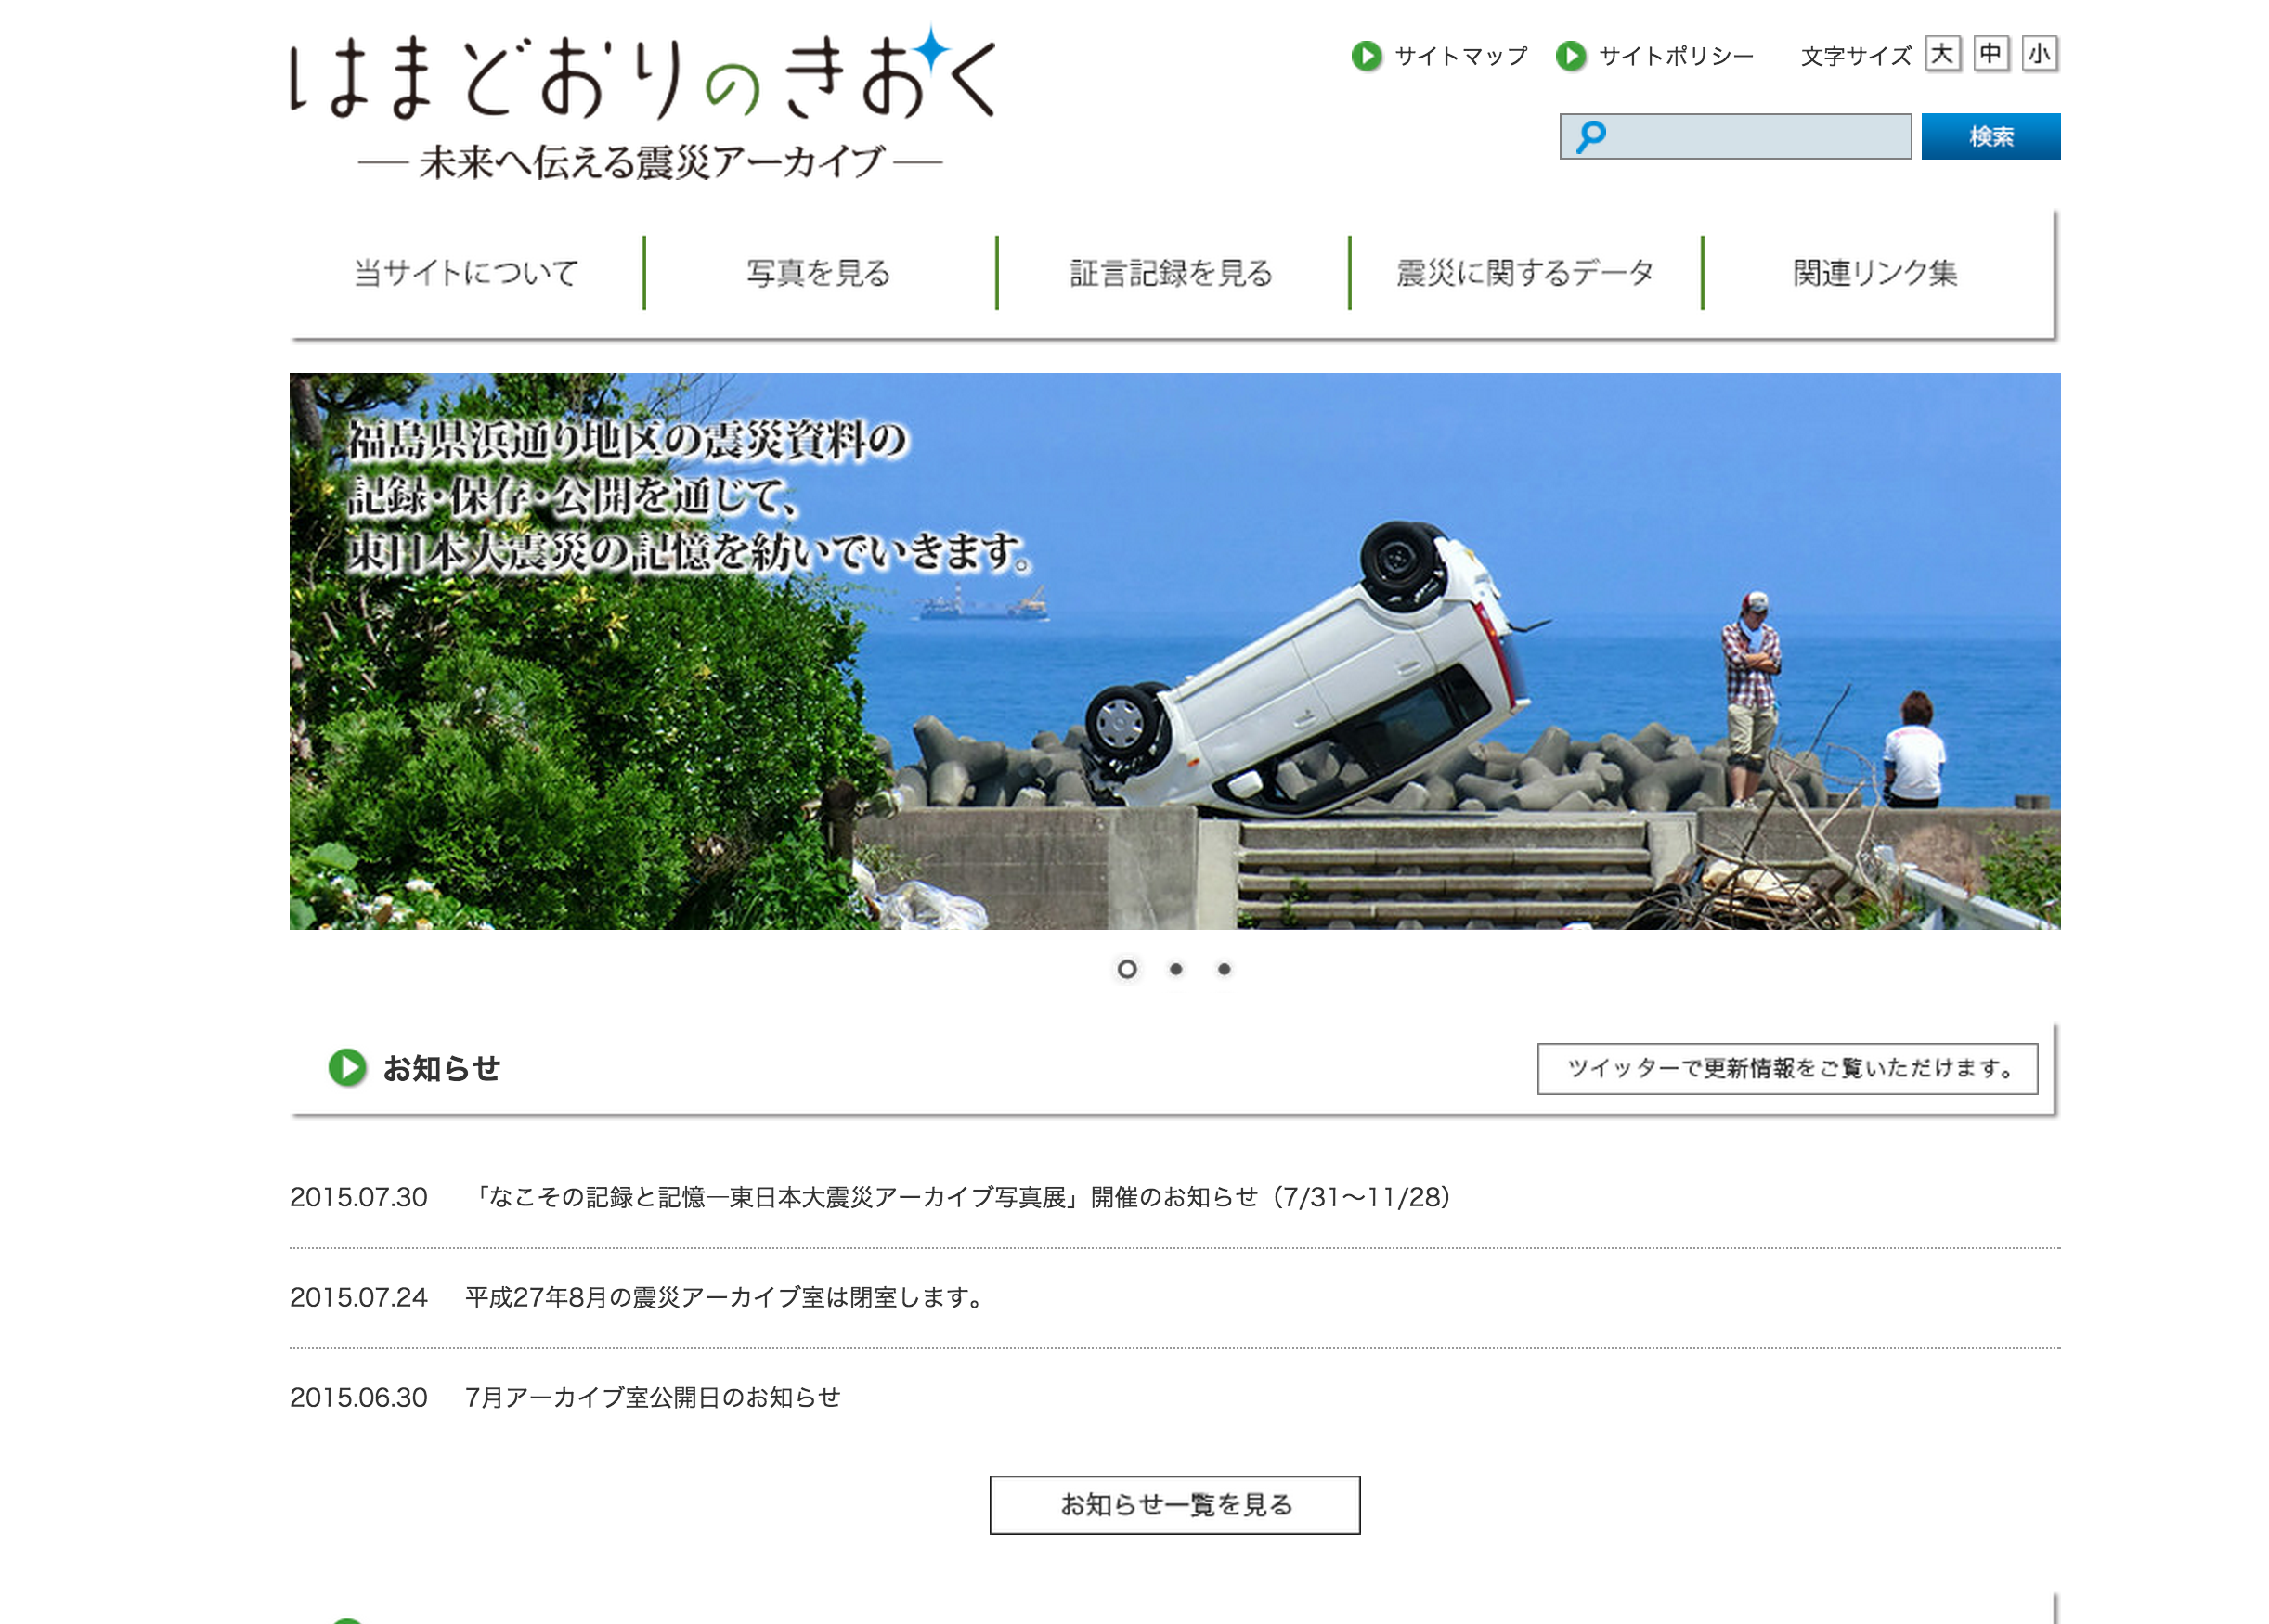
In 2015, Over 55 archives in Japan
青森震災アーカイブ
あおもりデジタルアーカイブシステム
浦安 震災アーカイブ
河北新報 震災アーカイブ
カレントアウェアネス・ポータル※
久慈・野田・普代震災アーカイブ
郡山震災アーカイブ
気仙沼アーカイブ
国土地理院
国立国会図書館インターネット資料収集保存事業（WARP）※
国立国会図書館雑誌記事索引※
国立国会図書館蔵書※
国立国会図書館デジタルコレクション※
災害撮影 [事業活動と社会貢献](株式会社パスコ)
参議院インターネット審議中継
市町村史に記された地震の記録（埼玉県立浦和図書館）
衆議院インターネット審議中継
震災関連資料コーナー（岩手県立図書館）
震災文庫
政府インターネットテレビ
赤十字原子力災害情報センターデジタルアーカイブ
東京電力福島原子力発電所事故調査委員会(国会事故調)
土木学会東日本大震災アーカイブサイト
日本財団
日本原子力研究開発機構図書館蔵書
農林漁業協同組合の復興への取組み記録 東日本大震災アーカイブズ（農林中金総合研究所）
はまどおりのきおく－未来へ伝える震災アーカイブ－
東日本大震災アーカイブ Fukushima
東日本大震災アーカイブ宮城
東日本大震災写真保存プロジェクト
東日本大震災の記録 Remembering 3.11
東日本大震災福島県復興ライブラリー（福島県立図書館）
被災地斜め航空写真
防災科学技術研究所自然災害情報室蔵書目録※
防災専門図書館（全国市有物件災害共済会）蔵書
未来へのキオク
みちのく震録伝
陸前高田震災アーカイブNAVI(サイト閉鎖)
立教大学共生社会研究センター
わかりやすいプロジェクト 国会事故調編
CiNii Articles※
ICT地域の絆保存プロジェクト「東日本大震災を語り継ぐ」（東松島市図書館）
JAIRO※
J-STAGE※
NHK東日本大震災アーカイブス
NHK東日本大震災音声アーカイブス
niconico
NWEC災害復興支援女性アーカイブ
2011年東日本大震災デジタルアーカイブ (JDA)
3がつ11にちをわすれないためにセンター(せんだいメディアテーク)
3.11震災文庫（仙台市民図書館）
311ドキュメンタリーフィルム・アーカイブ(山形国際ドキュメンタリー映画祭)
3.11 忘れない FNN東日本大震災アーカイブ
Kuji, Noda, Fudai
Miyagi Pref Library
Kesennuma city
Koriyama city
Urayasu City
Iwaki Meisei University
Notes:
JDA currently collaborate with the archive projects in blue

Slide 11
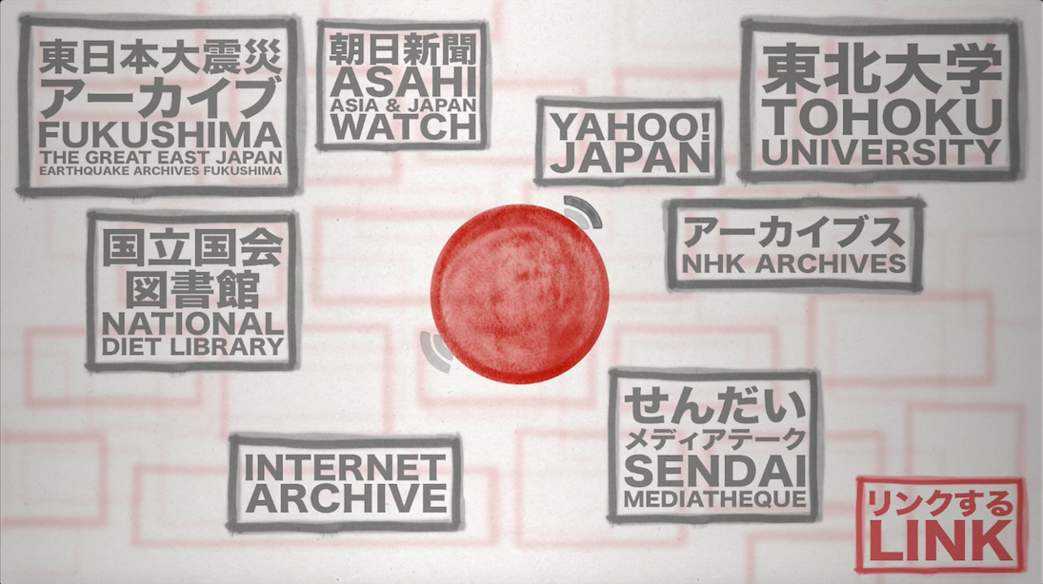
Federation of (digital)Archives
Notes:
What can a physically distant institution do for Japan and Tohoku?
Building a federation of digital archives and also focused on promoting various usages of massive dataset being collected on ground in Japan.

Slide 12
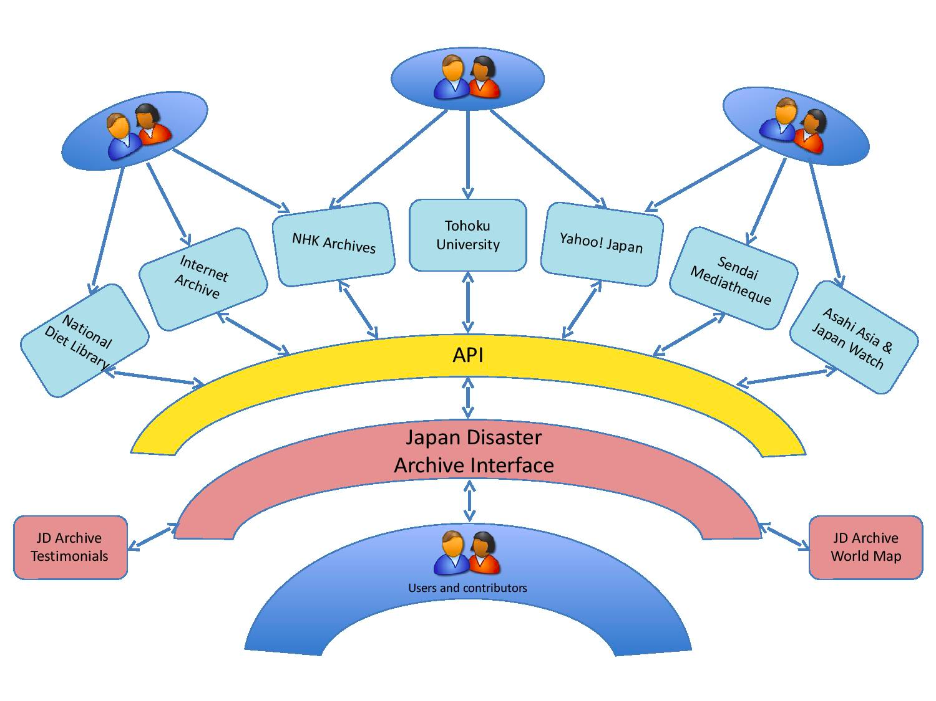
*API: Application Program Interface
Notes:
The architecture of the JDA. JDA not hosting most of its data but let the user view items from other archives connected via API.
The JDA is an archive of metadata more so than a conventional archive that stores materials.

Slide 13
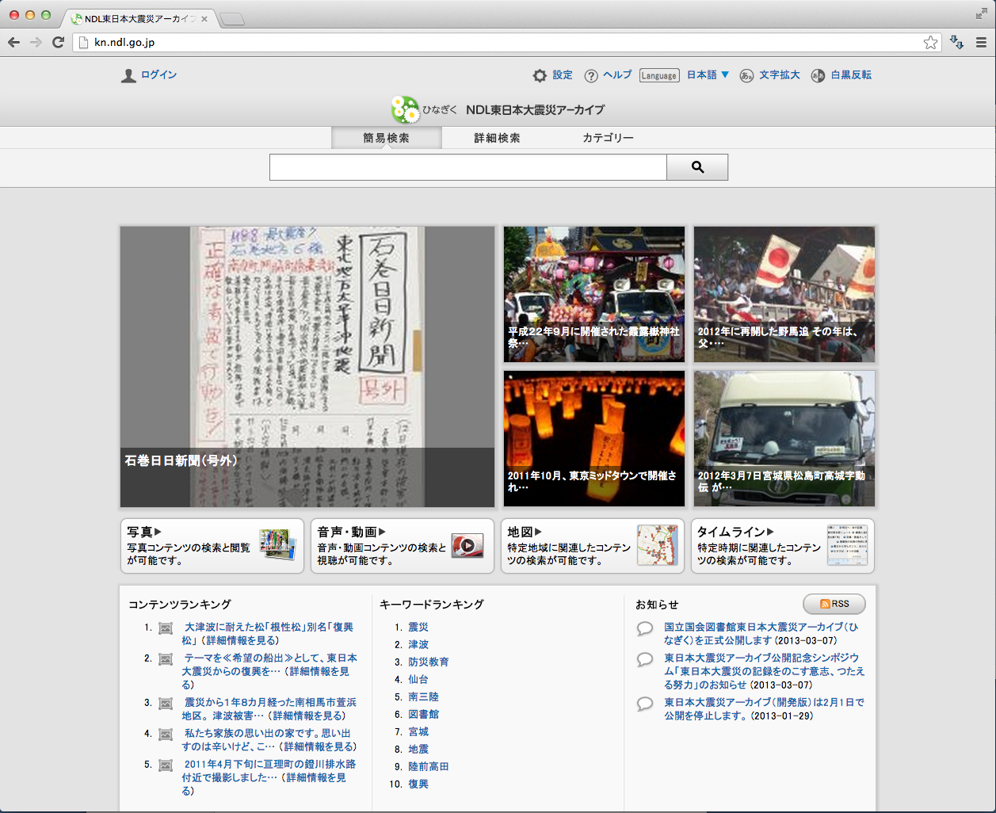
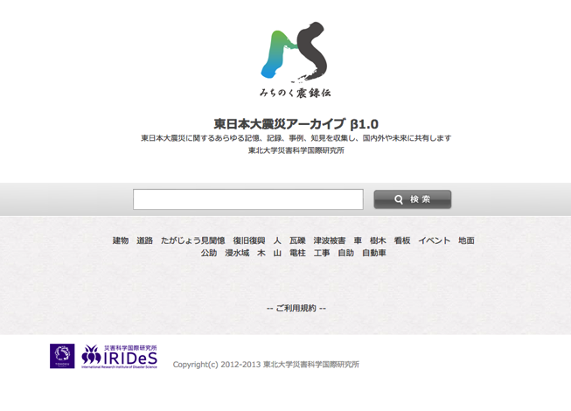
OAI-PMH： Open Archives Initiative Protocol for Metadata Harvesting
NDL
Hinagiku
Metadata Sharing
Harvard University
JDArchive
Tohoku University
Michinoku Shinrokuden
Notes:
API connection described. In order to enable a smooth inter-institutional collaboration, we need to establish a standard metadata structure.

Slide 14
The Language Archives Speak to Each Other
Example JSON file
{
"items": [
{
"username": ”Rio”, "display_name": "",
"title": "Chinese takeout and a werewolf movie on #halloween #planettakeout",
"description": ”Crazy”, "text": ”Boo",
"uri": "http://distilleryimage10.s3.amazonaws.com/5d4ec83be11e2a5c2a1f8acf_7.jpg",
"attribution_uri": "http://instagr.am/p/Rd6wALylKO/",
"date_created": "2012-11-06 22:14:39",
"media_type": "Image”, "layer_type": "Image”, "archive": "Instagram",
"thumbnail_url": "http://distilleryimage10.s3.amazonaws.com/
5d4ec83be11e28a5c2a1f8acf_5.jpg",
"media_geo_latitude": null, "media_geo_longitude": null,
"media_date_created": "2012-11-01 00:51:56”, "media_date_created_end": null,
"media_creator_username": ”Rio",
"media_creator_realname": ”Ryo",
"child_items_count": 0,
"attributes": [], "child_items": [],
"tags": [ "halloween”, "planettakeout"
],
}
]
}
Notes:
JSON formatted text files are maintained in MySQL and searched with the help of Solr.
Any archive that uses a different set of format, we need to run a python script to reformat to fit with our own metadata structure.

Slide 15
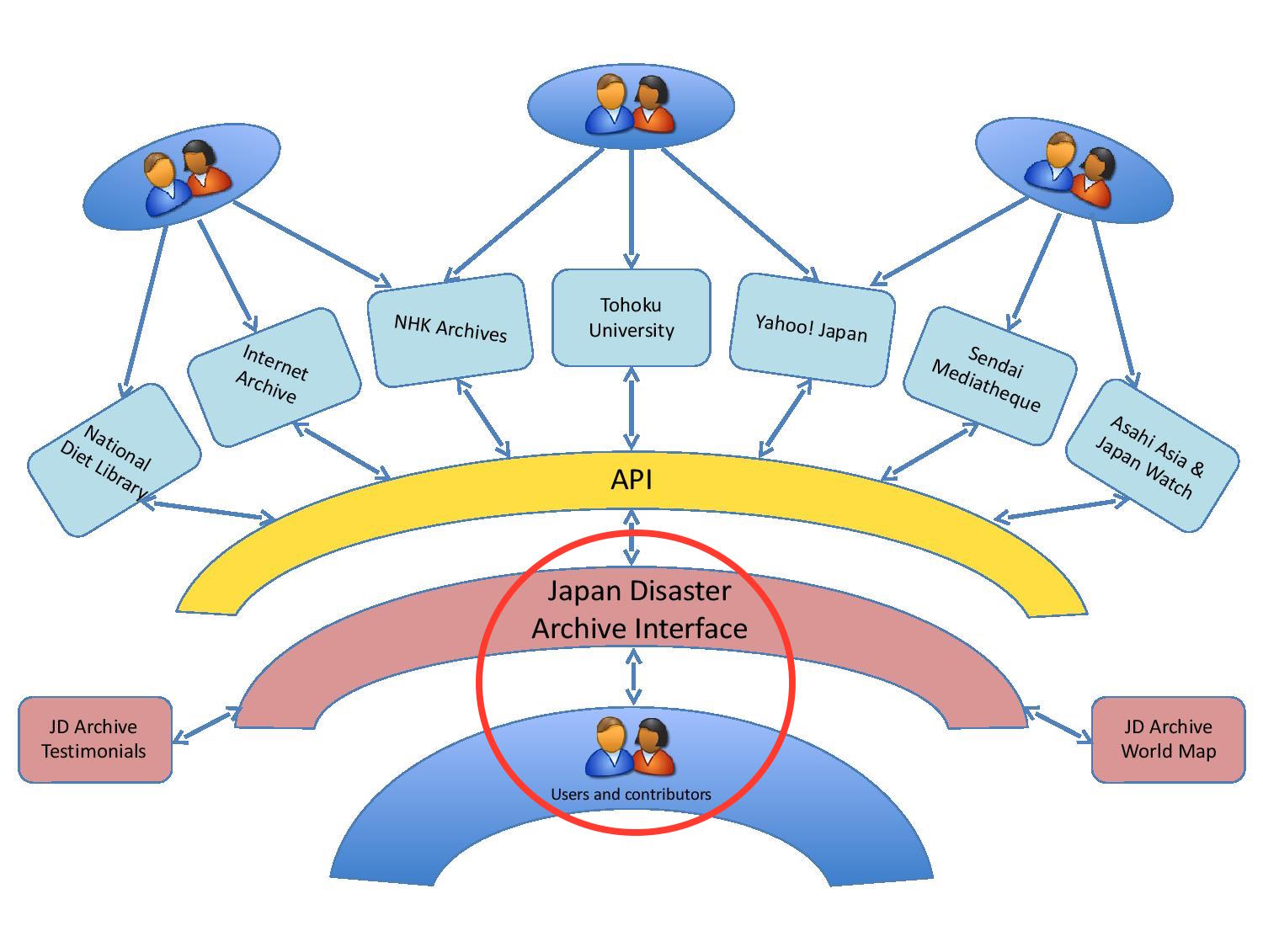
Notes:
Focus now on how users may contribute and participate.

Slide 16
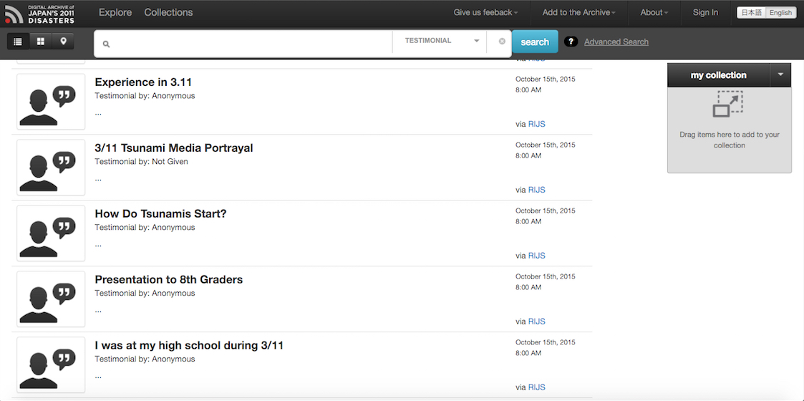
User contribution-Testimonial
Notes:
991 testimonies in the archive

Slide 17
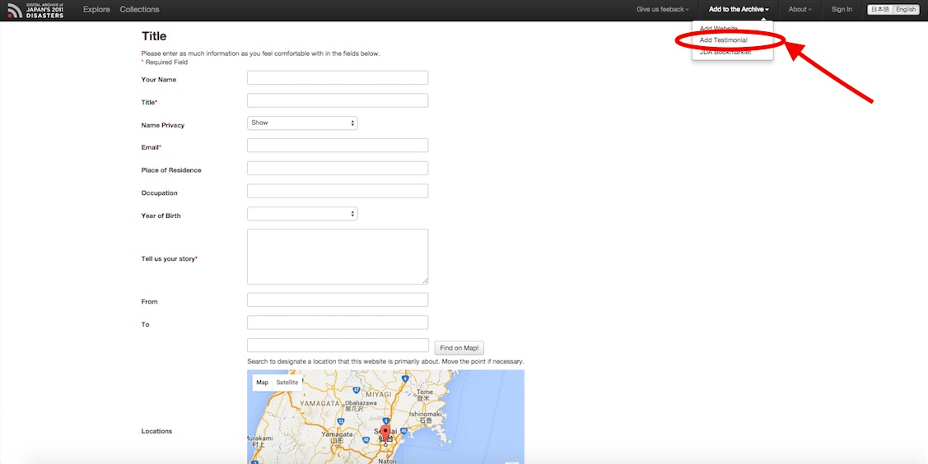
Notes:
Each user can manually add his/her testimonial.

Slide 18
Notes:
Entry by a student at the American School in Japan

Slide 19
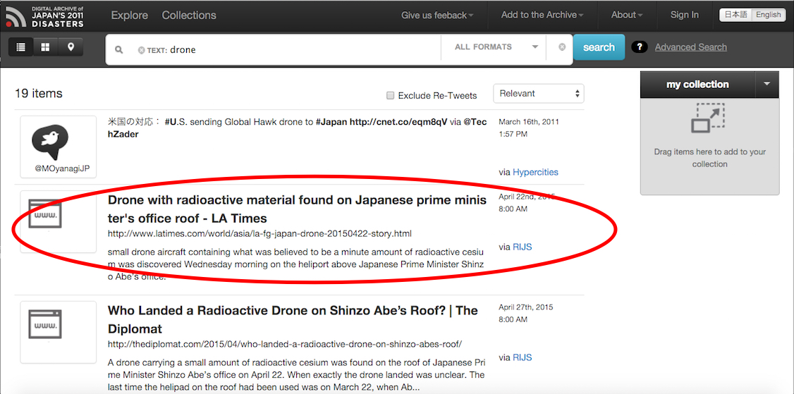
Digital life of a Website
Notes:
An example of how a website is archived in the JDA.

Slide 20
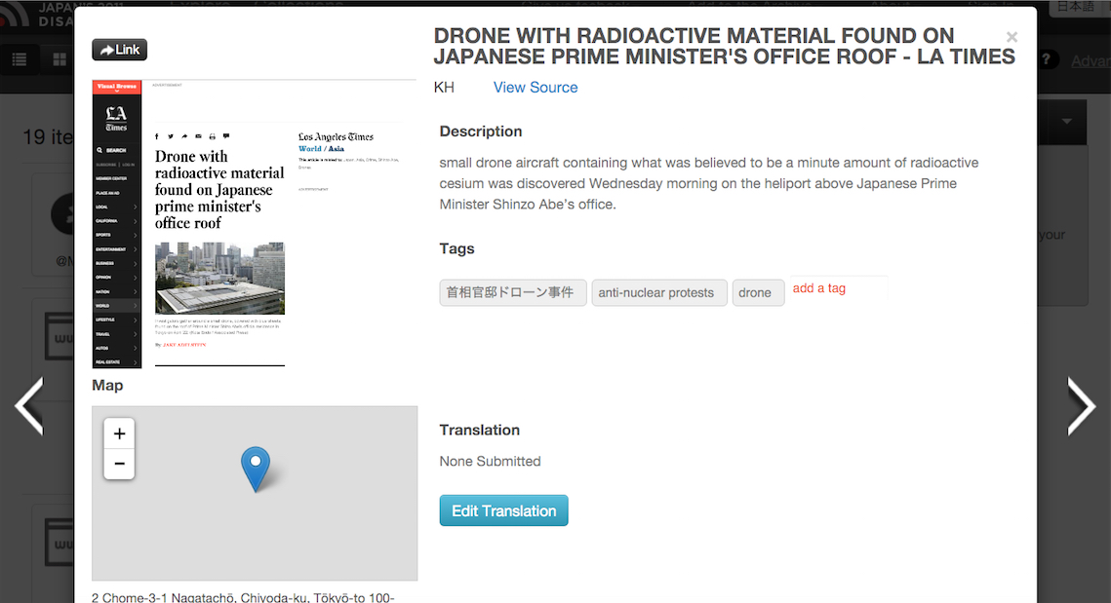
Notes:
On click an item, the user can view the detail information about the item.

Slide 21
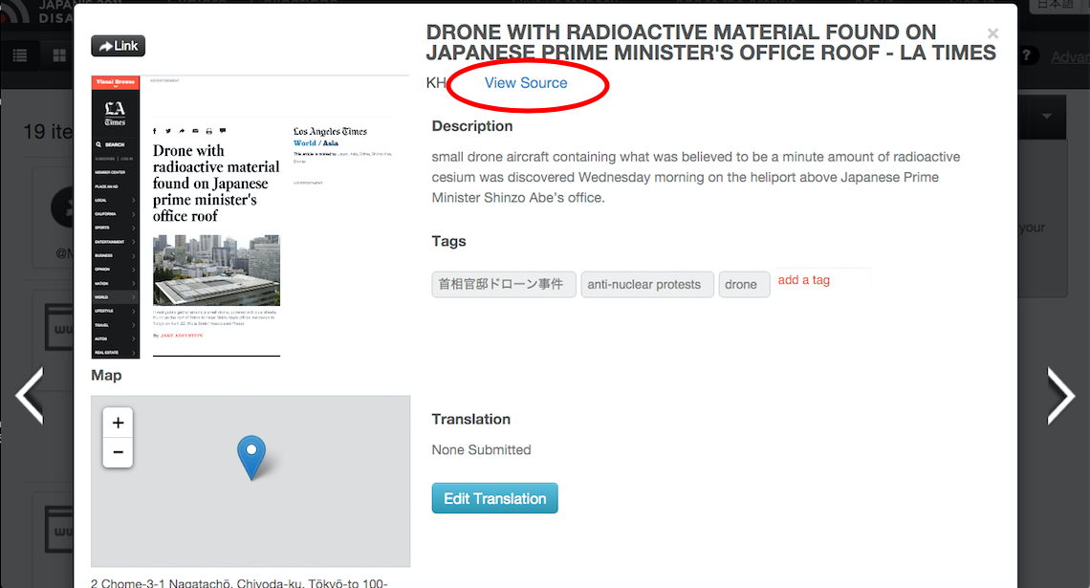
Notes:
Click view source to check the condition of the original link.

Slide 22
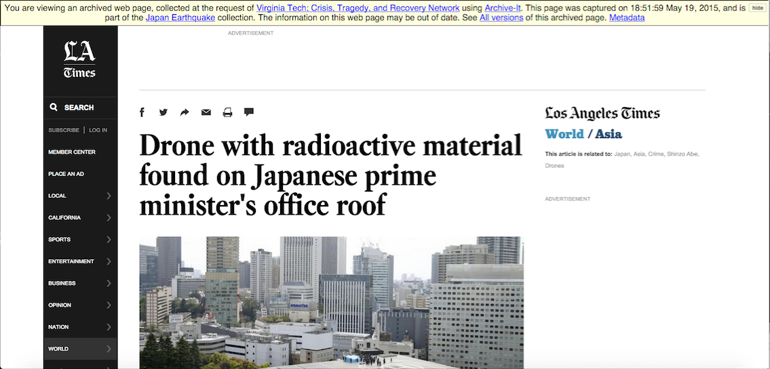
Notes:
The information on top indicate the item has been preserved by the Internet Archive.

Slide 23
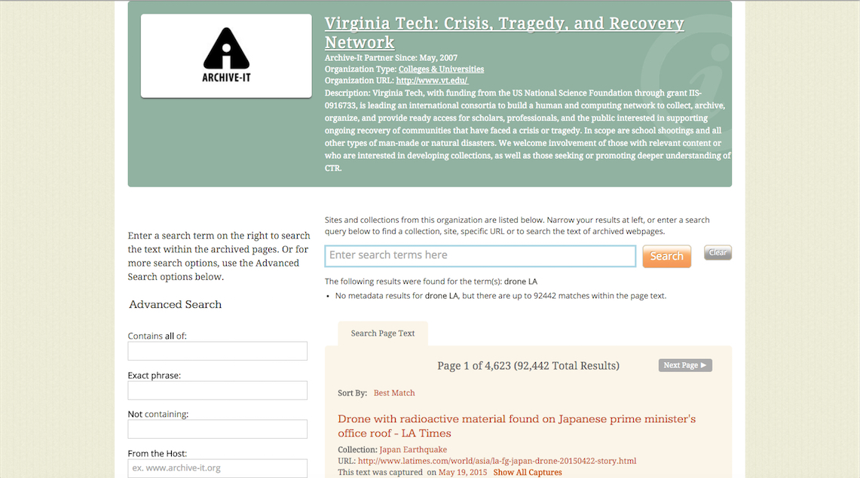
Wayback Archive it
Notes:
More than 63,000 items related to the disaster have been saved by the IA. Spontaneous event archive. How long is the life of a disaster?

Slide 24
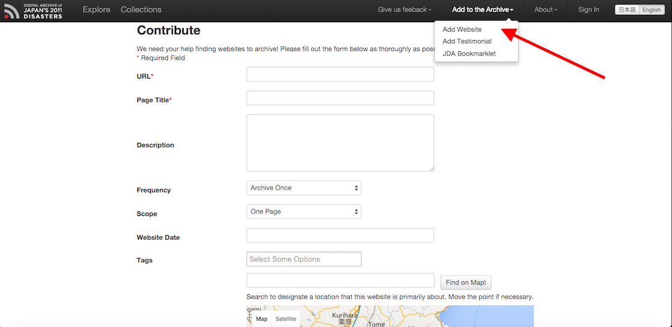
Notes:
The user can manually curate a born digital material.

Slide 25
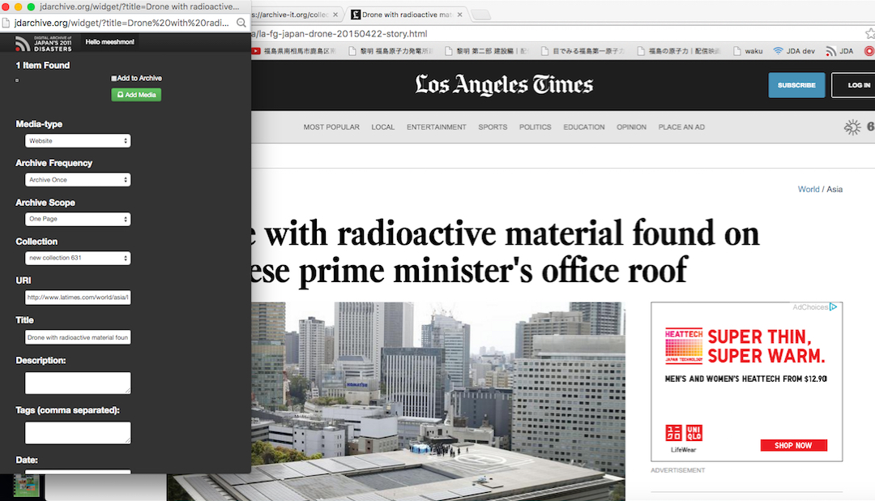
Notes:
Bookmarklet feature enables the user to curate a web-based item semi-automatically.

Slide 26
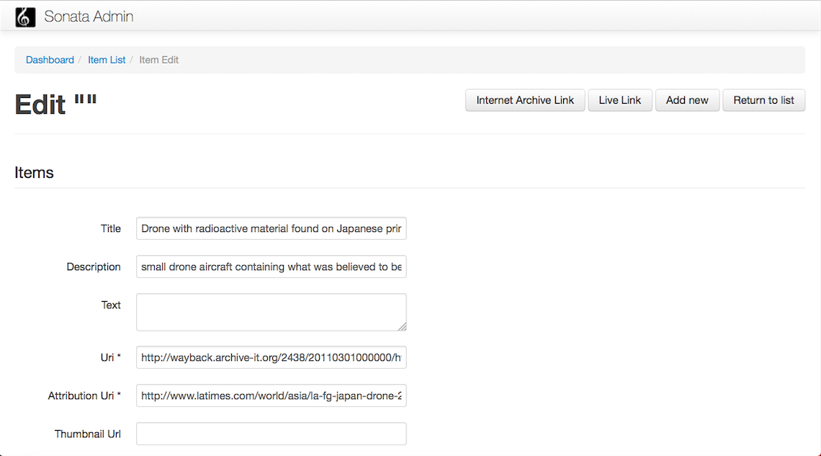
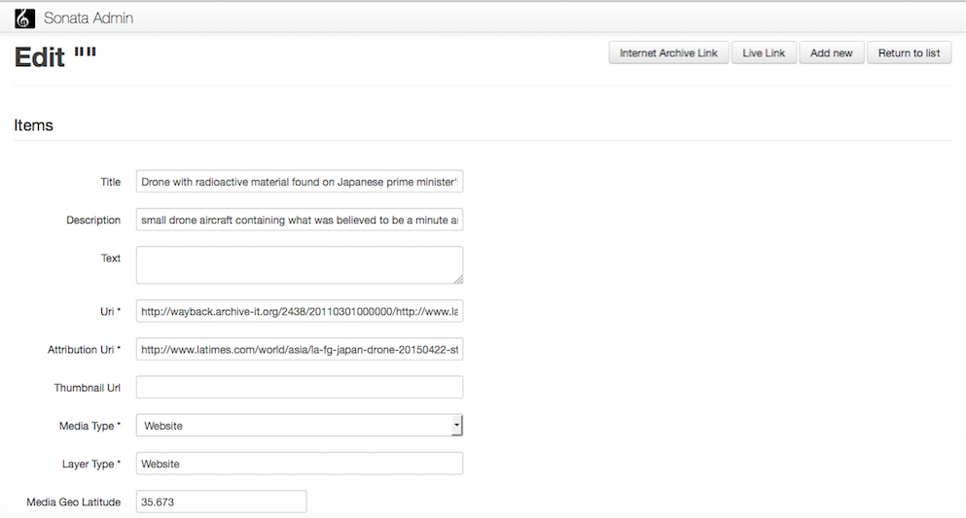
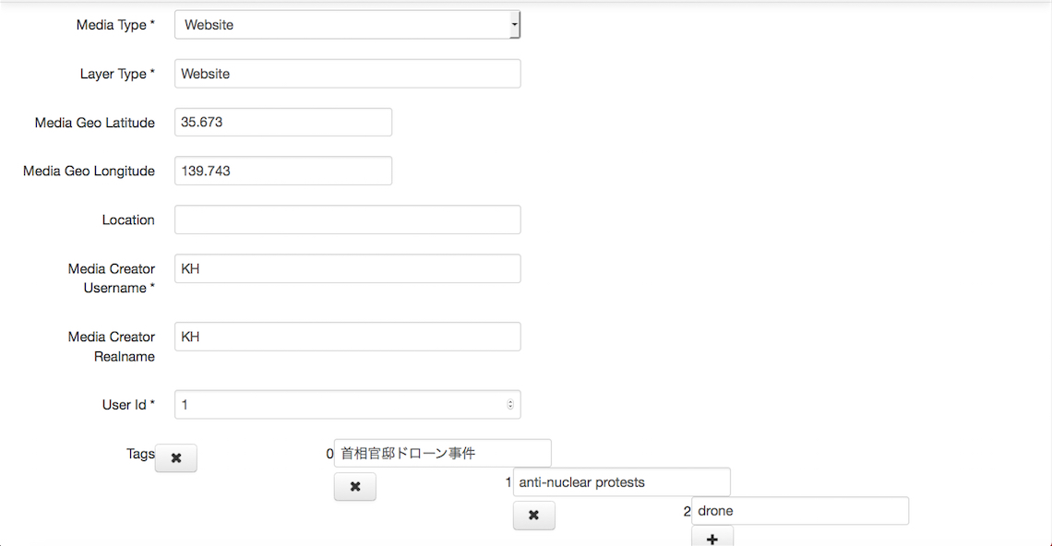
Notes:
The Sonata Project is an Open source set of bundles build on Symfony2

Slide 27
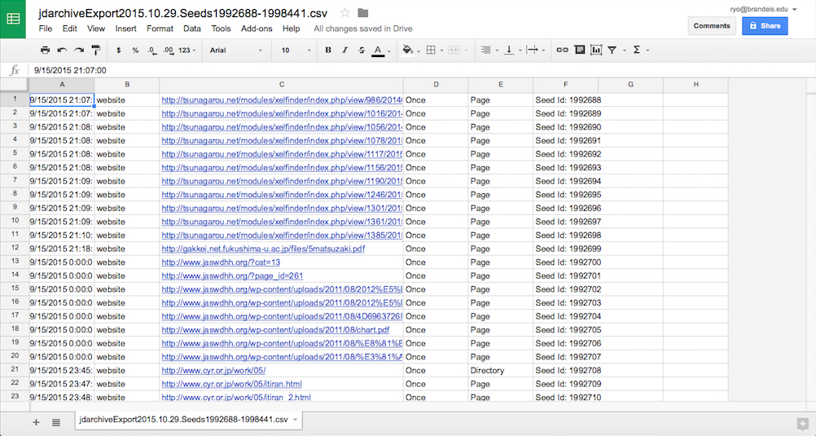
Notes:
A list of seeds needs to be created to send out to the IA.

Slide 28
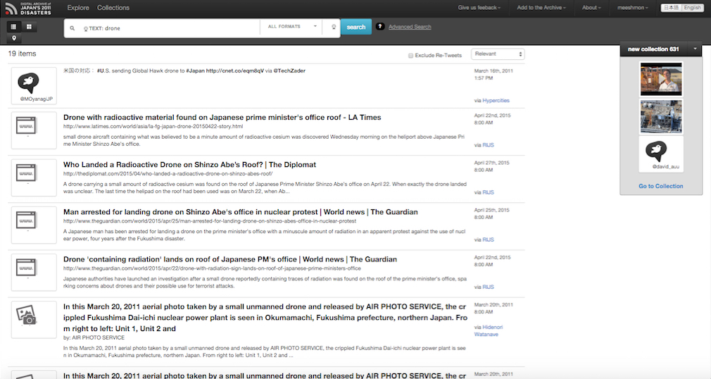
Notes:
And finally the website is securely saved in the archive.

Slide 29
JDA Organizational Chart
Steve McDonald
Jessica Yurkofsky
Notes:
It takes more than 5 people constantly working to get the archive running.
Both curating the ever flowing info about the disasters and maintaining the archive are labor intensive.

Slide 30
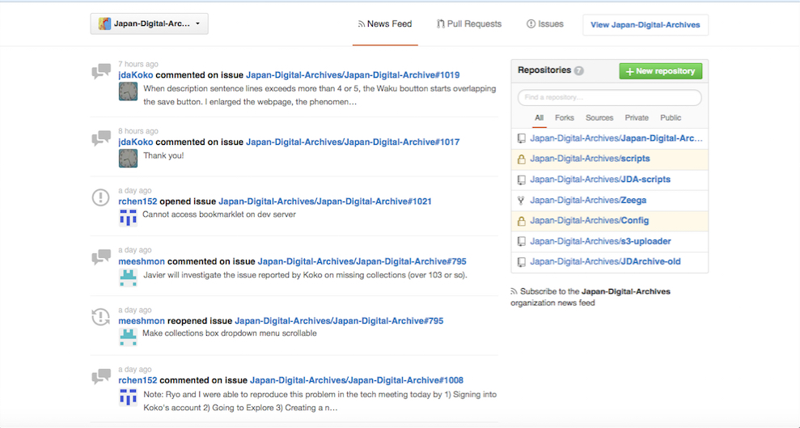
Maintaining the JDA
Notes:
GitHub Communication and the importance of documentations

Slide 31
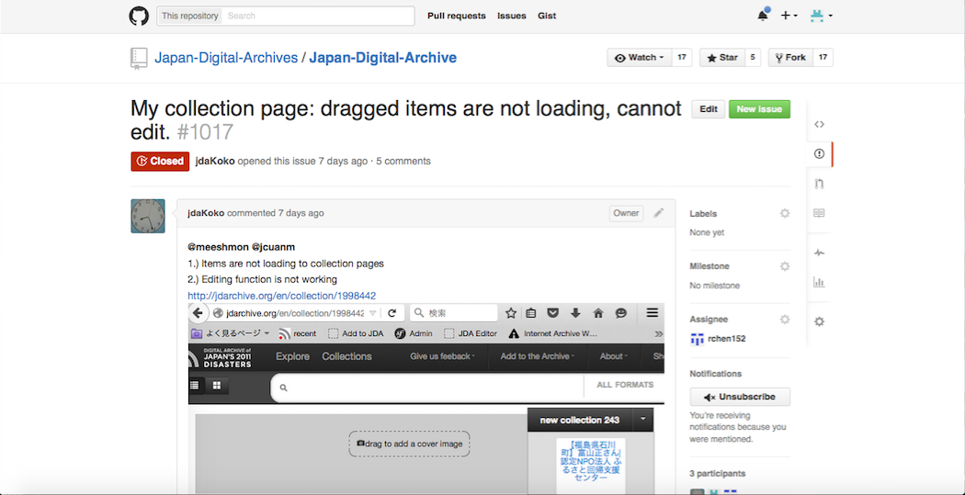
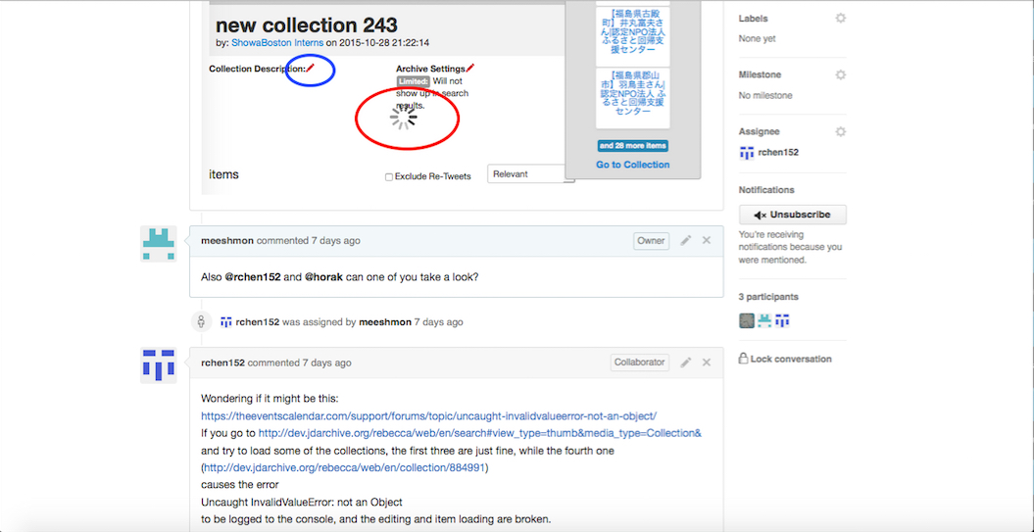
Notes:
An example of an error report on GitHub, https://github.com/orgs/Japan-Digital-Archives/dashboard

Slide 32
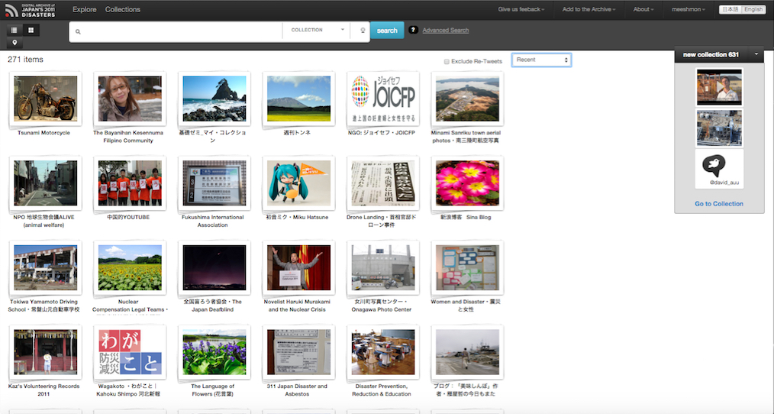
JDA Collections
Notes:
Collection is one of the features that makes JDA unique and different from other archive such as NDL’s Hinagiku, which similarly enables a cross-archival search. Any item discovered within the JDA or curated personally from the web can be added to your personal collection. Adding an item to a collection is done by a simple drag-and-drop to the small window to the left.

Slide 33
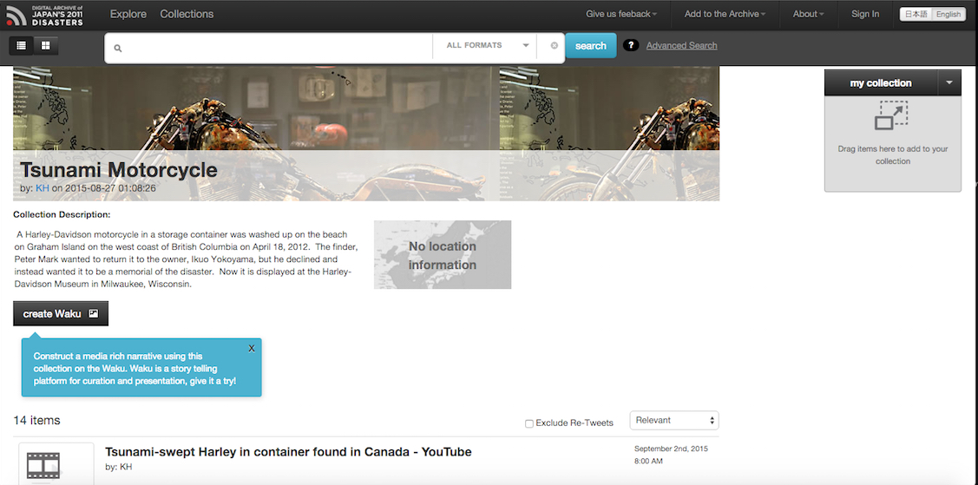
User-made collection
Notes:
On click a collection, all user can take a look at any collection made by other users.

Slide 34
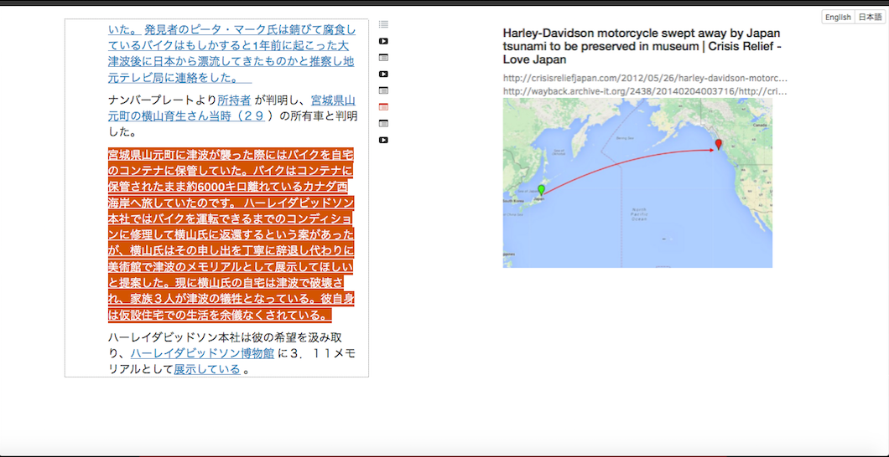
http://jdawaku.herokuapp.com/#en/proj/55e79c336799850300000001/view
Notes:
This is how a collection should look like. Showing items being curated by an user. The error report indicates that
the items in a collection were not loading.

Slide 35
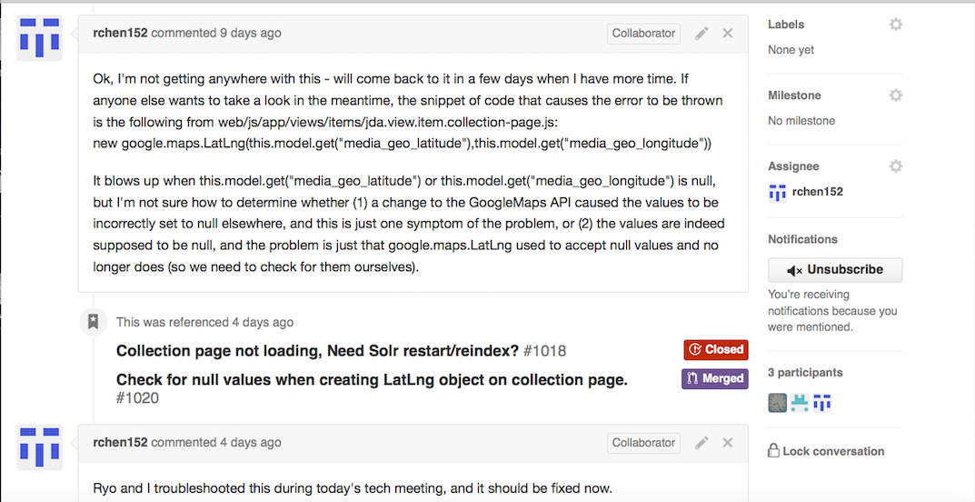
Notes:
The issue being a change in Googlemap API, which unexpectedly influenced the working of the archive→ an issue with opensource based programming (instability and compatibility across different services and languages especially when a service or program has an update).

Slide 36
Archiving [?] real-time

Slide 37
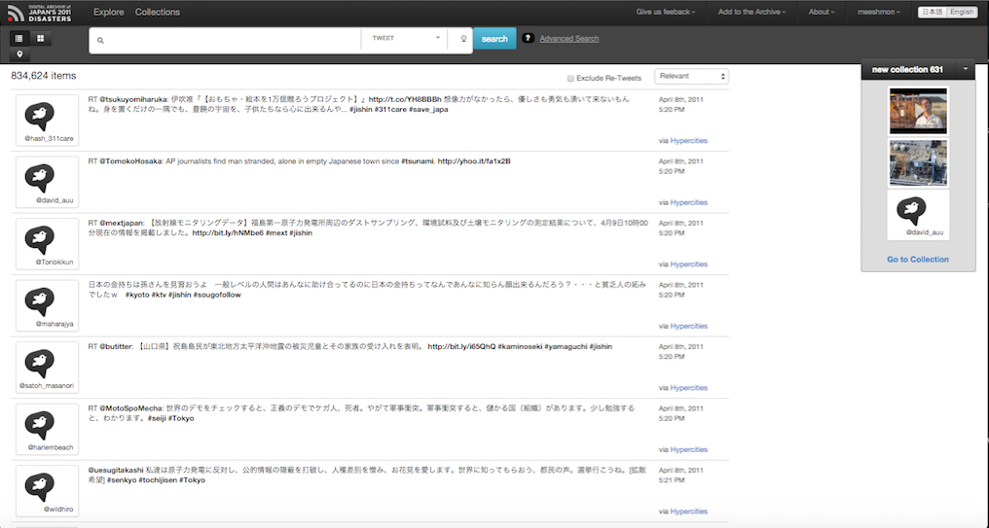
Too little or Too much data?
Notes:
The more is better?

Slide 38
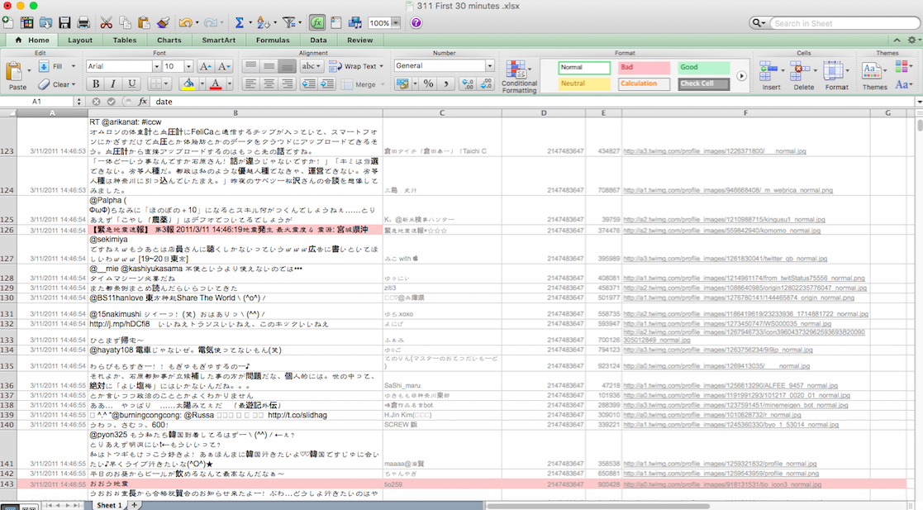
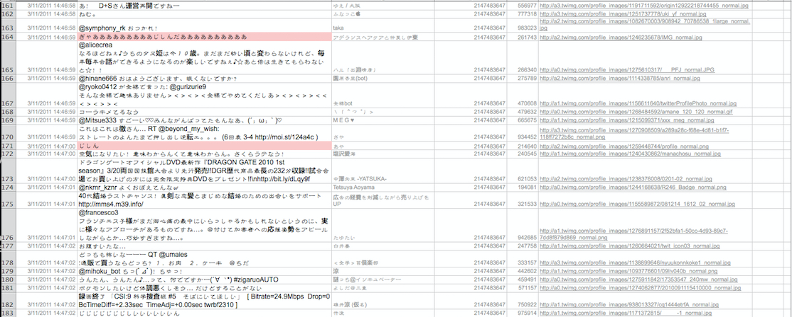
Notes:
What is the right balance between the size of the database, speed, ease of access/analysis/discovery?
Currently there are 1,489,089 items in the archive and the archive is still growing each day.
Can an archive forget? Are used data good (important) data, that is, how can we evaluate what is important and what is not?

Slide 39
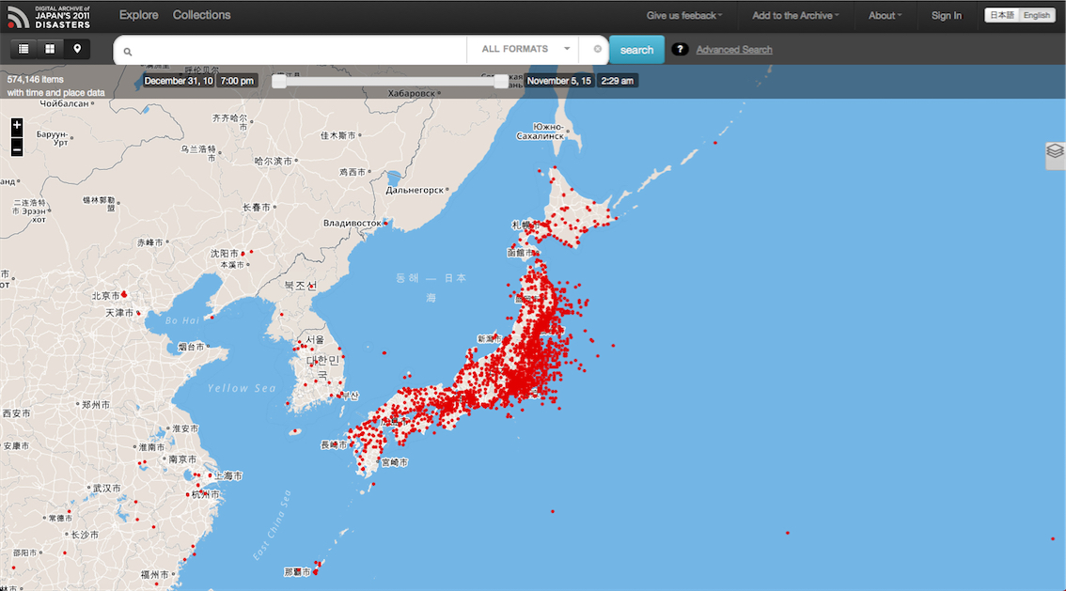
Raw data vs. Cooked data (powered by CGA)
Notes:
Need for a ready-made visualization(s)? What kind would be better.
JDA moving to heatmap.

Slide 40
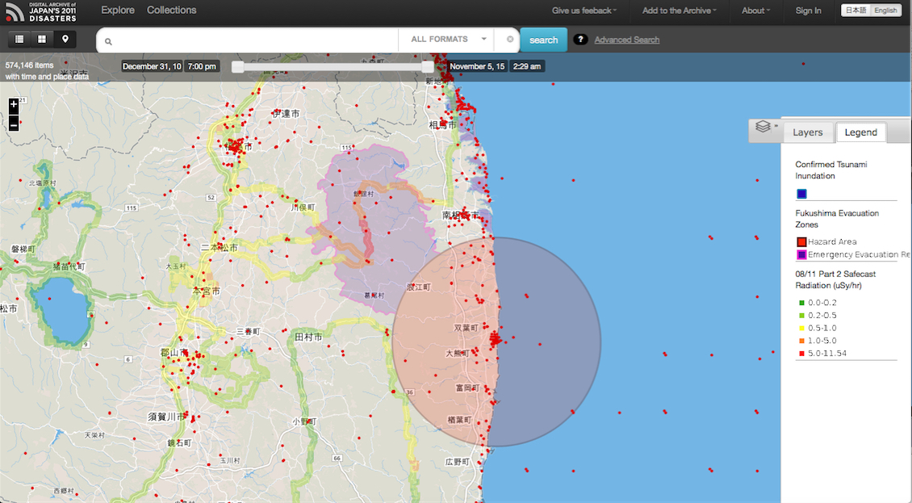
Notes:
Example of putting layers from Worldmap by CGA

Slide 41
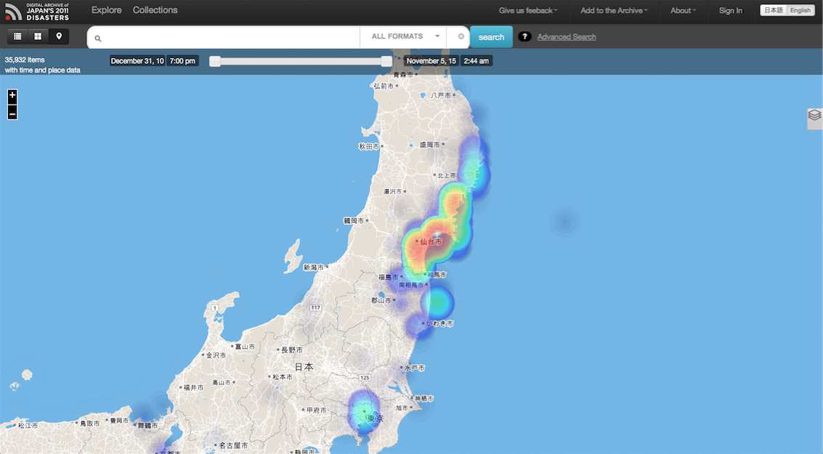
Notes:
How can an archive encourages its users to go beyond fancy visualization(s)?
The user tends not to make her collection unless it is a part of a class work.

Slide 42
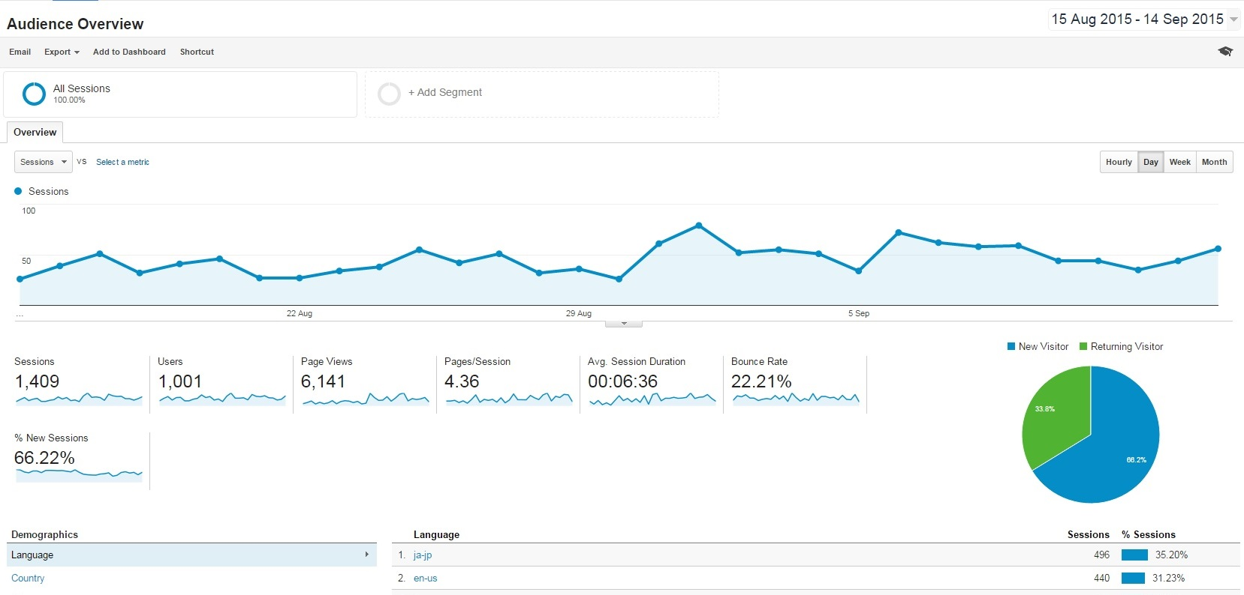
Who uses it for what purpose?
Notes:
How should a participatory archive structure itself, and what is the best model of an archive-in-flux?
Should an archive archive itself? →institutional memory and the wearout rate of digital data as well as stuff

Slide 43
Please contact us at info@jdarchive.org
Like us on Facebook:
https://www.facebook.com/Digital-Archive-of-Japans-2011-Disasters-143040332434759/?fref=photo

Slide 44
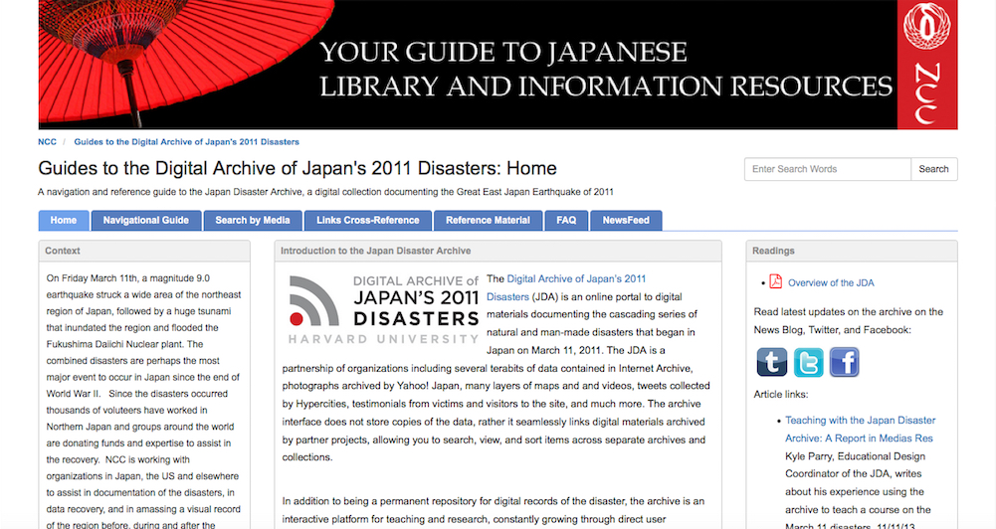
NCC’s Guides to the JDA http://guides.nccjapan.org/jdarchive
Notes:
Acknowledge that the NCC’s website has a page that describes in details about the JDA.

