Slide 1
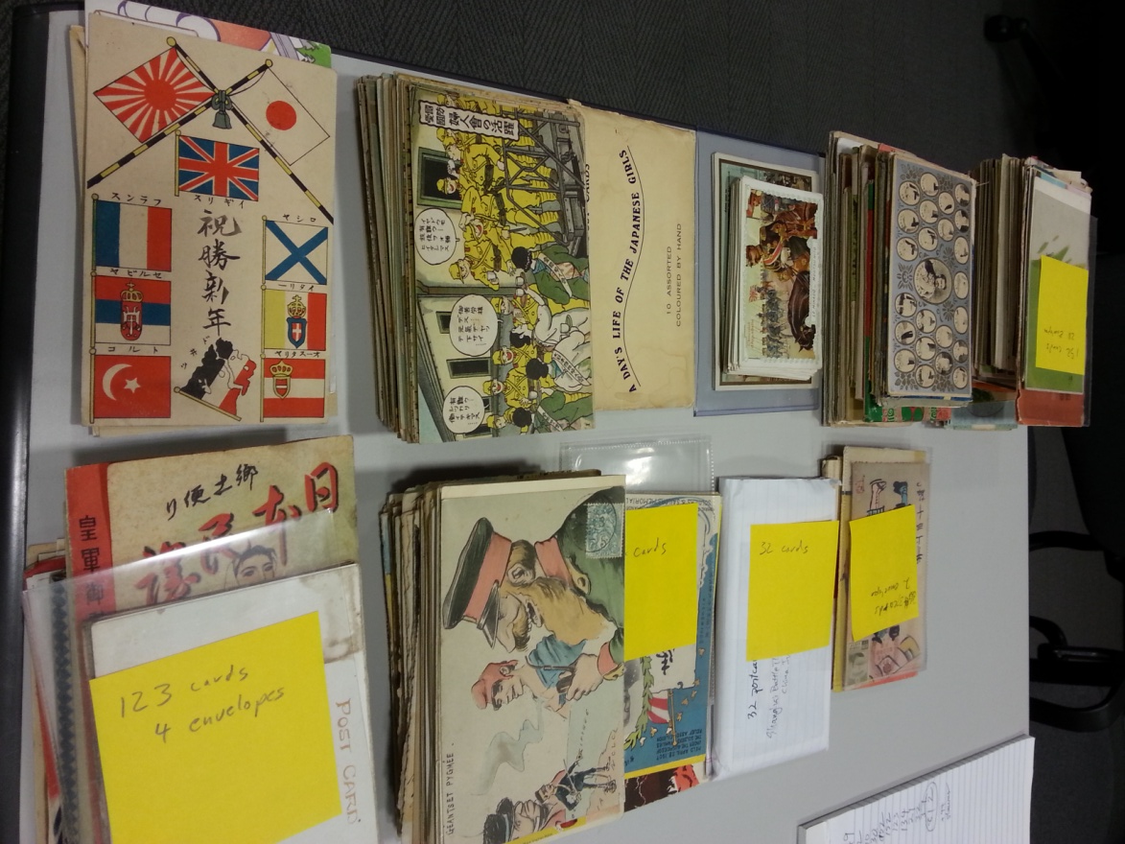
Growing the East Asia Image Collection over a Decade
Advancing Digital Scholarship in Japanese Studies: Innovations and Challenges
NCC & Reischauer Institute
Friday, November 6 & Saturday, November 7, 2015
Harvard University
Paul D. Barclay
Lafayette College
barclayp@lafayette.edu

Slide 2
Links
East Asia Image Collection, Lafayette College
http://digital.lafayette.edu/collections/eastasia
5832 records; photographs, postcards, pictorial publications, slides and negatives of East Asian history 1900-1950
East Asia Image Collection Blog
http://sites.lafayette.edu/eastasia/
Bibliography, links, essays about photographs and images in Japanese imperial and colonial history.
East Asia Image Collection Facebook Page
https://www.facebook.com/EastAsiaImageCollection/
Digital Scholarship Services, Lafayette College
http://digital.lafayette.edu/

Slide 3
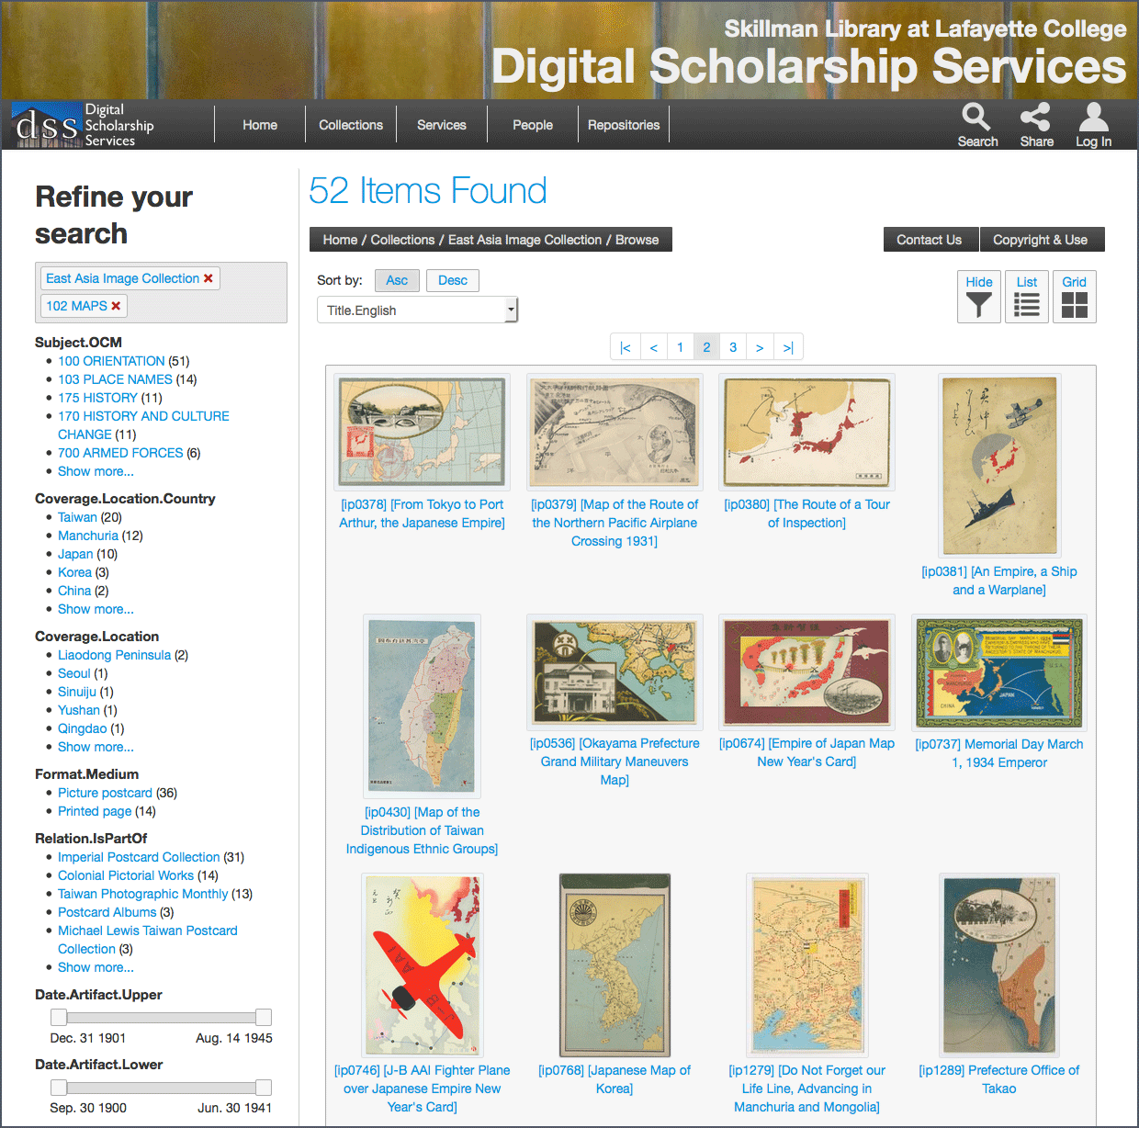
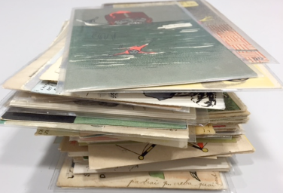
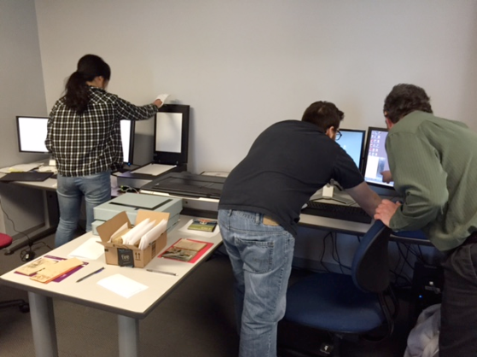
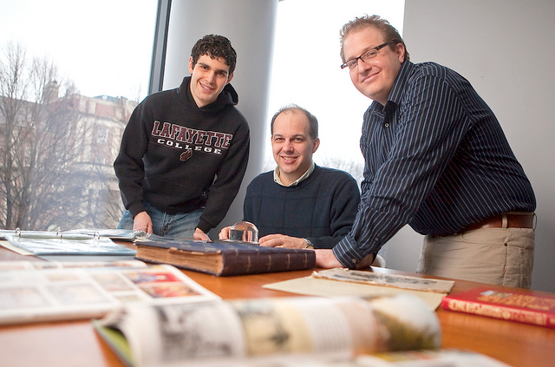
Notes:
Over the years, we have improved our processes significantly
Content
Working with donors
Budgets and reimbursement
Archival cataloging, housing, storage
Digitization
Disk space
Imaging, color correction standards
Hardware upgrades
Student training program
Description
Student researchers
Refinement of metadata schema
Metadb
Public display
Server environment
From CONTENTdm to Islandora, Hydra
Analytics
Facebook

Slide 4
benefits of ‘going digital’
Digital projects create opportunities, and spaces for collaboration across professions, institutions, and continents
Social scientists and humanists collaborate with library and information scientists
Teams of investigators from different institutions and national settings pool resources and expertise

Slide 5
Kyoto University, Japan February 2015
Showa Museum Tokyo Japan February 2015
Nanshan, Ilan County Taiwan 2014
Puli Municipal Library Taiwan 2014

Slide 6
Three collaborative projects
1. Transcribing and Publishing 415 letters from post-defeat Japan from family members to soldiers in Pacific Islands
2. Integrating and analyzing photographs and picture postcard from "Manchuria" in four repositories
3. Mapping and analyzing rare photographs of 1914 Truku-Japanese War in Taiwan

Slide 7
Project 1: 415 Letters to Japanese family members
from Japanese soldiers in Philippine Islands, late 1945-mid 1946
US Civil
Showa Memorial Museum
Yasukuni Street-Kudanshita
Tokyo, Japan
David Bishop Skillman Library, Lafayette College Easton, PA

Slide 8
Transcribing and archiving project
Over 415 handwritten postcards from war-torn and occupied Japan describing:
Material Conditions in Japanese town and country
Family Life
Japanese-American interactions
Civilian Reactions to the Post-War Situation
Showa-kan already archives, analyzes and displays similar material in on-site exhibitions (not open, remote access)
Lafayette College owns this rare material, and has experience with digital repository construction, meta-data schemes, and open-access project design
Each side gains from the other: they get access to unique and valuable materials, we get help transcribing, digitizing text, and interpreting the data

Slide 9
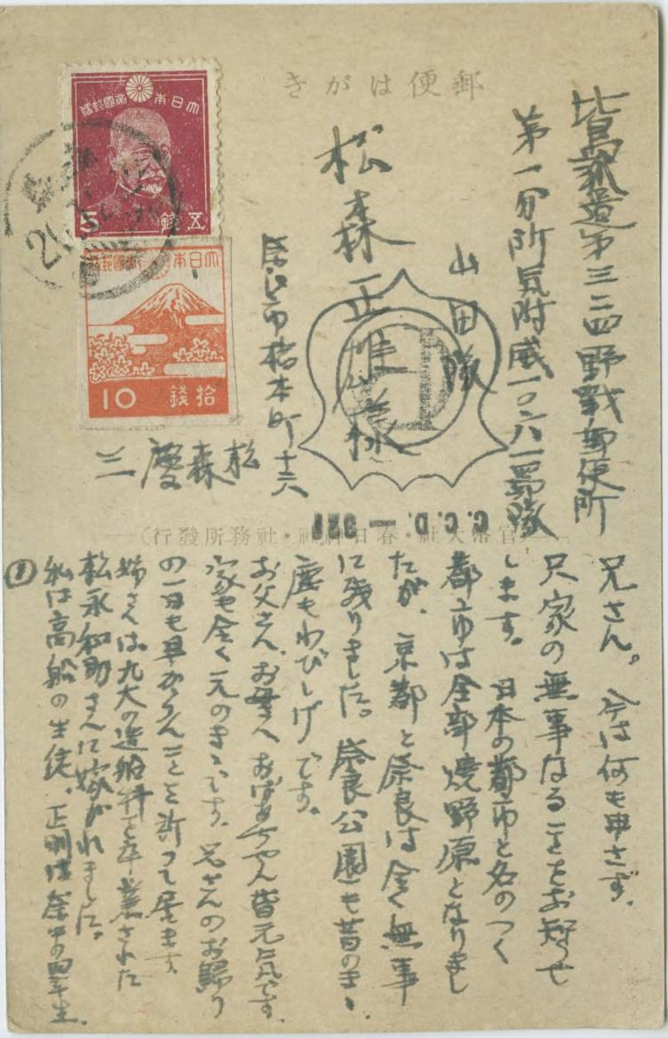
The letter was sent to the 324th Philippines Expeditionary Force Field Post Office, attn: 1st branch office "I" Unit #1061 and postmarked December 24th, 1945. The rubber stamp "C.C.D" stands for the "Civil Censorship Detachment" (of General Headquarters) and "321" indicates the office that processed the letter. The "PC" logo inside of the shield-shaped stamp indicates that this communication was approved by the censor (Censorship-Passed).
The letter is addressed to "elder brother" Matsumori Tadao, and says that Japanese cities have generally been destroyed and turned into "burnt wastes," but that Kyoto and Nara are still unscathed, and reports on family matters.

Slide 10
East Asia Image Collection Materials: Various Levels of Difficulty

Slide 11
Digitized Showa Memorial Museum Materials

Slide 12
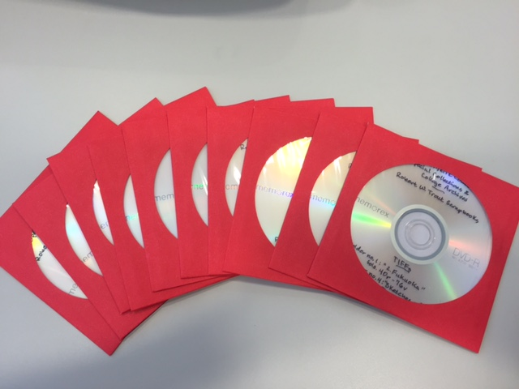
Collaboration Process:
Lafayette DSS sent high resolution images to Tokyo; the Showa-kan is subcontracting records to professional transcribers and translators to convert handwriting to digital text in modern Japanese (it is even difficult for contemporary Japanese to read)

Slide 13
Collaboration across institutions and continents
How does a liberal arts college in Easton PA, with one historian of modern Japan, make institutional and scholarly connections with a large national museum in Tokyo Japan?
The curators at Showa Memorial viewed a collection of Kodachrome slides in the East Asia Image collection, and made a trip to Easton to look at our materials for their 70th Anniversary of Postwar exhibit.
While visiting Skillman library, they viewed the collection of letters they are now transcribing, which had only been partially made available on the web.
The next summer, our team visited them in Tokyo to firm up the agreement (paperwork).

Slide 14
Institutional benefits of ‘going digital’
Donors, collectors, volunteers, and other contributors join these projects as they expand, in turn helping them grow in new directions
Example: The East Asia Image Collection is both the cause and the result of a process which might termed “the snowball effect.”

Slide 16
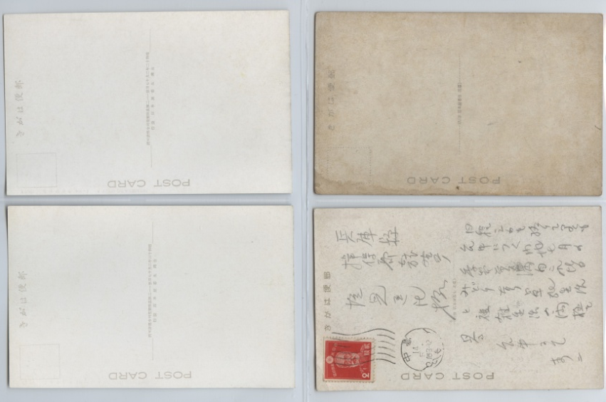
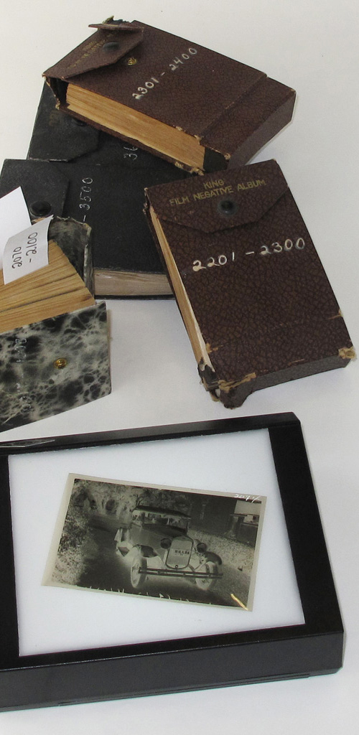

Slide 17
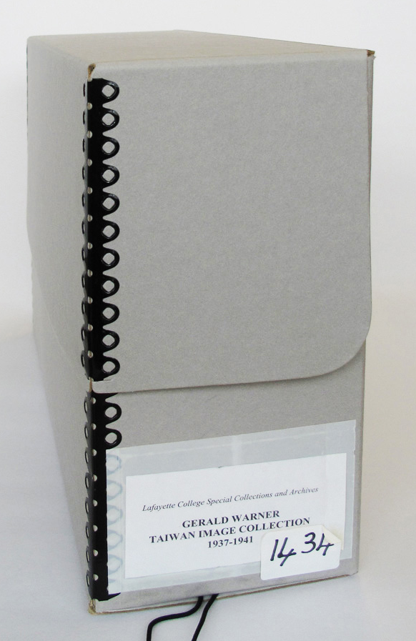
East asia image collection and “the snowball effect"
Dallas Finn, of Bethesda MD, donated 344 of Gerald Warner's 1930s Taiwan postcards and souvenir photographs to Lafayette College in 2002, and we had built a website out of them. This was our first sub-collection (Finn and Warner worked together in Tokyo in the early 1950s)

Slide 18
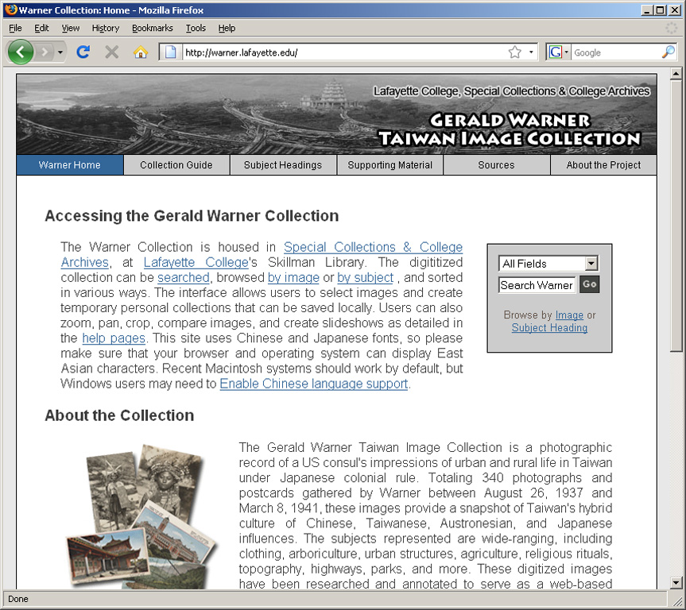

Slide 19
An art dealer in Taipei, Nicolas Grevot, introduced us to Gerald Warner’s daughters (who sold him artifacts collected in Taiwan.
Anne and Elizabeth Warner saw our project, and were eager to cooperate with us.

Slide 20
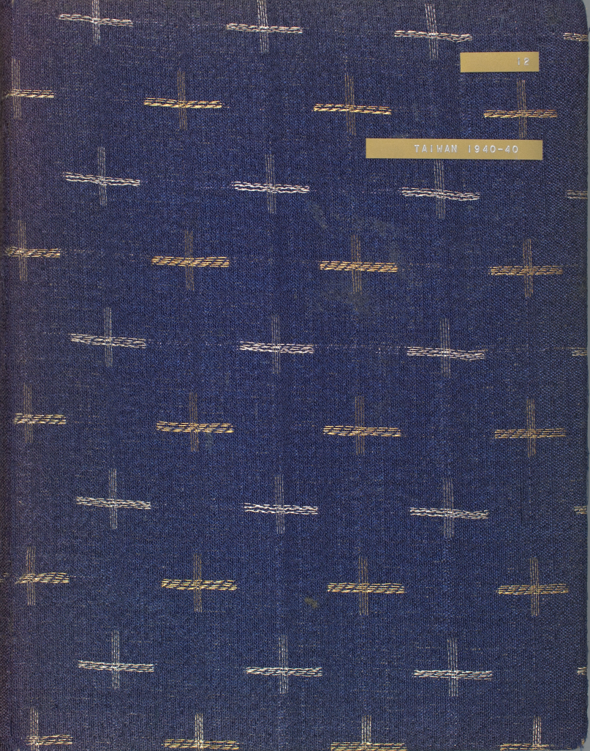
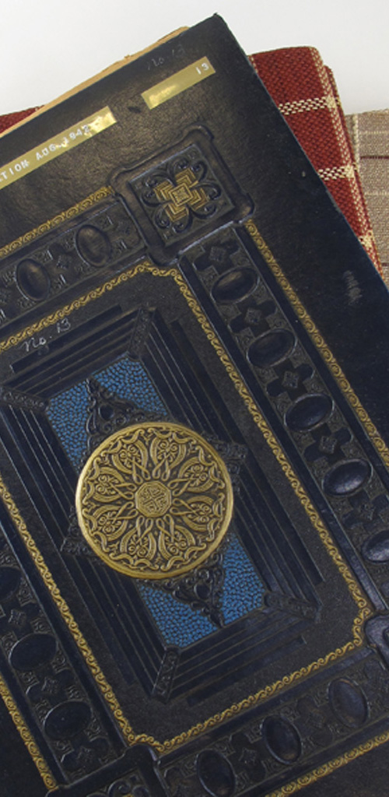
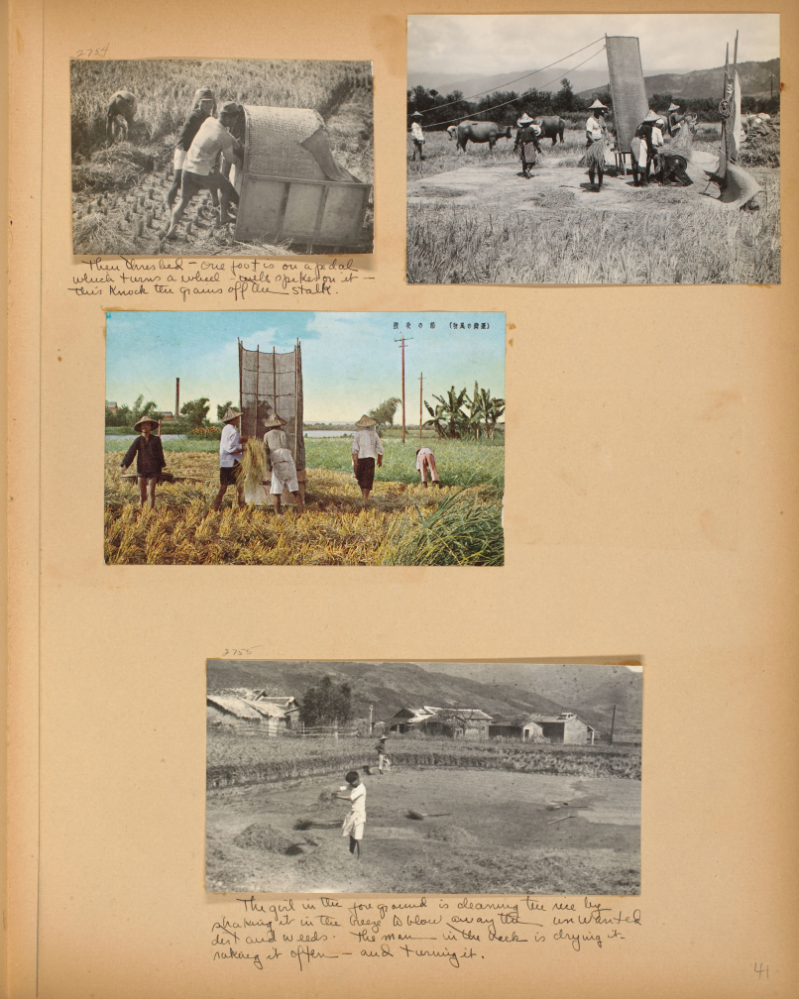
3600 negatives, 12 scrapbooks, correspondence, 1933-52 Manchuria, Mongolia, China, Taiwan, and japan (2008)

Slide 22
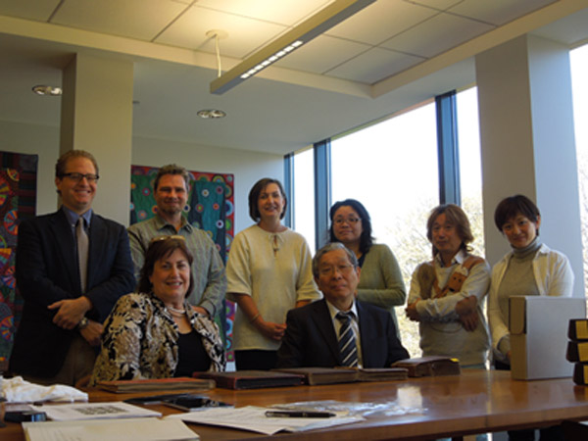
showa team visits skillman library November 2014

Slide 23
Google Analytics from last 30 days. ~1100 sessions; 835 users;
35% in Japan, 28% in U.S., 19% in Taiwan, 5% in UK, 2% in PRC

Slide 24
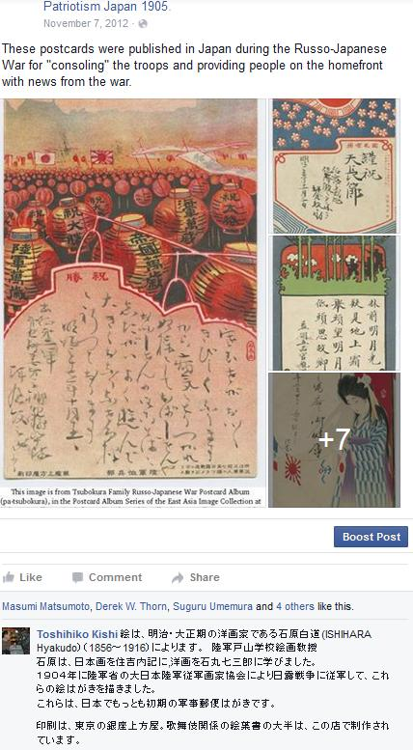
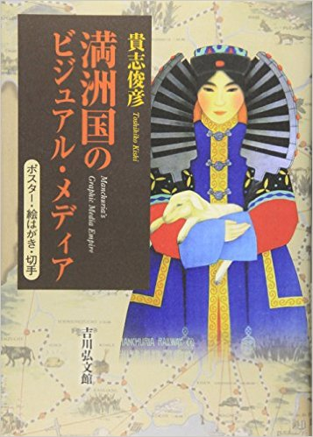
In 2012, a Kyoto University scholar, Kishi Toshihiko, responded to one of my Facebook "crowd-source" posts with detailed information about Russo-Japanese era artists.

Slide 25
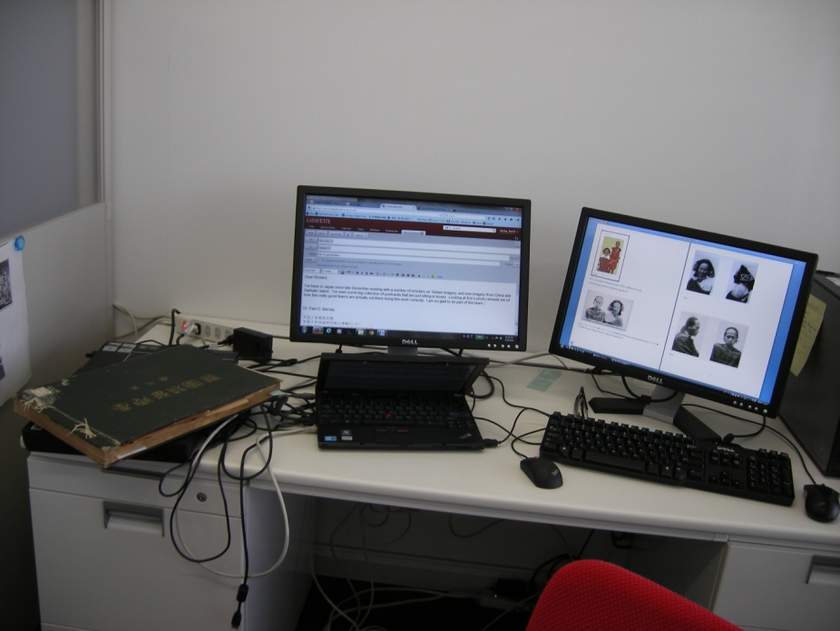
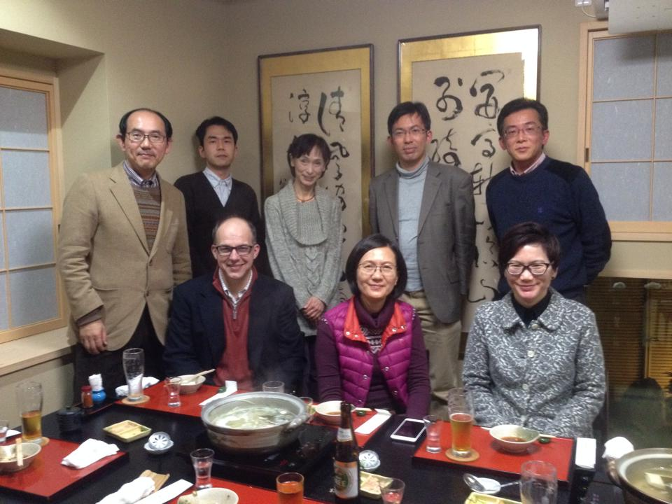
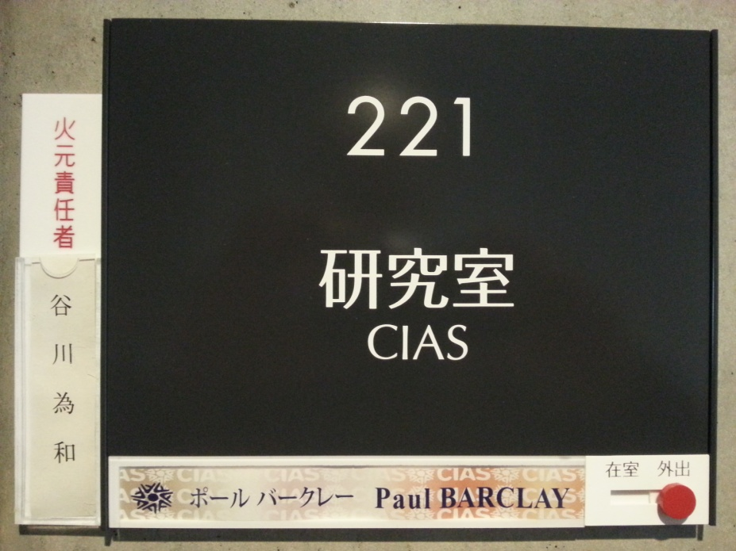
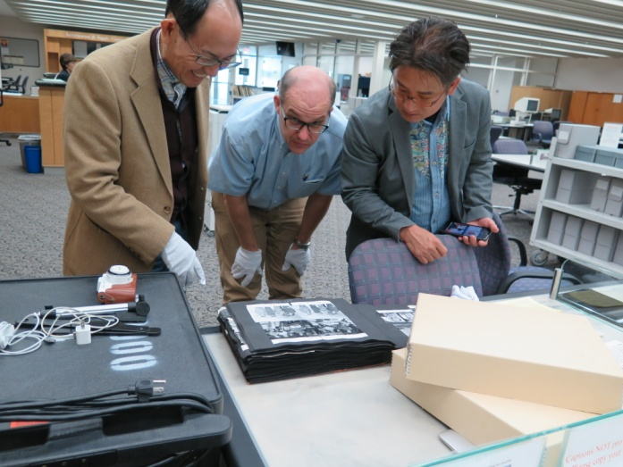

Slide 26
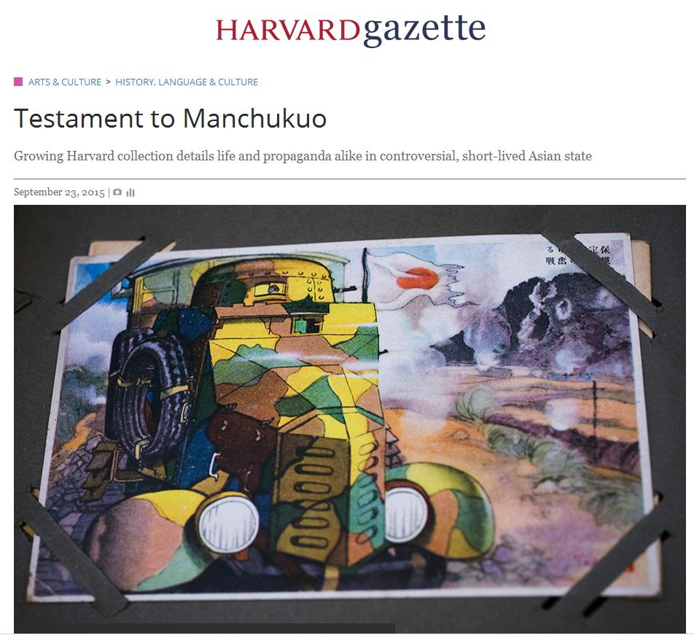
2. Project two: Manchukuo_Postcards.org
Build database of postcards of Manchukuo from collections of (at least) four repositories:
East Asia Image Collection (Lafayette College)
Japan Camera Industry Institute
Harvard Yenching Library
Museum of Fine Arts, Boston

Slide 29
Next Session: how to build this project
Important points:
Aggregation of databases is necessary
because individual collections are partial, fragmentary, and unrepresentative
Separated, small databases are difficult to use for systematic investigations of ephemera such as postcards

Slide 30
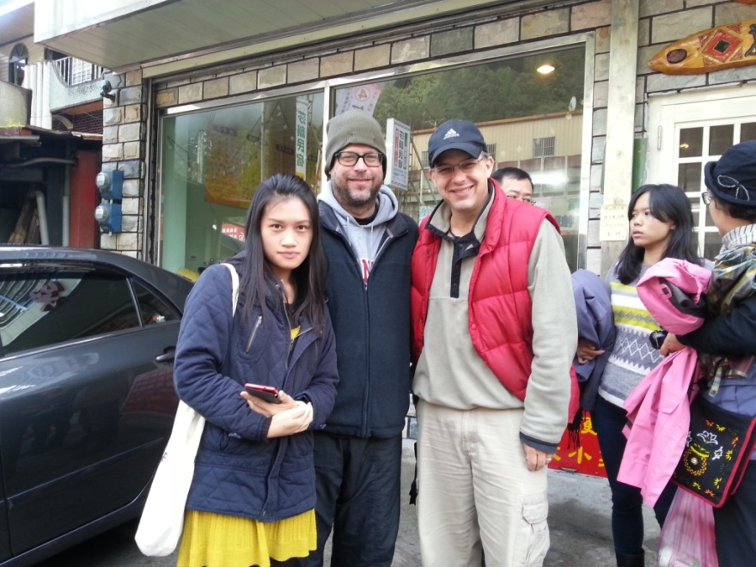
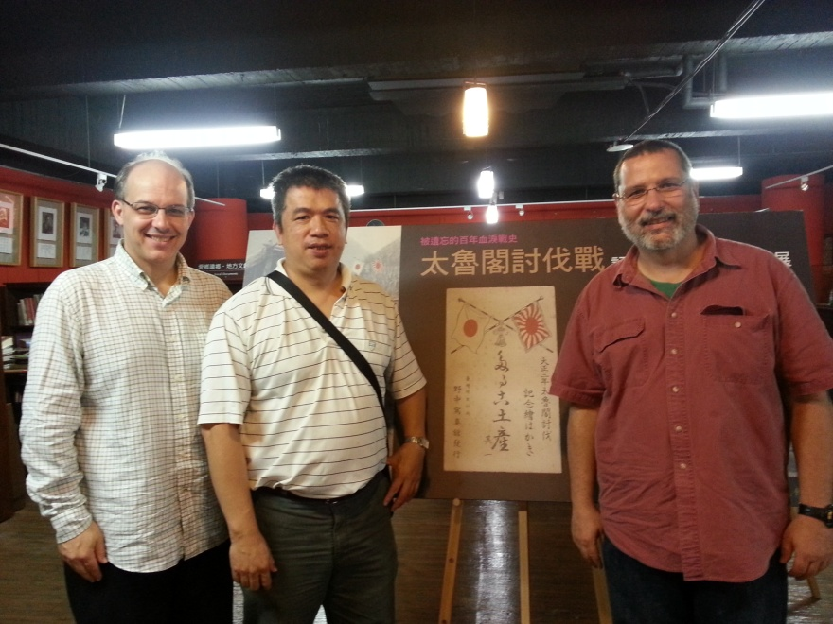
Project 3: Taroko-Japan War 1914: Images and Texts

Slide 31
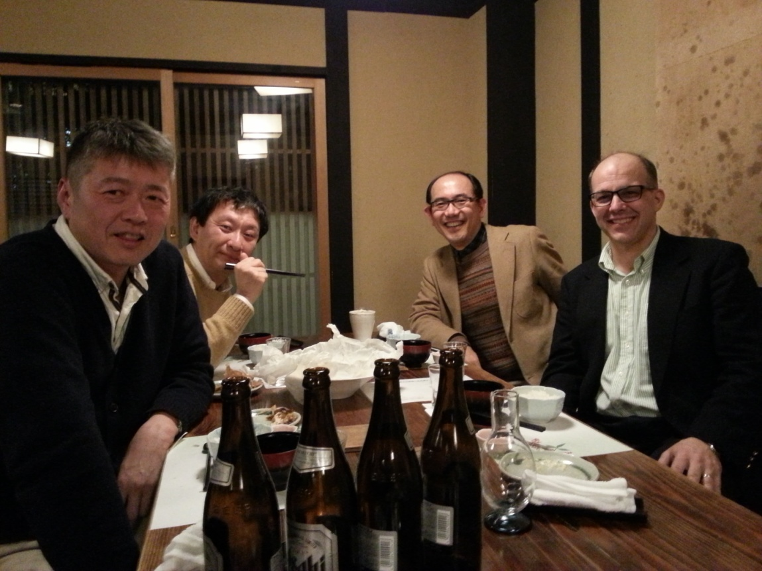
Closing thoughts

Slide 32
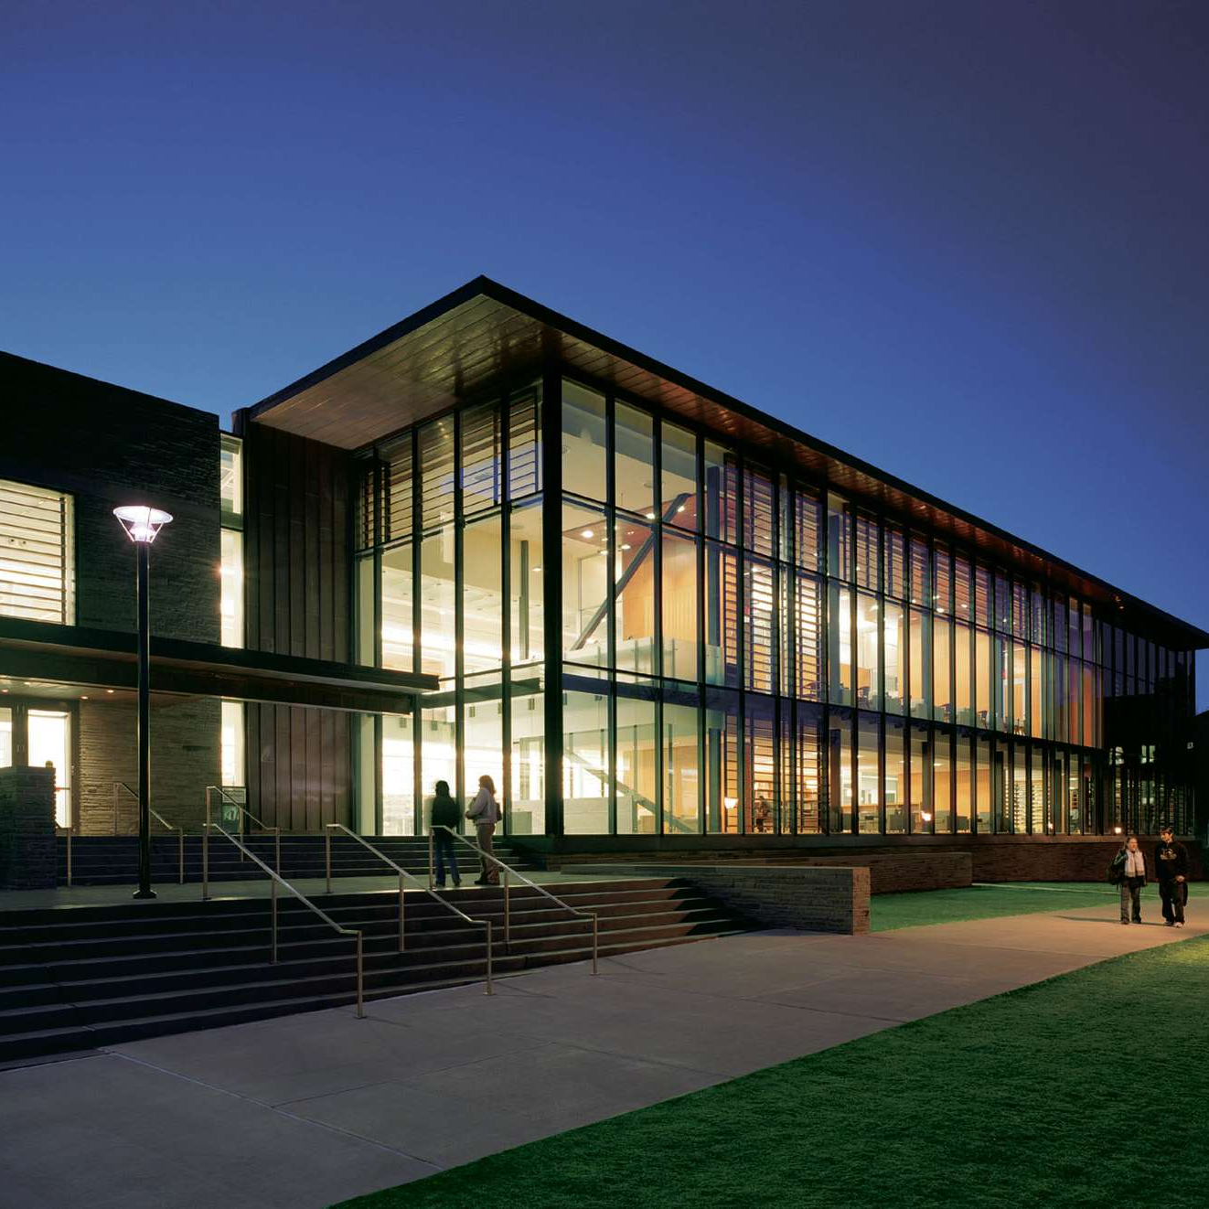
Thanks to East Asia Image Collection team!
Neil McElroy, Diane Shaw, Lijuan Xu, Elaine Stomber, Pam Murray, Paul Miller, James Griffin III, Keith Faust, Li Guo ('14), Jonathan Dever ('12), Ashutosh Tamrakar ('12), Haruki Yamaguchi ('10), Long Ho ('10), Kyeun Hyeunkoo, Emanuel Santa-Donato ('10), Naoko Ikegami, Seo-Hyun Park, Jeff Pfaffman and the people who keep the machines humming….

