Slide 1
HACKING HAIKU
Brian Croxall, Brown University
Cheryl Crowley, Emory University
Advancing Digital Scholarship in Japanese Studies:
Innovations and Challenges
NCC, Cambridge, MA
November 6, 2015

Slide 2
Team members:
Lawrence Hamblin, Japanese Studies Librarian
Sara Palmer, Electronic Full Text Specialist, ECDS
Megan Slemons, GIS Librarian, ECDS
Emory Center for Faculty Development and Excellence

Slide 3
Taorigiku 手折菊(Hand-picked chrysanthemums, 1812)
Tagami Kikusha 田上菊舍 (1753 - 1826)

Slide 4
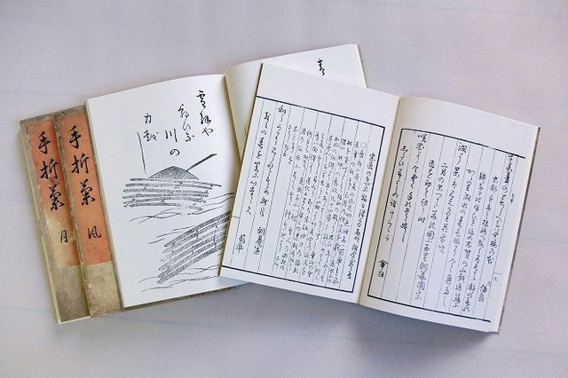
Taorigiku 手折菊:
Four volumes
Genres:
Prose
Hokku 発句 (17-syllable verse)
Haikai no renga 俳諧の連歌 (linked verse)
Haiga 俳画 (hokku + image)
Kanshi 漢詩 (verse in Chinese)

Slide 5
Outline
1. Literary landscape
2. Social networking
3. Cultural geography
4. A journey visualized

Slide 6
1. Literary landscape
2. Social networking
3. Cultural geography
4. A journey visualized

Slide 7
1. Literary landscape
the old pond:
a frog jumps in
sound of water
古池や蛙飛び込む水の音
Matsuo Bashô 松尾芭蕉 (1644-1694)

Slide 8
1. Literary landscape
at a time like this
even I
feel moved --
a frog trills at nightfall
in flooded fields
折にあへばこれもさすがにあはれなり小田のかはづの夕暮の声
「新古今集 1477]
Fujiwara no Tadayoshi 藤原忠良 (1164-1225)

Slide 9
1. Literary landscape
2. Social networking
3. Cultural geography
4. A journey visualized

Slide 10
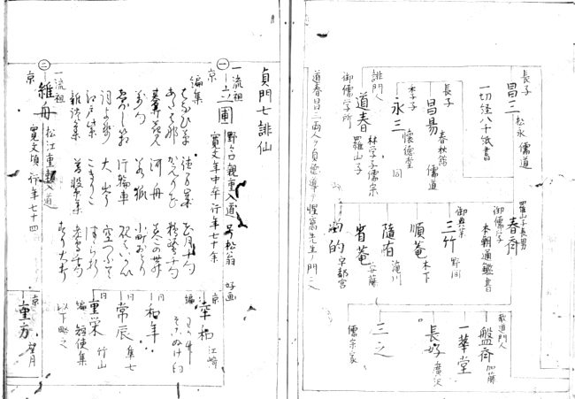
2. Social networking
Image: 俳諧系譜 http://www.nijl.ac.jp/pages/database/

Slide 11
2. Social networking
Shôfû 蕉風 / 正風 Bashô School
Mino Faction 美濃派
Chôbô-en Sankyô 朝暮園傘狂 (1727-1793)
Shinran Shônin 親鸞上人 (1173-1263)
Seikô-ji 清光寺, Hagi

Slide 12
1. Literary landscape
2. Social networking
3. Cultural geography
4. A journey visualized

Slide 13
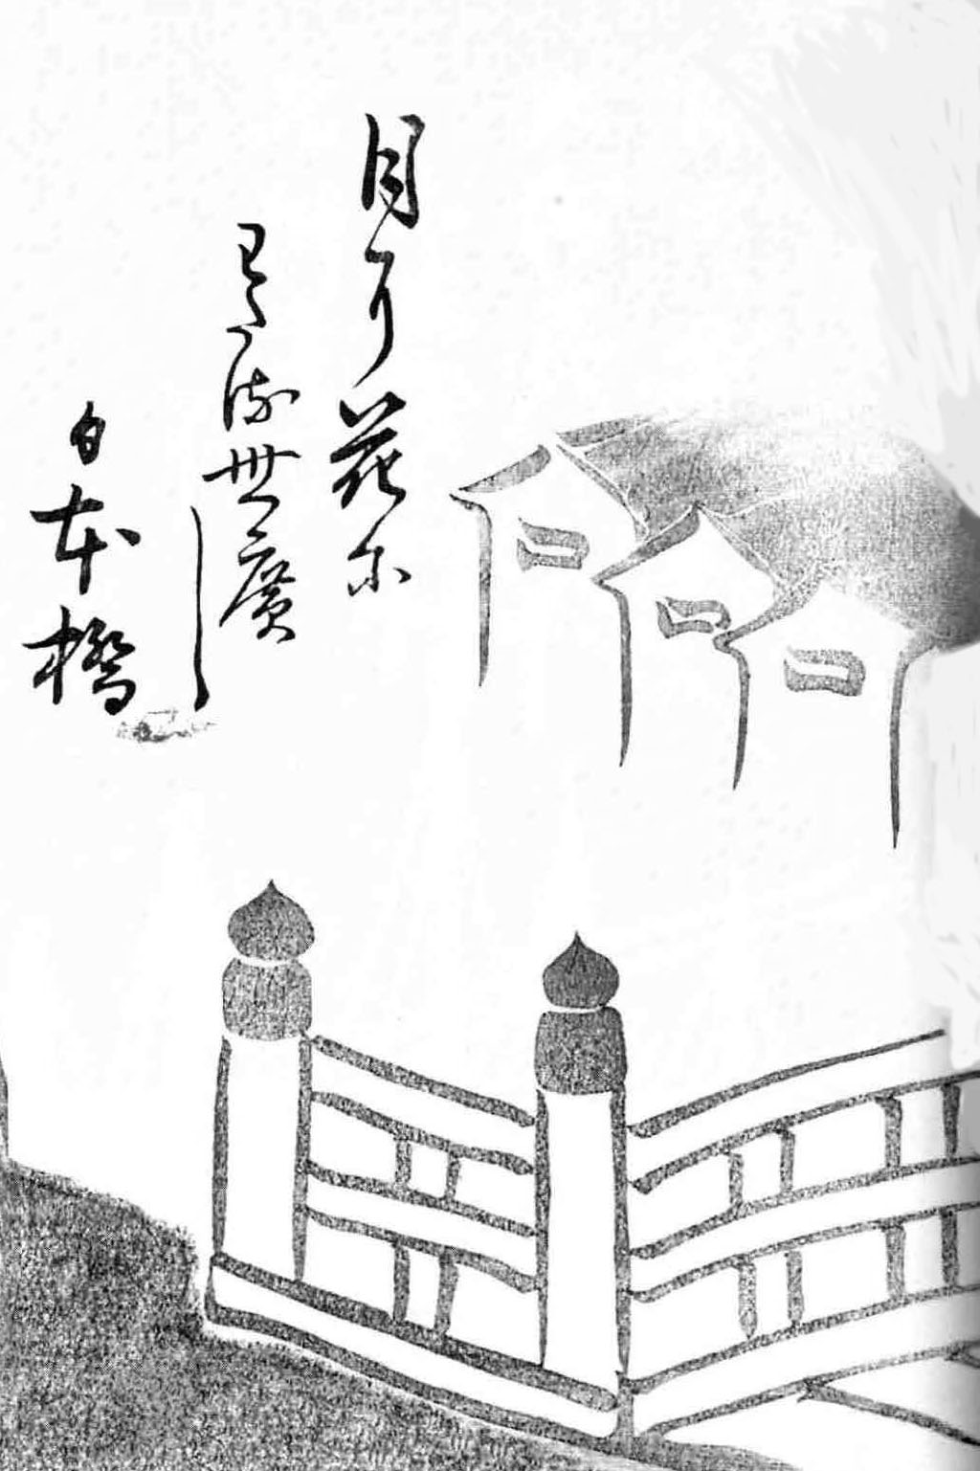
3. Cultural geography
Nihonbashi
under moonlight and blossoms
the world spreads out --
Nihonbashi Bridge
月に花にわたる世広し日本橋

Slide 14
1. Literary landscape
2. Social networking
3. Cultural geography
4. A journey visualized

Slide 15
Links
Database
Website( beta)

