Slide 1
GIS and Medieval Maritime Trade in the Seto Inland Sea
Michelle Damian
November 6, 2015
Advancing Digital Humanities in Japanese Studies Workshop, Harvard University

Slide 2
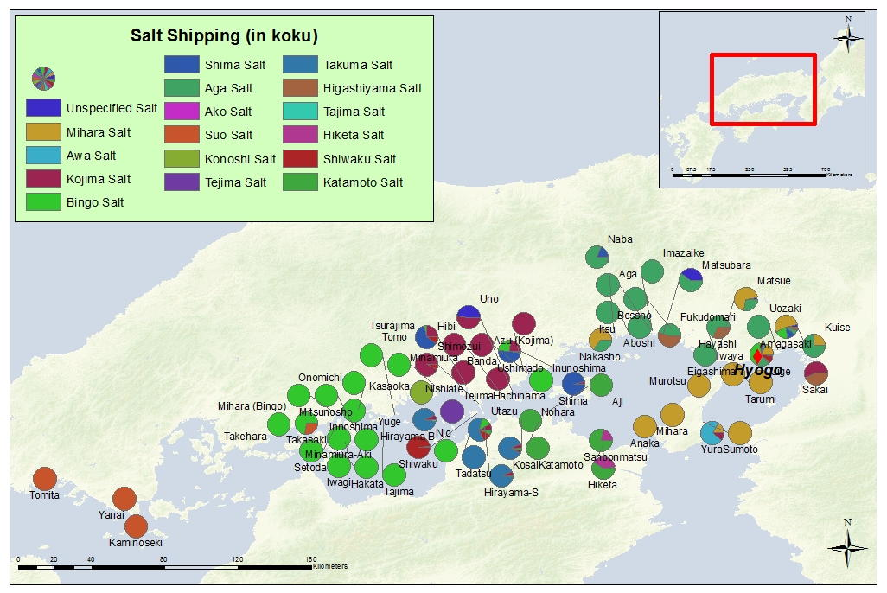
What we can learn: Transshipping

Slide 3
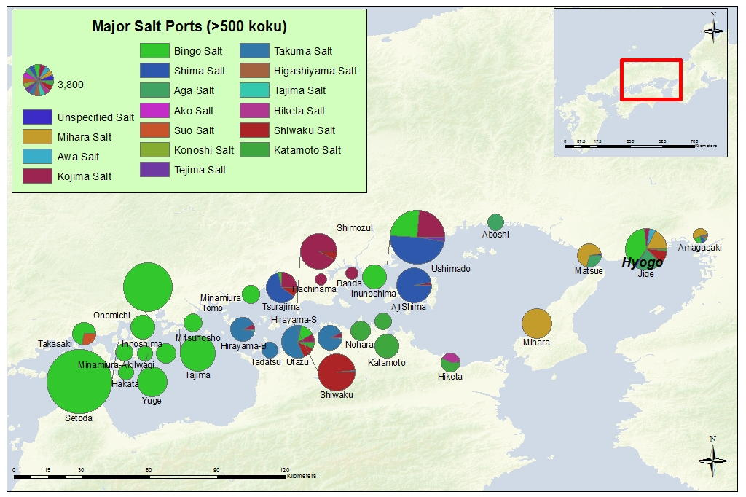
What we can learn: Transshipping

Slide 4
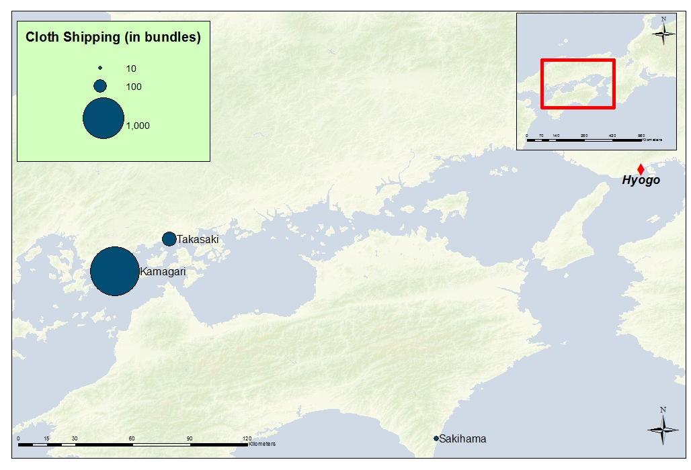
What we can learn: Transshipping

Slide 5
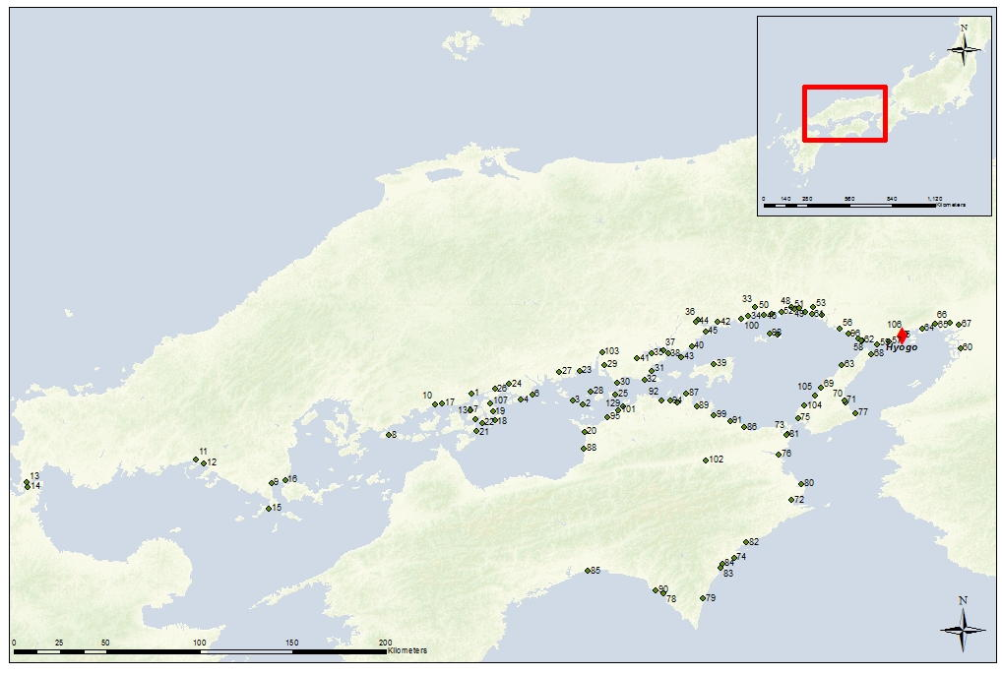
What we can learn: Transshipping

Slide 6
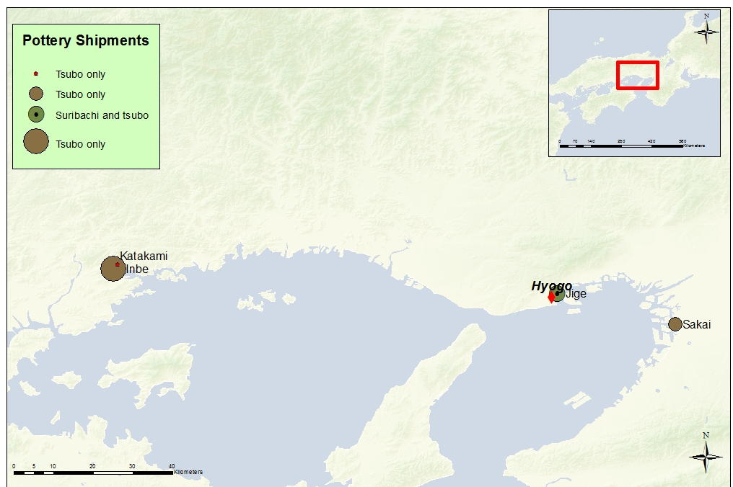
Shipping Routes: Bizen-yaki (pottery)

Slide 7
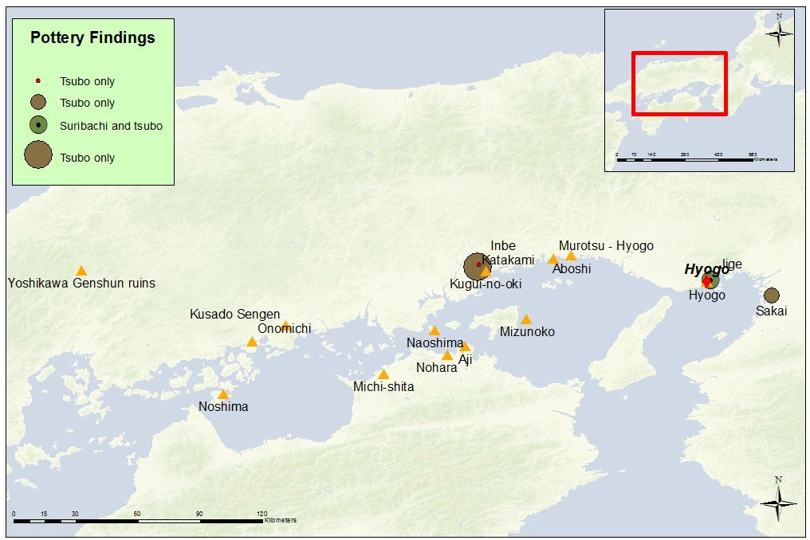
What we can learn: Combining Sources
Archaeological Site

Slide 8
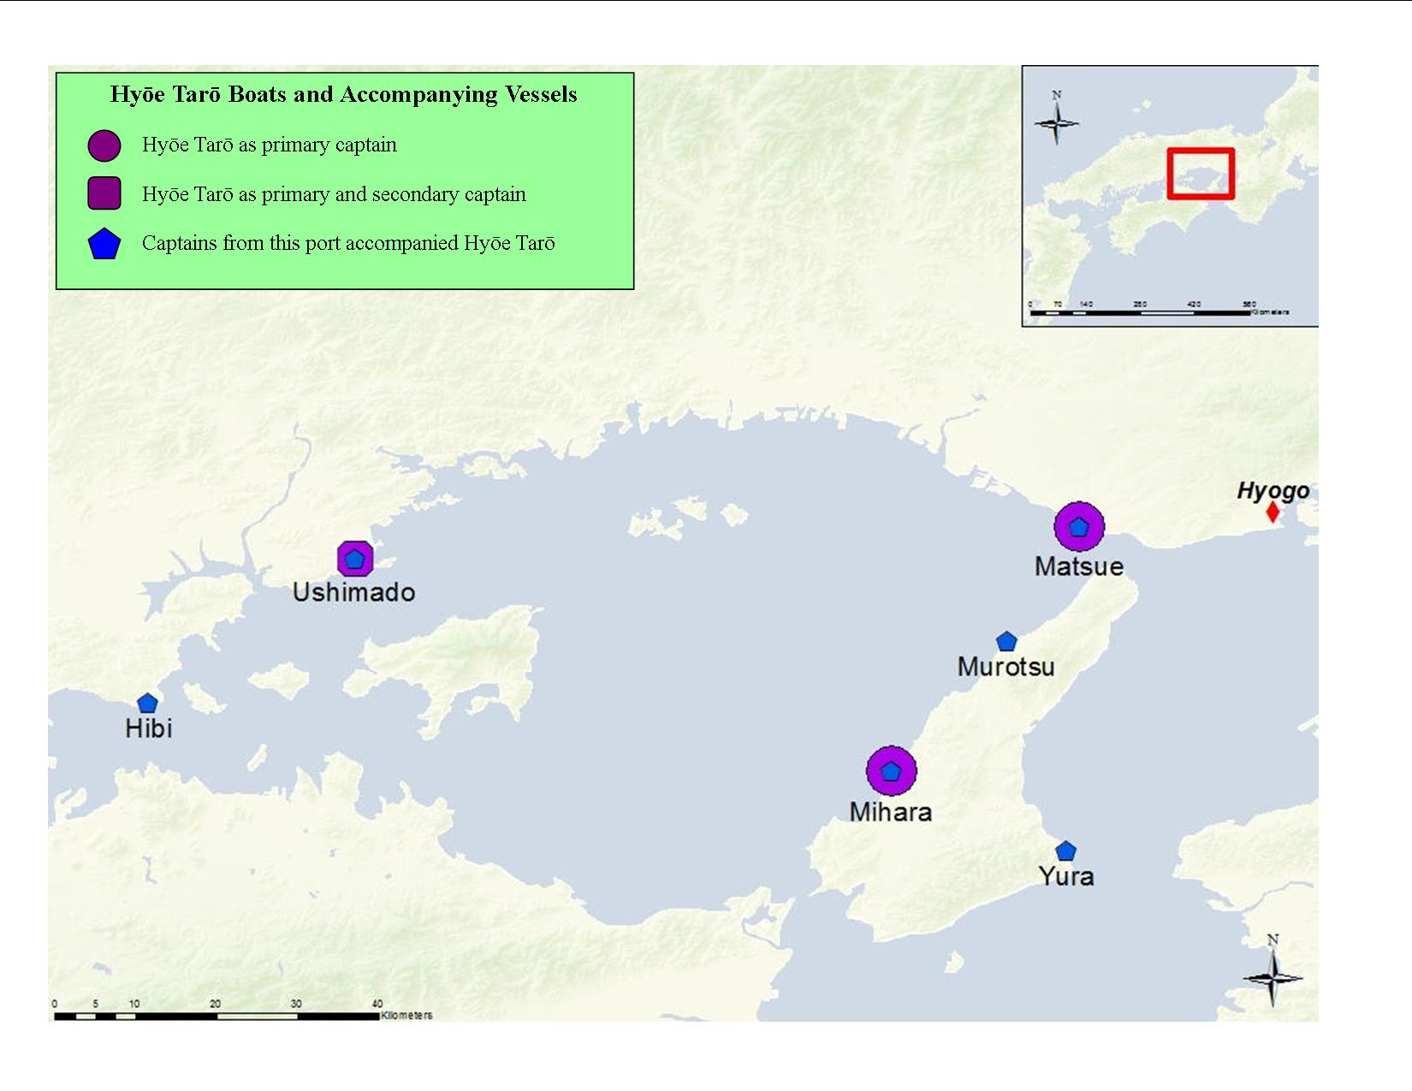
Collaborative Voyages
Archaeological Site

