Slide 1
DIGITAL PLATFORMS FOR ALL SCHOLARS
C. Erdmann
Harvard-Smithsonian Center for Astrophysics
@libcce | cerdmann@cfa.harvard.edu

Slide 2
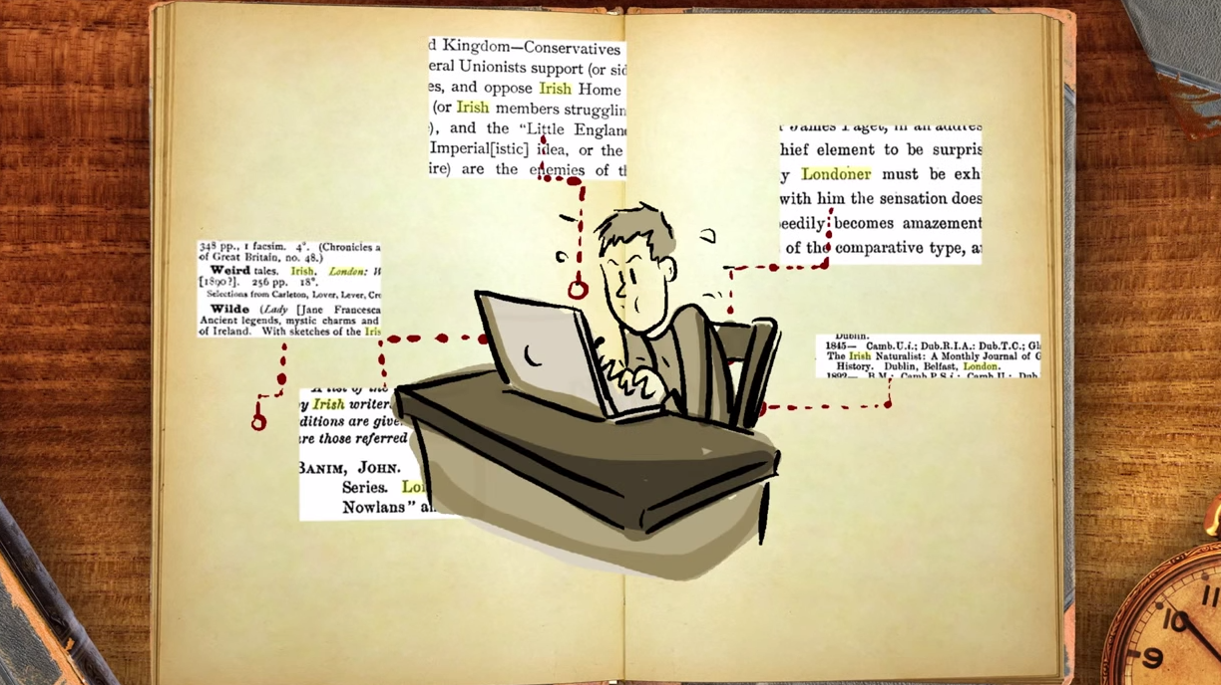
From the Programming Historian: Big Data + Old History
A. Crymble: https://www.youtube.com/watch?v=tp4y-_VoXdA

Slide 3
Training for Librarians → Training for Scholars
DST4L @ DTU http://podcast.llab.dtu.dk/feeds/dst4l-2015

Slide 4
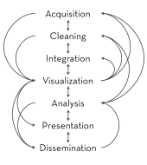
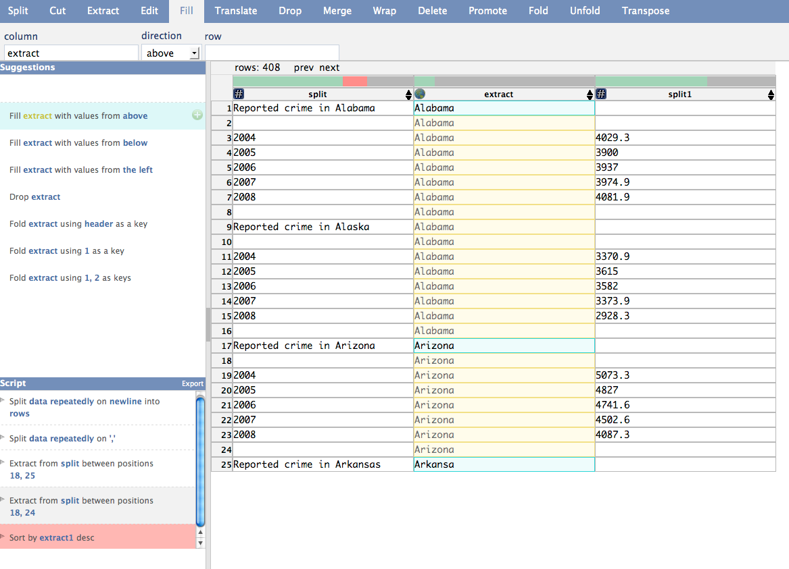
Experience the Research Data Lifecycle
Jeffrey Heer
Data Wrangler / Trifacta

Slide 5
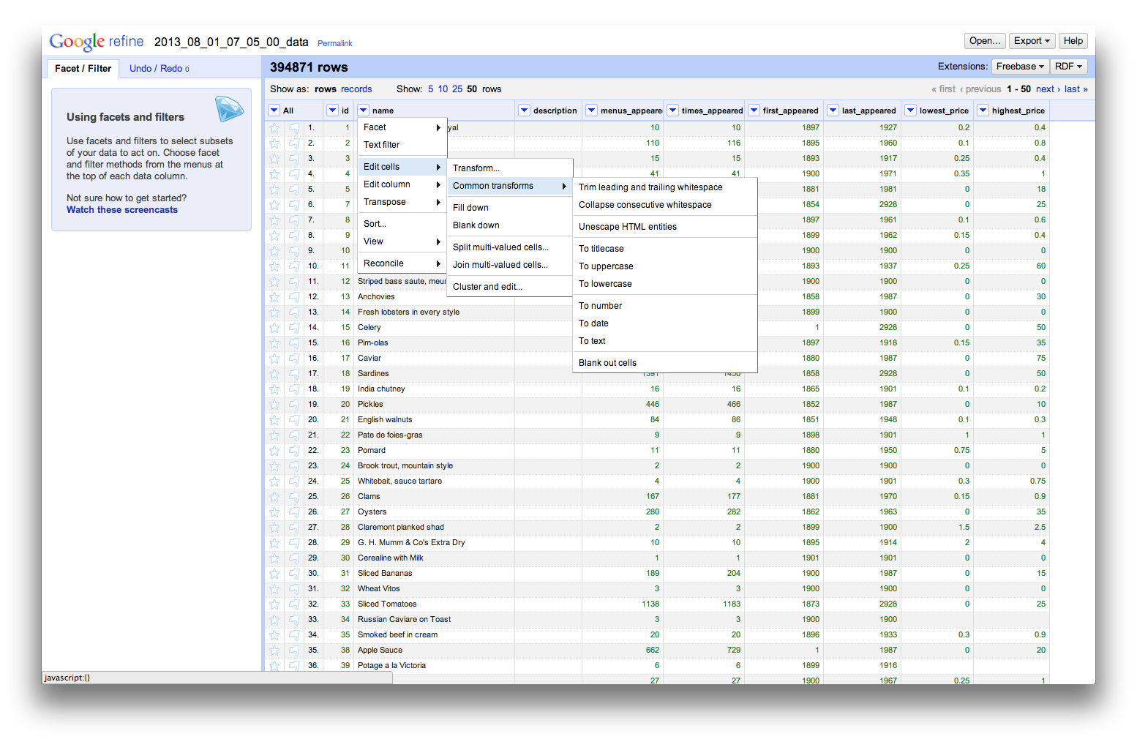
Data Wrangling w/ Open Refine

Slide 6
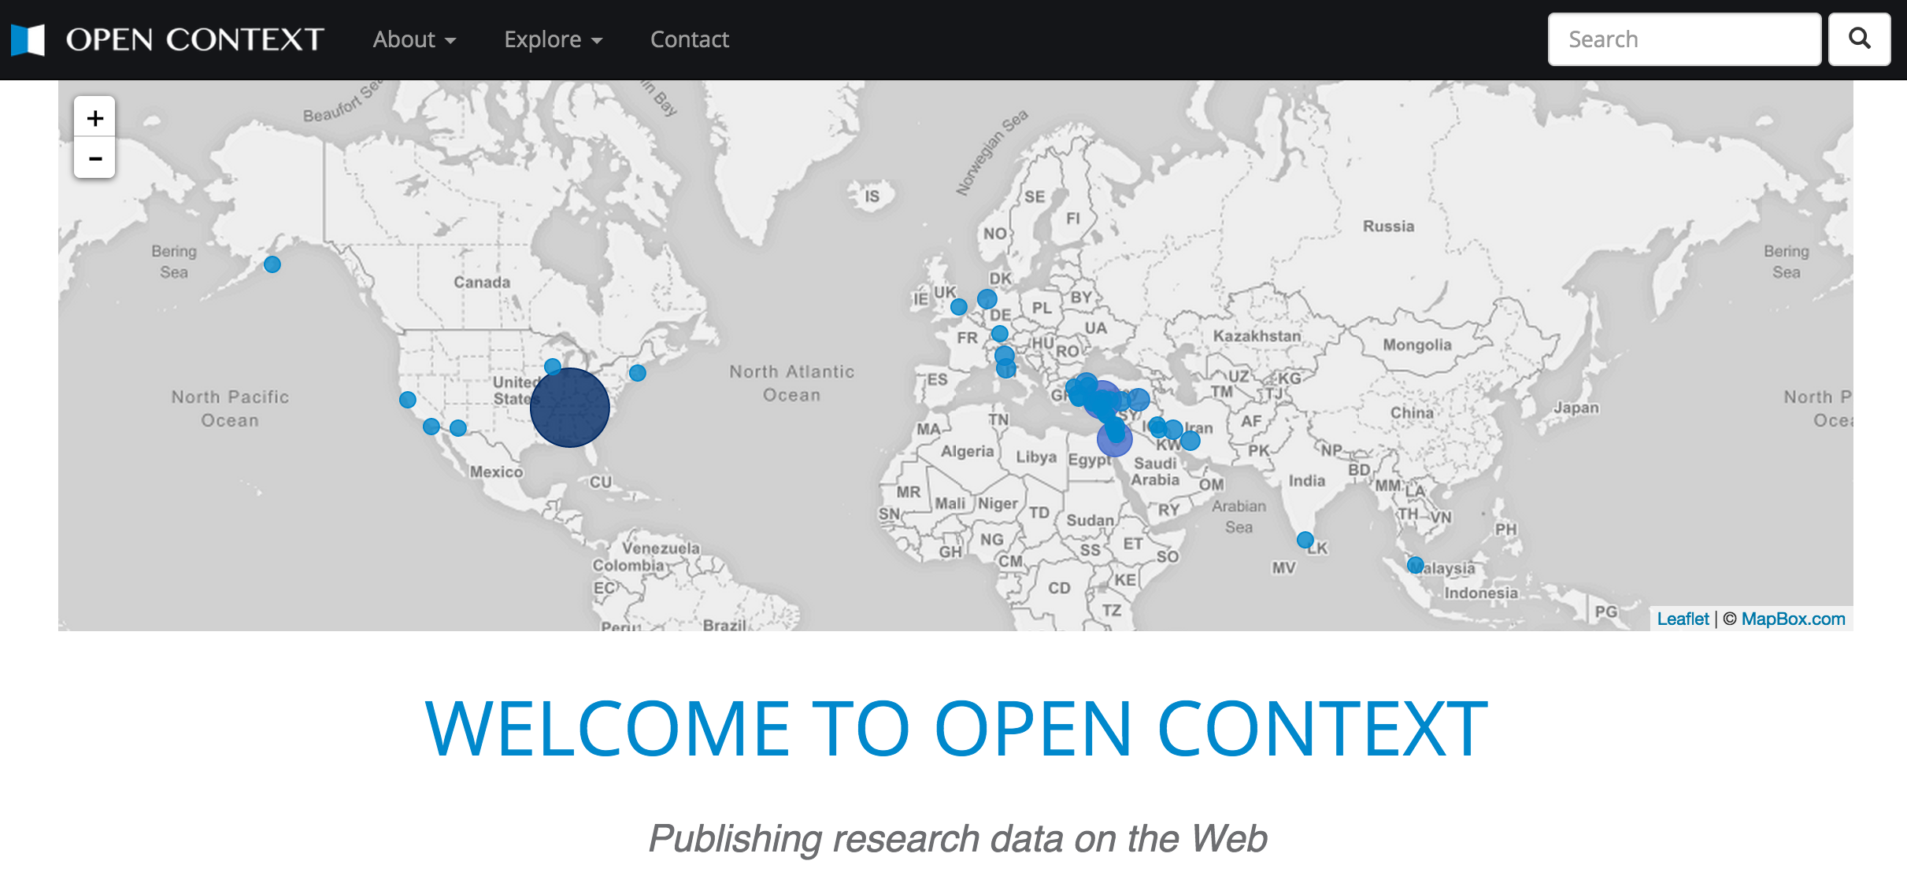
Data Cleaning Pipeline

Slide 7
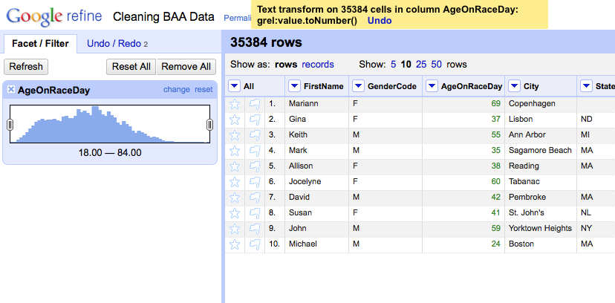
Facet/Filter

Slide 8
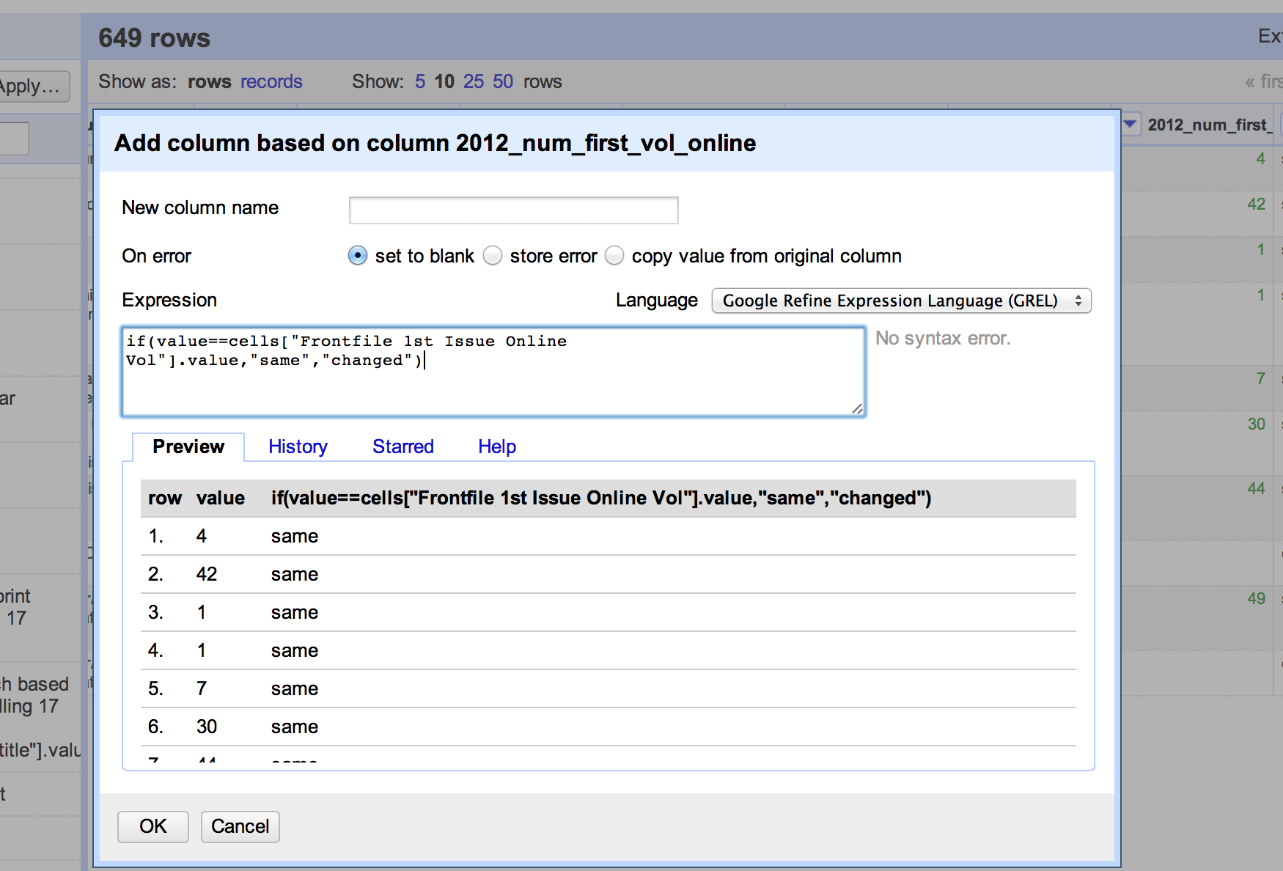
Advanced Cleaning w/ GREL

Slide 9
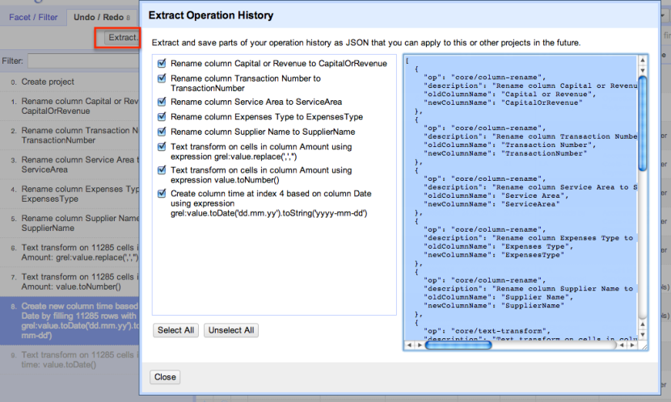
Extract & Share Operation History

Slide 10
Open Refine in the Cloud

Slide 11
Recipes & Training
Recipes:
https://github.com/OpenRefine/OpenRefine/wiki/Recipes
Big Data University, Introduction to Open Refine:
https://bigdatauniversity.com/courses/introduction-to-openrefine/

Slide 12
Software/Data Carpentry

Slide 13
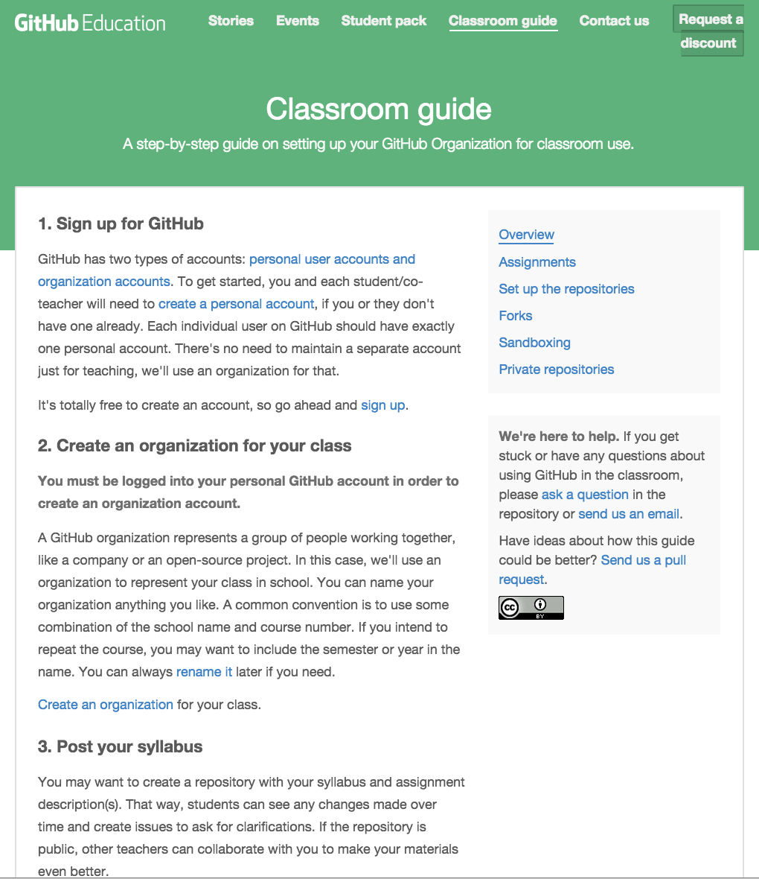
GitHub in the
Classroom

Slide 14
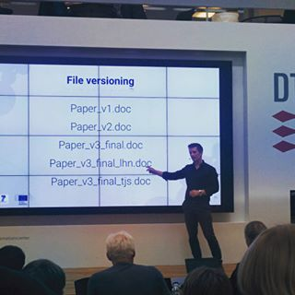
File Versioning

Slide 15
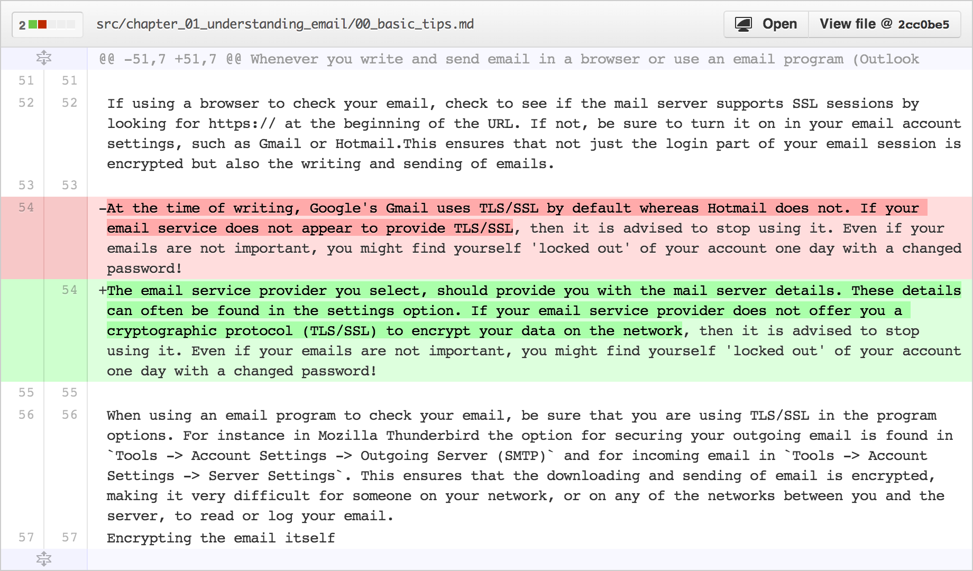
GitHub diffs

Slide 16
Using pull requests
Pull requests let you tell others about changes you've pushed to a repository on GitHub. Once a pull request is sent, interested parties can review the set of changes, discuss potential modifications, and even push follow-up commits if necessary.
https://help.github.com/articles/using-pull-requests/

Slide 17
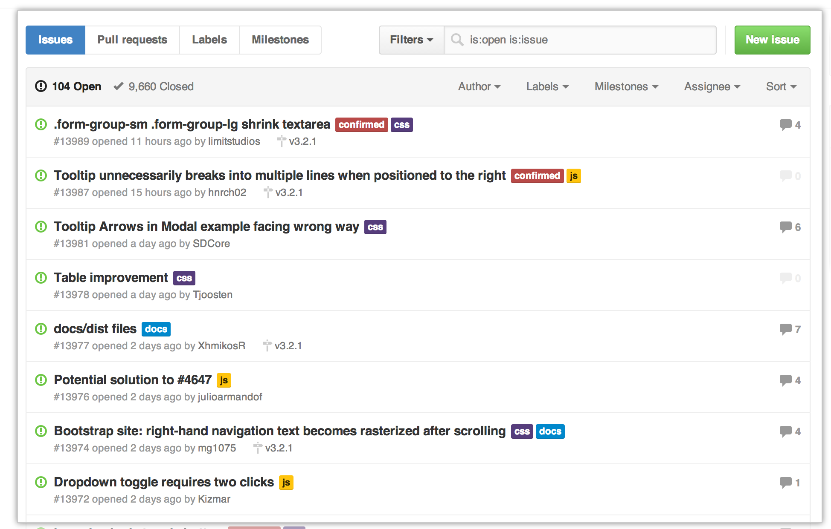
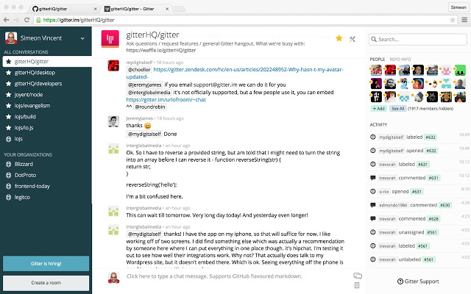
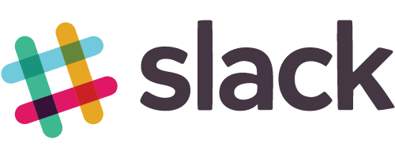
Issues
Gitter

Slide 18
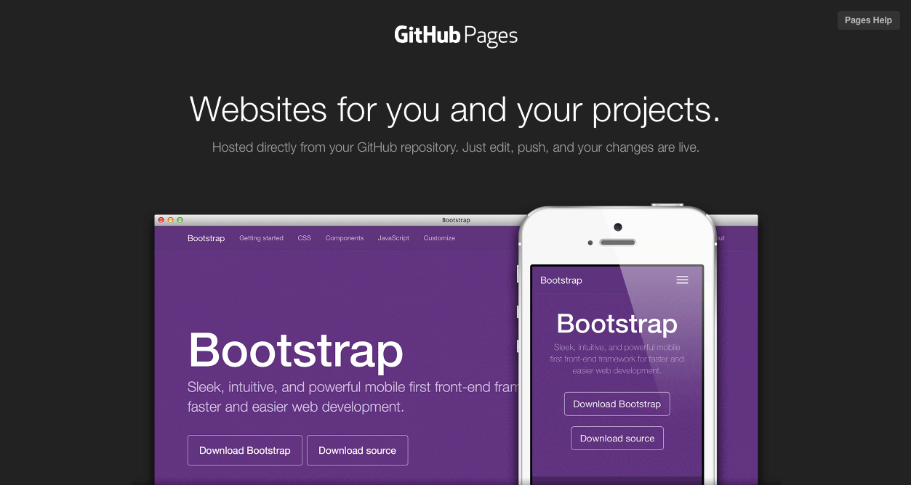
GitHub Pages

Slide 19
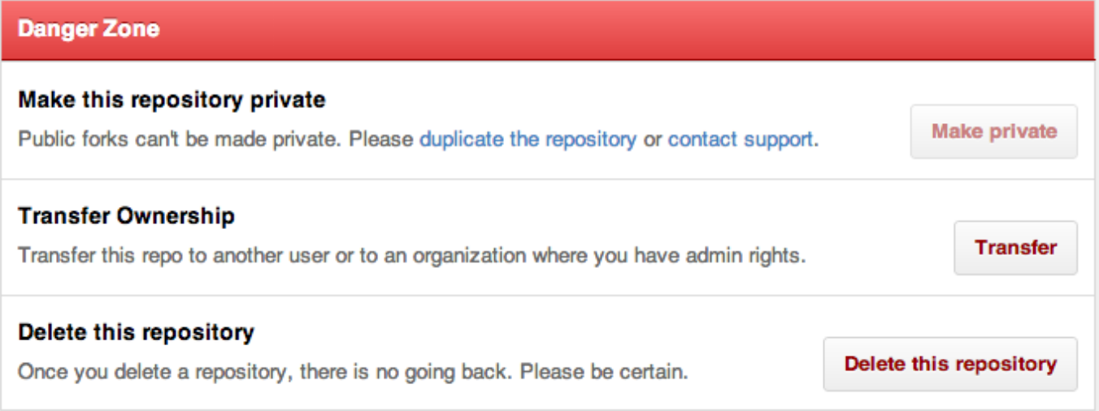
GitHub Danger Zone

Slide 20
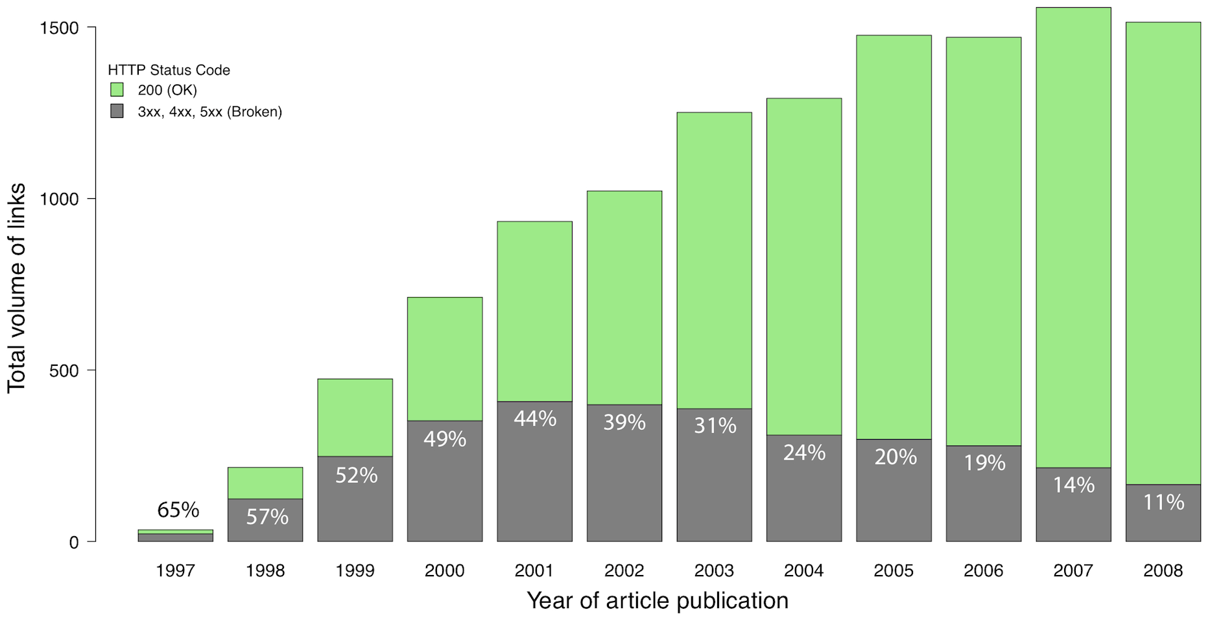

Slide 22
Preserve & Cite
Notes:
doi:10.1088/1475-7516/2014/12/028
arXiv:1401.0080 [hep-ph]

Slide 23
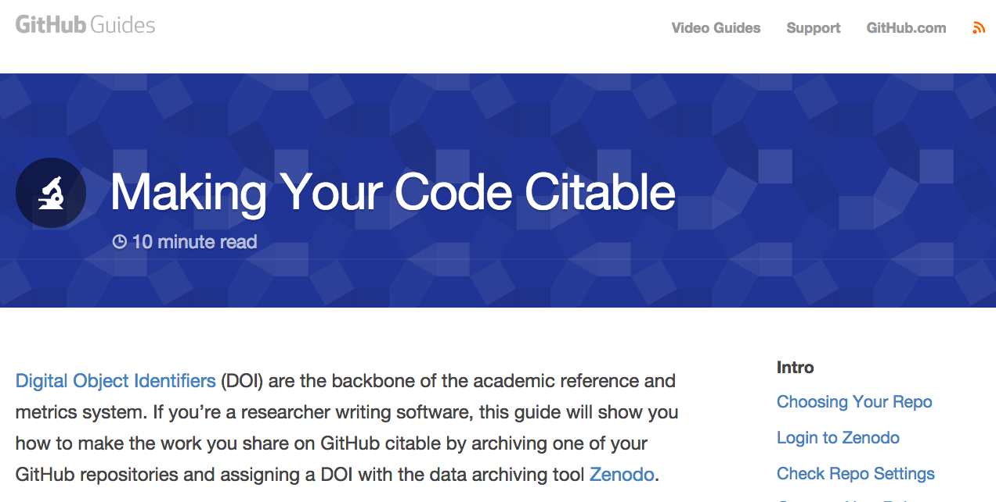

Slide 24
GitHub Training
GitHub Online Classes:
https://training.github.com/classes/
Software Carpentry, OReilly, Lynda, etc

Slide 26
How to negotiate with publishers: an example of immediate self-archiving despite publisher’s embargo policy
PANDELIS PERAKAKIS, PHD Academic Website
https://pandelisperakakis.wordpress.com/2015/09/09/how-to-negotiate-with-publishers-an-example-of-immediate-self-archiving-despite-publishers-embargo-policy/

Slide 27
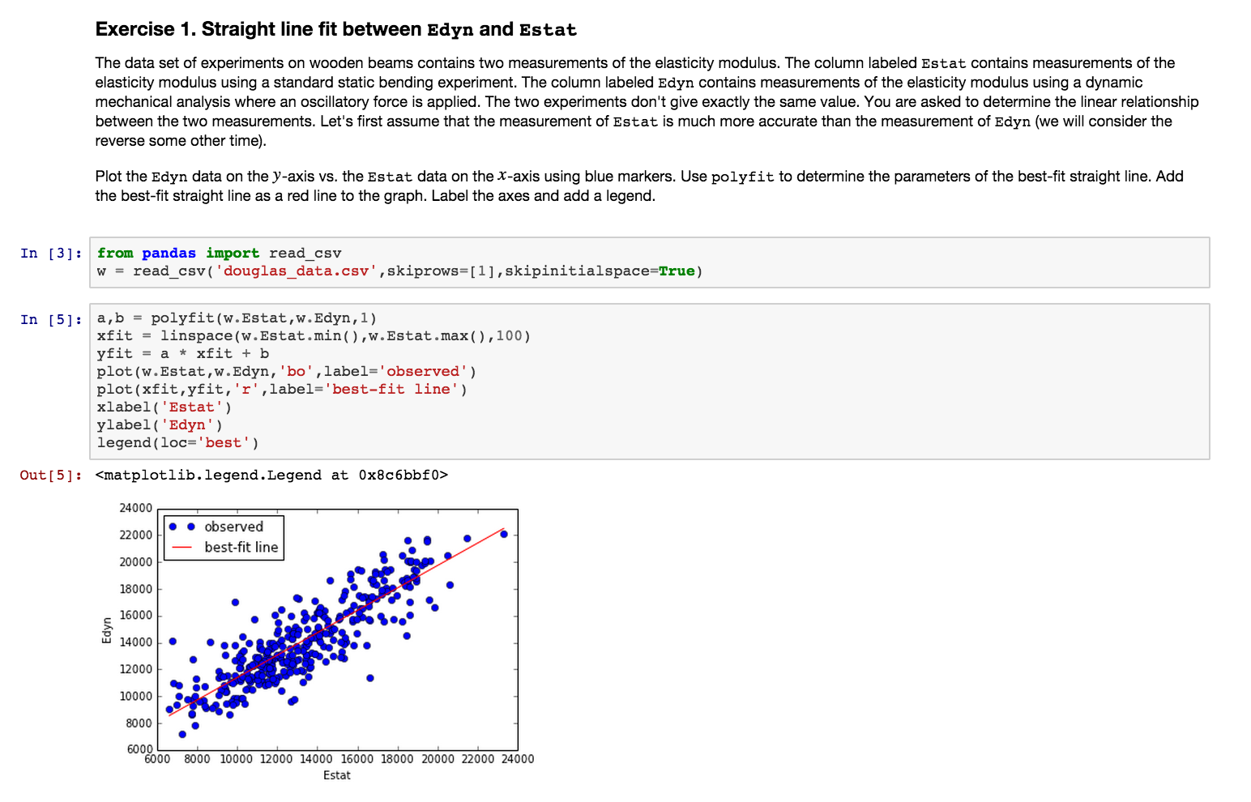
Jupyter (IPython) Notebooks

Slide 28
Interactive notebooks: Sharing the code
The free IPython notebook makes data analysis easier to record, understand and reproduce.
Helen Shen
05 November 2014
Nature
http://www.nature.com/news/interactive-notebooks-sharing-the-code-1.16261

Slide 29
Lorena A. Barba group
Introducing AeroPython!
I decided to develop a set of lessons using IPython Notebooks, to use as the scaffold for interactive class meetings. IPython Notebooks allow me to create media-rich content for the students, embedding executable Python code within it.
Google Hangout:
https://www.youtube.com/watch?v=HVfLnpoyqxE

Slide 30
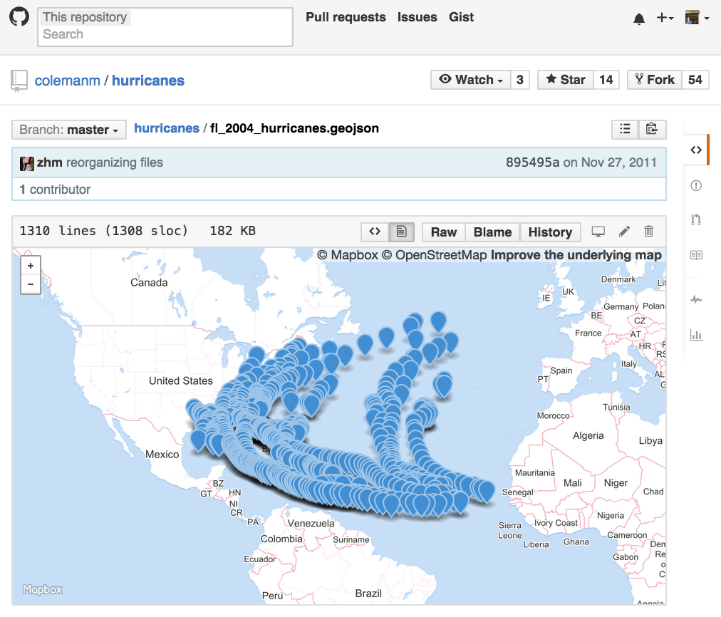
Render Jupyter & GeoJSON on GitHub

Slide 31
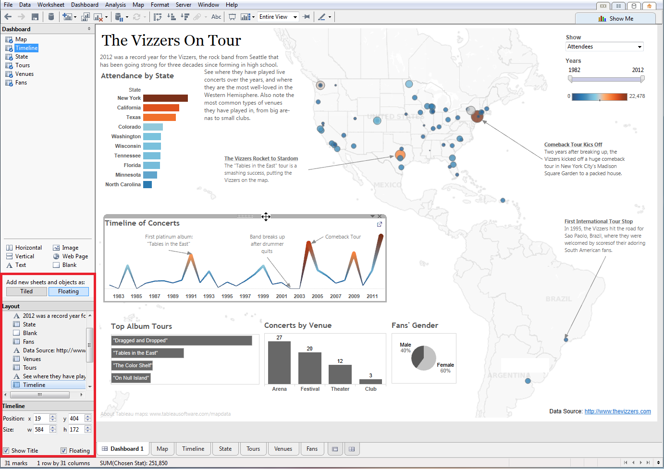
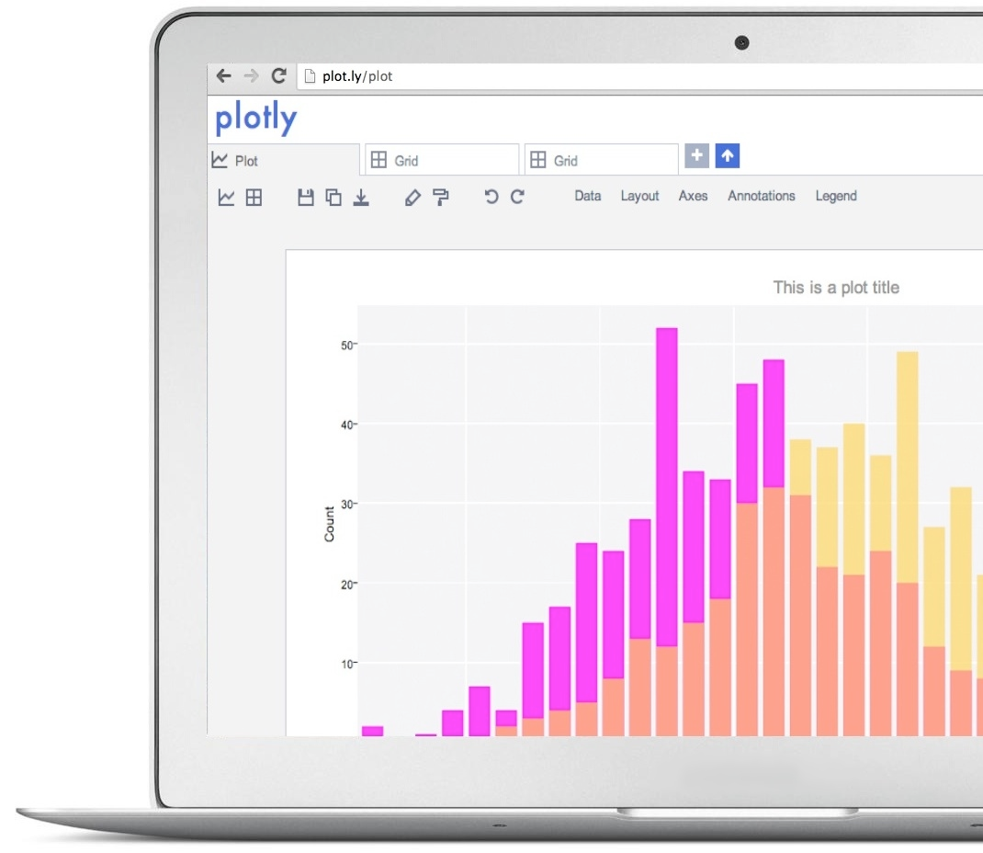
Tableau & Plotly

Slide 32
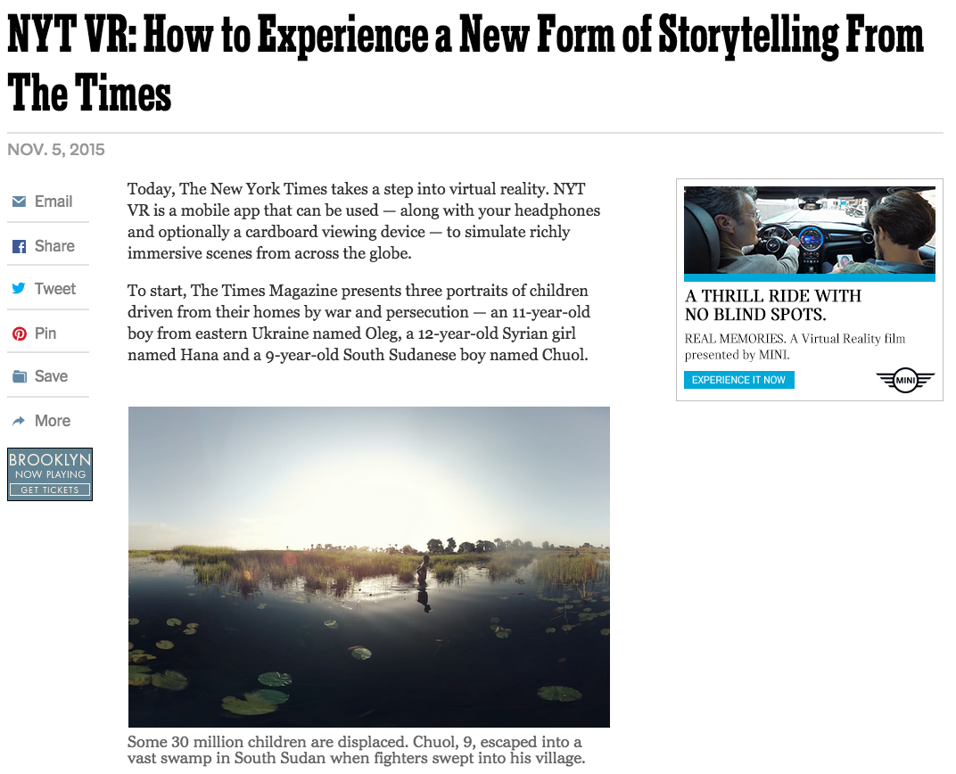
On the near
horizon

Slide 33
Thank you. Questions?

