Slide 1

Introducing Asia on the Museum of Underwater Archaeology
Michelle Damian
Advancing Digital Scholarship in Japanese Studies
November 7, 2015

Slide 2
The Museum of Underwater Archaeology
Our mission: to assist and promote the use of the Internet by ethical professional, student, and avocational underwater archaeologists.

Slide 3
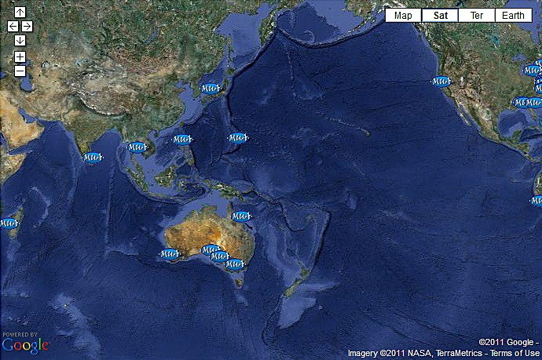
The MUA in Asia

Slide 4
Benefits to Online Publication
Wide audience
Means of gathering information
Increased name recognition

Slide 5
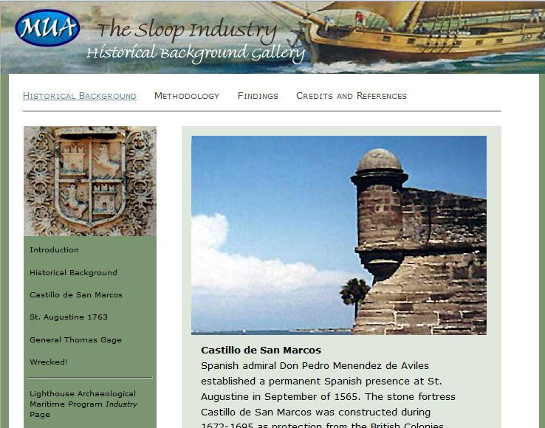
Types of MUA Presentations: Exhibits
Detailed investigation of a site or project

Slide 6
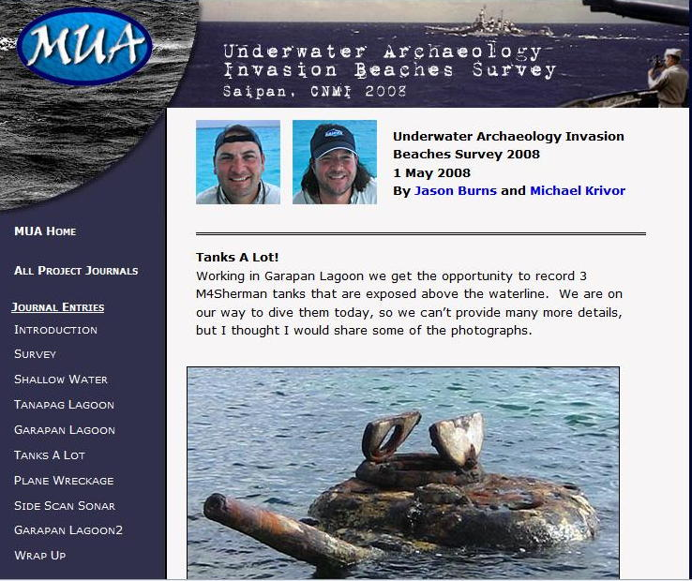
Types of MUA Presentations: Project Journals
Chronicling a project in real time

Slide 7
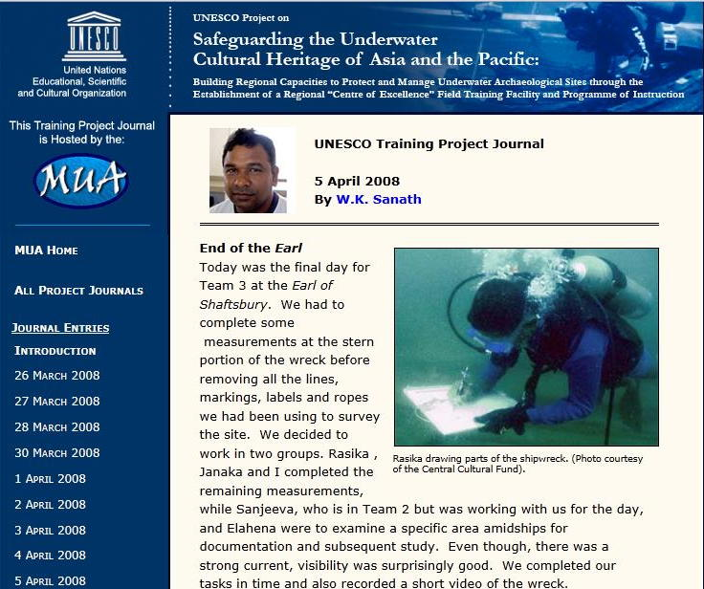
Types of MUA Presentations: Project Journals
Field Schools and Training Journals

Slide 8
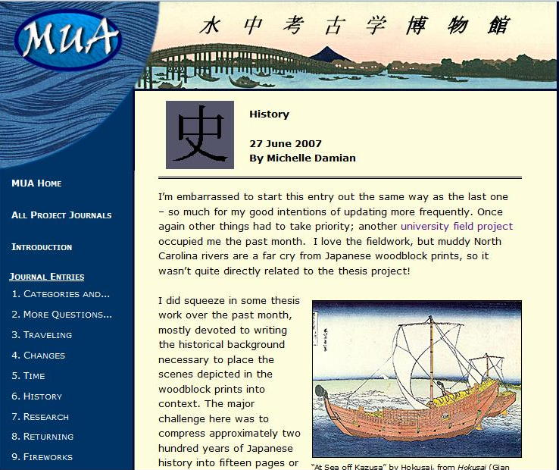
Types of MUA Presentations: Project Journals
Individual Research Projects

Slide 9
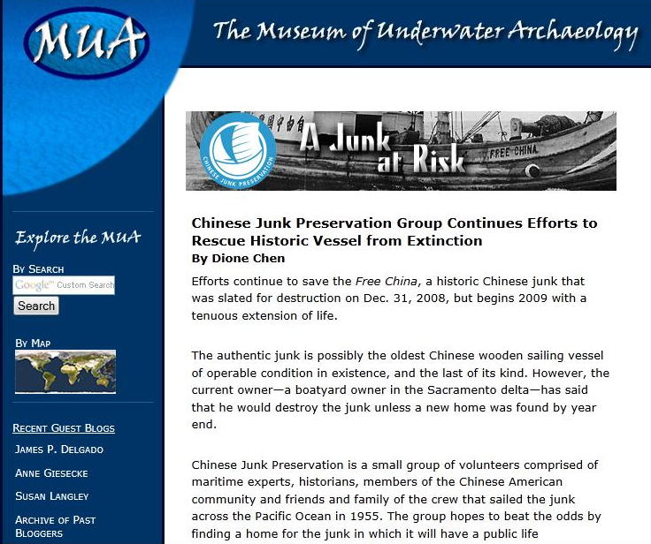
Types of MUA Presentations: “In the Field”
Short Project Introductions

Slide 10
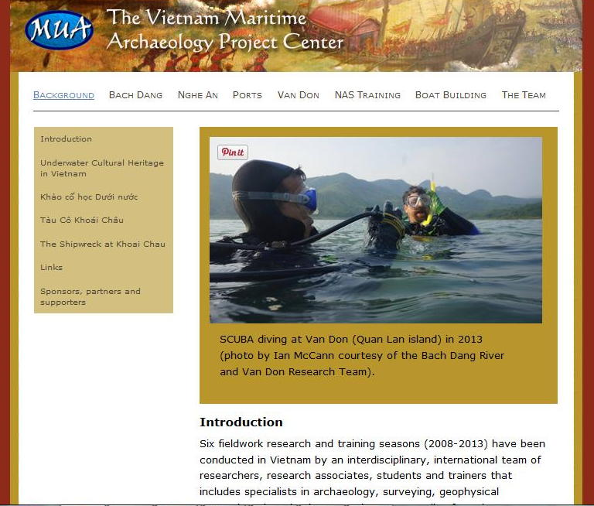
Types of MUA Presentations: Project Centers

Slide 11
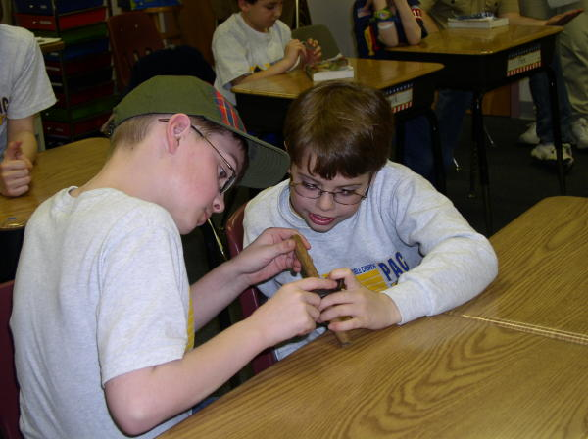
Additional Outreach: Classroom Kit

Slide 12
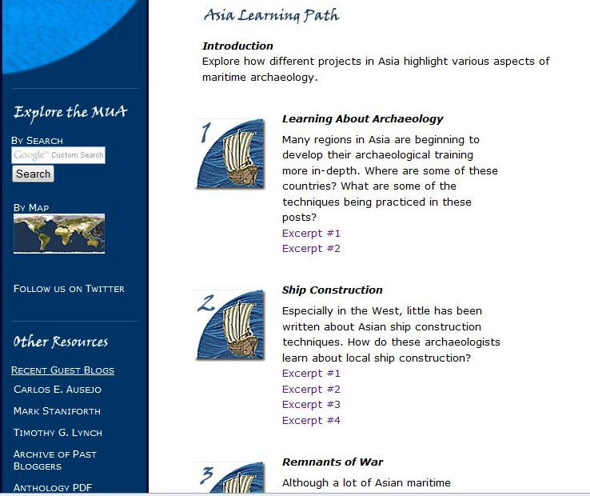
Additional Outreach: Learning Path

Slide 13
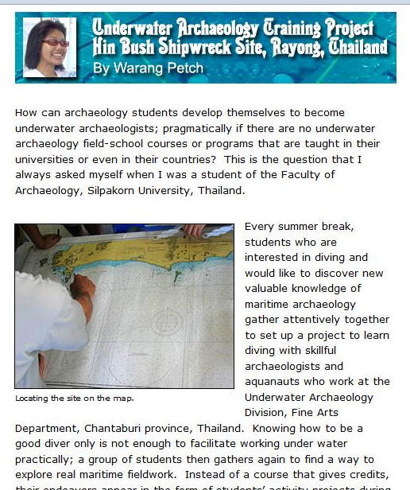
Additional Outreach: Learning Path

Slide 14
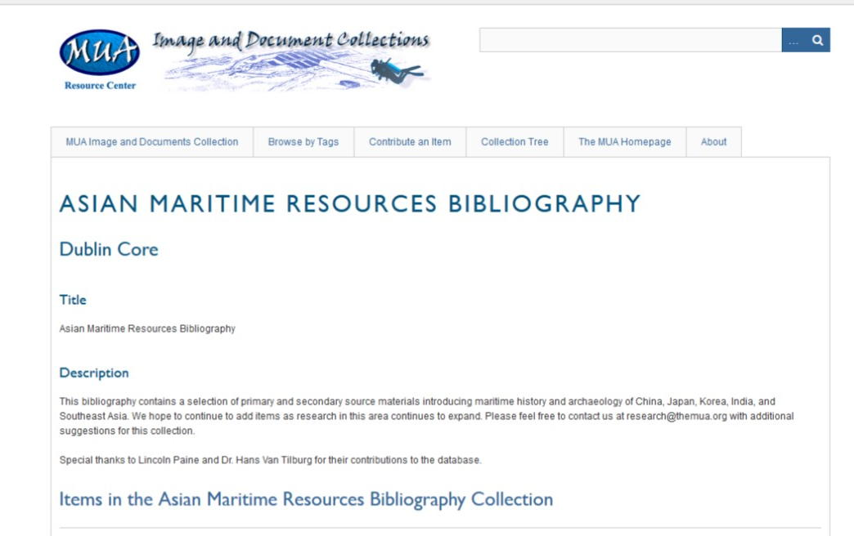
Other Resources: Bibliography

Slide 15
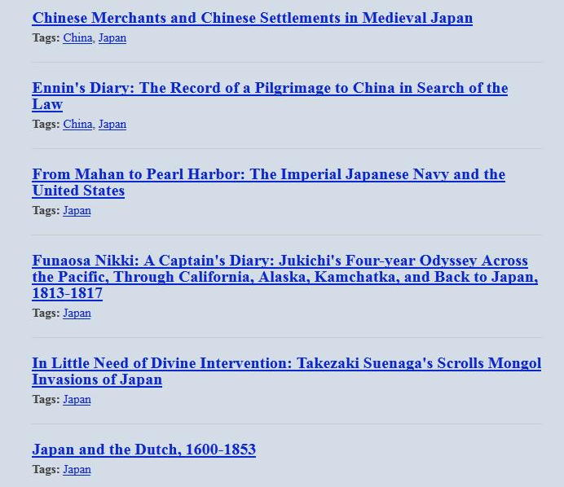
Other Resources: Bibliography

Slide 16
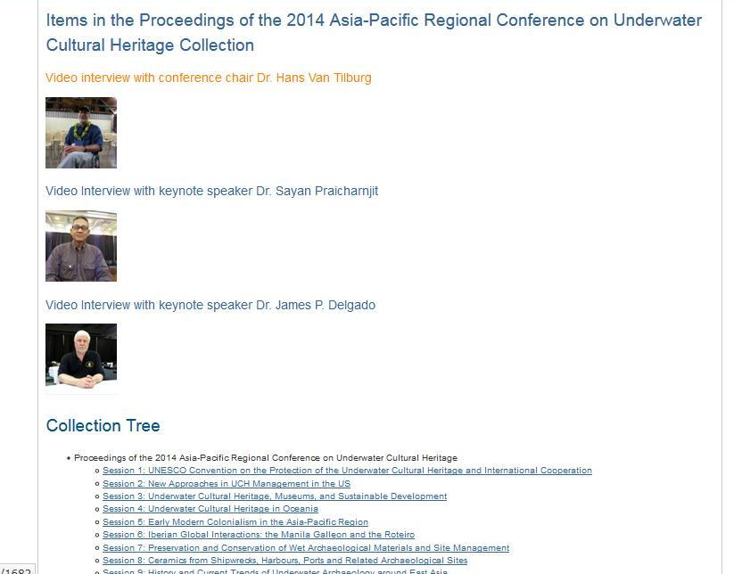
Other Resources: Conference Proceedings

Slide 17
For more information: research@themua.org http://www.themua.org
Thank you!

Slide 18
URLs for Part I:
The Museum of Underwater Archaeology:
http://www.themua.org
MUA Images and Documents Collection:
http://www.themua.org/collections/image-documents
Omeka:
http://www.omeka.org
Wordpress:
https://wordpress.com/
Zoomify:
http://www.zoomify.com/
Agisoft
http://www.agisoft.com/
The MUA on Facebook?
https://www.facebook.com/The-Museum-of-Underwater-Archaeology-MUA-179873378749116/?ref=br_tf

Slide 19
URLs for Part II:
Exhibits on the MUA: http://mua.apps.uri.edu/exhibits.html All Project Journals: http://mua.apps.uri.edu/pj.html Saipan project journal: http://mua.apps.uri.edu/project_journals/saipan/saipan_intro.shtml UNESCO Sri Lanka field school: http://mua.apps.uri.edu/project_journals/un/un_intro.shtml Japanese boats through woodblock prints: http://mua.apps.uri.edu/project_journals/aj/aj_intro.shtml All “In the Field” projects: http://mua.apps.uri.edu/inthefield.html Free China introduction: http://mua.apps.uri.edu/in_the_field/junk_update.shtml Thailand field school introduction: http://mua.apps.uri.edu/in_the_field/thai.html Vietnam Project Center: http://www.themua.org/vietnam/ Teaching kit: http://mua.apps.uri.edu/teaching.html Asia Learning Path: http://mua.apps.uri.edu/alpath.html Asia Maritime Bibliography: http://www.themua.org/collections/collections/show/11 2011 Asia-Pacific Regional Conference on Underwater Cultural Heritage Proceedings: http://www.themua.org/collections/collections/show/2 Proceedings of the 2014 Asia-Pacific Regional Conference on Underwater Cultural Heritage: http://www.themua.org/collections/collections/show/13

